Slide 1

SfC Updates for Somerset LEM
Holly Stockdale
(Locality Manager)

Slide 2
RMN 17.10.24
CQC: the first 6M of the SAF: learning and resources to support you
17/10/24, 10.30-3.30, Stoke St Gregory Village Hall
Free to attend, refreshments and lunch included
Presentations, case studies, group work and networking
Feedback from Dorset colleagues included: ‘a very informative session: made you think’
Book here: https://forms.office.com/e/nVzTTn36Ky

Slide 3
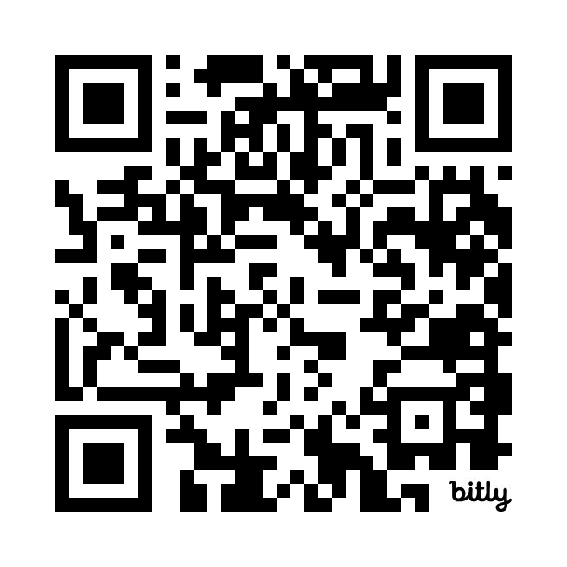
Workforce Strategy for Adult Social Care in England has now launched!
This is a huge turning point for social care as the sector launches a Workforce Strategy.
Skills for Care has been leading the development of this workforce strategy, working in collaboration with a wide range of organisations and people with a stake in the future of the adult social care sector.
The Strategy highlights the impact of social care on improving lives – as well as its role in supporting economic growth, with the sector currently contributing almost £60 billion a year to the economy.
Find out more about the strategy here
#
ASCWorkforceStrategy

Slide 4
Care Workforce Pathway
The care workforce pathway will set out clearly what a career in social care means and the level of knowledge, experience and skills required to deliver high-quality, personalised, care and support
We’ve been working in partnership with DHSC to develop the first part of the pathway focusing on staff working in direct care roles which outlines an initial four role categories.
Moving forward we will continue to work in partnership with DHSC on phase 2. This will include developing further role categories we will be engaging further with the sector for insight and feedback on what knowledge, skills and behaviours each of these require.
Find further information on the pathway and how it has been developed .
Notes:
we will be engaging further with the sector for insight and feedback on what knowledge, skills and behaviours each of these require.
We will also work with DHSC to scope further parts of the pathway, and plan for implementation and adoption.

Slide 5
Adult Social Care Learning and Development Support Scheme (LDSS)
The DHSC has launched the learning and development support programme for the financial year 2024 to 2025.
Information on the scheme which includes:
guidance on eligibility and the process which includes completing an expression of interest to gain access to the online claims service
FAQs
course list can be found on the DHSC web page

Slide 6
The Workforce Development Fund 2024-25
The Workforce Development Fund (WDF) is open to organisations that provide adult social care services and directly employ care staff within England.
The fund is being scaled down in 2024-25 and it will only be possible to claim WDF for qualifications and apprenticeships which started on or before 31 March 2024 and which will complete by 31 March 2025.
This year, WDF will be distributed exclusively by Skills for Care.
Find out more

Slide 7
New Level 2 Care Certificate qualification
The Level 2 Adult Social Care qualification is an accredited qualification designed to provide a baseline standard to care, reduce the need for repeat training and give recognition to our care workforce.
It’s expected to take a new learner around 6-8 months to complete. An experienced care worker may complete this in a shorter period of time.
Eligible employers can claim funding for the Level 2 Adult Social Care Certificate on behalf of eligible care staff for up to £1500 per qualification through the Learning and Development Support Scheme (LDSS)
www.skillsforcare.org.uk/CareCertificateQual

Slide 8
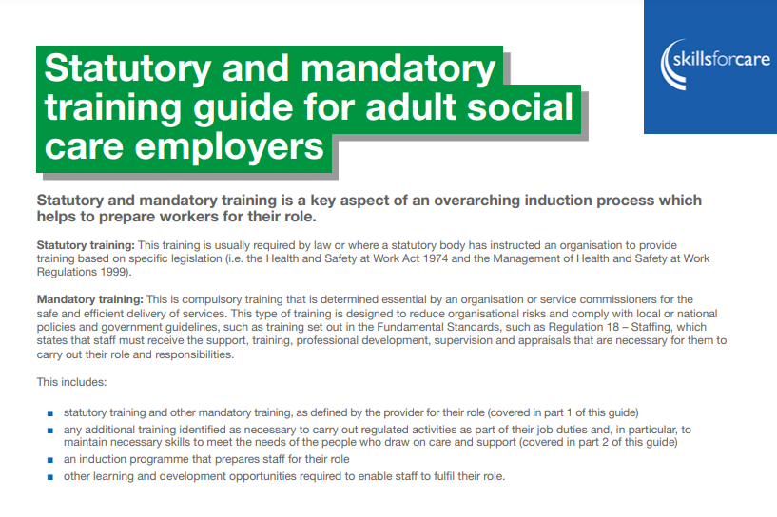
Statutory and mandatory training guide for adult social care employers
Produced in partnership with a panel of social care employers, learning providers and representative organisations and updated in-line with CQC’s revised inspection framework and the Workforce Strategy for adult social care in England.
The guide covers statutory and mandatory knowledge and skills in a variety of topic areas based on a review of legislation, guidelines, statutory guidance, standards and recommendations
Find out more

Slide 9

Digital Update
FREE digital skills e-learning modules
Digital leadership programme
Digital skills framework self-assessment user group
What good looks like self-assessment user group

Slide 10

Latest Podcast
Series 5 | Ep 1
Live in conversation with James Bullion (CQC)
Listen to James talking about his role as chief inspector of Adult Social Care and integrated care as well as the changes that the CQC are implementing

Slide 11
Registered manager membership
Skills for Care is the membership organisation for registered managers.
Through membership, we support managers to develop best practice and knowledge, keep up-to-date with sector developments and share ideas with like-minded peers.
Membership benefits include:
printed copy of our ‘Social care manager’s handbook’
monthly newsletter including practical information and guidance
access to Good and Outstanding care guide: Single Assessment Framework version and 34 Quality Statement Recommendation checklists
an exclusive annual resource when you renew your membership
the chance to train to become a mentor or receive mentoring.
Become a member for £35 a year

Slide 12

Advice line for managers
If you are a social care manager, we can help you to recruit and retain staff, develop your team, strengthen leadership, and meet CQC expectations around quality of care.
Our team can help you with:
resources
wellbeing
online learning
funding
latest guidance and advice
Call
0113 241 1260
Email
RMAdvice@skillsforcare.org.uk

Slide 13

Size and structure of the adult social care sector
Explore our annual ‘Size and structure of the adult social care sector and workforce in England’ report.
Key findings:
Total filled posts the highest number on record to 1.705m in 2023/24
The total number of vacant posts has decreased to 131,000
It’s estimated there are 1.59m people working in adult social care
Join us for the launch of our annual ‘State of ASC’ report free online event on 10th October. Register here

Slide 14

Keep up to date….
Sign up to our newsletter
https://id.skillsforcare.org.uk/Account/RegisterCreate

