Slide 1
The IMCA role in Serious Medical Treatment Decisions

Slide 2
The Independent Mental Capacity Act Advocate
IMCA
Professionally independent from all other services, authority bodies and organisations.
Statutory role within the Mental Capacity Act 2005.
Role & responsibilities are set out by Mental Capacity Act 2005 / DoLS 2009, the Advocacy Charter and the Advocacy Code of Practice.
National Independent Advocacy Qualification required for practice.

Slide 3
Long term move decision to hospital, care, or nursing home for over 28 days.
Care and accommodation review
Safeguarding adults process
Serious medical treatment decision
Deprivation of Liberty Safeguards process
The MCA Instructions for IMCA

Slide 4
“Serious medical treatment means treatment which involves providing, withdrawing or withholding treatment in circumstances where: (a) in a case where a single treatment is being proposed, there is a fine balance between its benefits to P and the burdens and risks it is likely to entail for him; (b) in a case where there is a choice of treatments, a decision as to which one to use is finely balanced; or (c) the treatment, procedure or investigation proposed would be likely to involve serious consequences for P.”
Serious Medical Treatment
A definition
“Serious consequences” are those which could have a serious impact on P, either from the effects of the treatment, procedure or investigation itself or its wider implications. This may include treatments, procedures or investigations which: (a) cause, or may cause, serious and prolonged pain, distress or side effects; (b) have potentially major consequences for P; or (c) have a serious impact on P’s future life choices.”
Courts and Tribunals Judiciary
www.judiciary.uk/wp-content/uploads/2015/06/copd-pd-9e-serious-medical-treatment.pdf

Slide 5
“The Mental Capacity Act provides an extra safeguard for people who lack capacity to make serious medical treatment decisions and who don’t have family or friends who can represent them. In such cases, an IMCA must be instructed to support the person.
(SCIE. www.scie.org.uk/mca/imca/do/role)
Medical professionals' statutory obligations:
To make sure an IMCA has been instructed
To provide access to relevant health records
To have regard to any issues and concerns raised by the IMCA, including those included in the IMCA’s report.
(www.scie.org.uk/mca/imca/info-for/doctors/)

Slide 6
Common serious medical treatment in IMCA referrals.
DNACPR / DNAR forms and processes
Treatment Escalation Plans (TEPS)
Treatment or investigations that require significant sedation or general anaesthetic
Surgery, investigations or procedures
Notes:
Withholding or giving of nutrition, medication, fluids or attempts to resuscitate.
Treatments that carry risk of injury of death (Anaesthetic)
Treatments that present protracted recovery, poor or limited outcome, is intrusive or long-lasting impairment.
MCA says:
chemotherapy
electro-convulsive therapy
therapeutic sterilisation
major surgery (such as open-heart surgery or brain/neurosurgery)
major amputations (for example, loss of an arm or leg)
treatments that will result in permanent loss of hearing or sight
withholding or stopping artificial nutrition and hydration
termination of pregnancy.

Slide 7
Somerset Referrals for IMCA (SMT)
All IMCA referrals must be from the decision maker or a Social Worker who has indicated the named decision maker on the referral form.
This excludes TEPs.
Referrals for IMCA SMT (Serious Medical Treatment) Treatment Escalation Plans (TEPs) can be accepted from care providers.
The TEP decision maker must be recorded on the referral form. For example, in nursing homes this will typically be a Lead Nurse and in residential homes this will always be the GP.

Slide 8
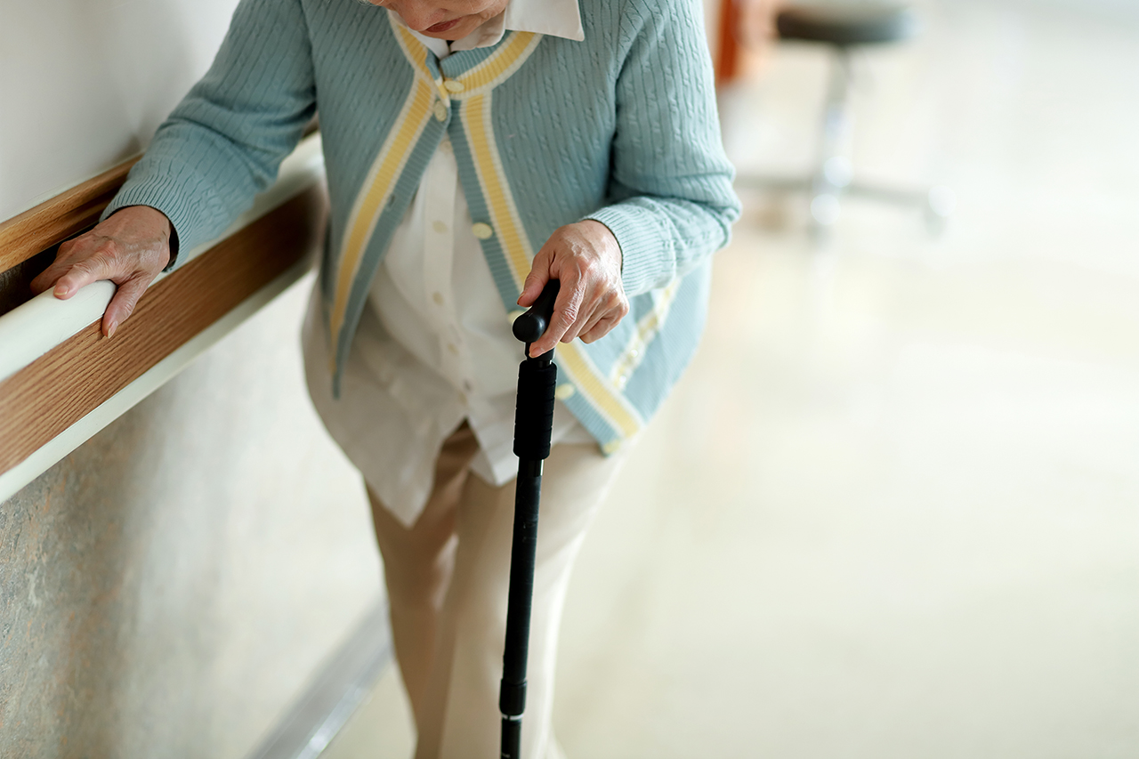
Joan is an older lady who has COPD. She has recently been returned from a stay in hospital to her care home residence following an admission for pneumonia.
Joan lives at the care home, but is unable to make accommodation decisions, she is currently under a DOLS authorisation to remain there.
She is still unwell and weakened, she now requires an enhanced care plan in the home. Her doctor does not expect Joan to recover fully, primarily due to her age and ongoing lung problems which have been further impacted by the pneumonia.
This has left Joan at high risk of further lung infections. The doctor feels this event would be very hard to treat, and treatment would likely have a poor outcome.
In addition to her accommodation decisions, Joan has been assessed as lacking the capacity to make decisions about her care and treatment options, she has no family or friends, that anyone knows of, that can support her in decision making for either choice.
The health and care teams feel that Joan should have a treatment escalation plan in place for the possibility of her needs escalating and in the event of a further infection occurring.
A fictional IMCA case example
(based on practice)
Notes:
TEPS is a serious medical treatment decision as it will likely involve DNACPR - withdrawing or withholding treatment but also any considerations about whether Joan would or would not be re-admitted in the event of further infection / receive any treatment for the infection knowing that the treatment would likely be unsuccessful. The potential outcome of withholding treatment would likely be Joan’s death.
Jaon has no representatives to speak for her and she lacks capacity to make the decision herself. Therefore an IMCA must be instructed.

Slide 9
The IMCA supports and represents Joan in the decision-making process. This will involve:
Speaking to the Joan themselves where possible.
Speaking to the doctor and other medical staff about the proposed treatments or interventions.
Looking at Joan’s relevant health records (IMCAs have a statutory right to access and take copies of these).
The IMCA has a statutory right to ask for a second medical opinion.
The IMCA has a statutory right to raise concerns or initiate formal challenges where needed.
The IMCA can attend Best Interest Meetings to represent for Joan as part of the multi-disciplinary, decision-making approach.
IMCA rights and powers within serious medical treatment decisions.

Slide 10
The IMCA is required to write a report about Joan which should be considered by the doctor before making their decision.
The IMCA must ensure that Joan’s wishes and feelings have been considered and that the MCA is being followed. It’s important for the IMCA to ‘tell the person’s story” to ensure that person centred approaches are followed.
The IMCA must take the Joan’s circumstances into consideration by balancing her rights under the MCA and other relevant legislation; for example, reflecting on the less restrictive option, the proportionality of the proposal, and taking in account what might be in Joan’s best interests overall.
These considerations are then given to the decision maker to inform the best interests decision being made.
IMCA responsibilities

Slide 11
Deprivation of Liberty Safeguards
and IMCA

Slide 12
“There are a number of different IMCA roles involved in supporting and representing people who may be subject to the Deprivation of Liberty Safeguards.
These are set out in Section 39 of the amended Mental Capacity Act 2005 (MCA). It is important to be clear which role an IMCA is taking, as they are instructed for different reasons and have different rights and responsibilities.
Briefly the roles are:
Section 39A IMCAs are instructed when there is an assessment in response to a request for a standard authorisation, or a concern about a potentially unauthorised deprivation of liberty.
Section 39C IMCAs cover the role of the relevant person’s representative when there is a gap between appointments.
Section 39D IMCAs support the person, or their relevant person’s representative [RPR], when a standard authorisation is in place.”
(SCIE: www.scie.org.uk/mca/imca/roles/dols/)
Deprivation of Liberty Safeguards
IMCA ROLES
Notes:
Also, Paid Representative outside of the IMCA role.

Slide 13
Key Functions of the IMCA
“A key function of a 39d IMCA is to support the person being deprived of their liberty and the RPR to understand their RPR role and the person’s rights. The RPR must be confident in exercising their rights.
A 39d IMCA is expected to take reasonable steps to help the relevant person and the relevant person’s representative. This can include helping them to: understand the legal terms of the deprivation of liberty, the assessments which are required, and how to exercise the person’s rights if they object to the deprivation of liberty, or elements of it (these are referred to as restrictions). ”
(Leanne Barber, Advocacy Focus https://advocacyfocus.org.uk/news/demystifying-the-39d-imca-by-leanne-barber/ )
Notes:
39A – support at urgent assessments
39C – Bridging the gap until the RPR can arrive
All similar roles in raising the client's views and wishes / making challenges / explaining rights etc.

Slide 14
The IMCA is required to keep the Supervisory Body informed about their visits to Joan and any proposed actions they make take.
The IMCA must ensure that Joan’s wishes and feelings about her accommodation have been considered and that the MCA/DoLS principles are being followed. The IMCA will be sure to check if Joan objecting to the authorisation.
The IMCA must consider Joan’s Article 5 (and others) rights with consideration to her deprivation and any restrictions that are applied in her current circumstance.
The IMCA must try to explain to Joan her rights under DoLS in respect of challenging the authorisation or restrictions.
The IMCA can arrange for legal representation and an application to the Court of Protection in the event of objection.
The IMCA must visit Joan regularly.
IMCA responsibilities
‘JOAN’
Notes:
The SMT IMCA and the DoLS IMCA can be the same person for continuity.

Slide 15
Thank you.
Any questions?

