Slide 1
Workstream Update Somerset LEM 02.04.2024 Holly Stockdale – Locality Manager

Slide 2
Dates for the Diary
16.05.24: ‘workforce wellbeing – practical and cost effective ways to support your team’ RM webinar
09.05.24: ‘being prepared for CQC inspection’ seminar (linked to the inspection toolkit)

Slide 3
Wednesday 17 April, 10:00-15:00, Albemarle Centre, Taunton
Your future and mine: Managing a service, leading a workforce
This event is for all adult social care employers across the South West and anyone with a passion or remit for workforce development.
We’ll be focusing on how to manage a service and lead a workforce when political, economic, social, technological, legal and environmental issues bring many challenges but may also present opportunities.
Book by visiting www.skillsforcare.org.uk/events and searching for the event on 17 April. Book by 4 April.
Notes:
The link to the event is https://bit.ly/3TFKL1n

Slide 4
New resource
International recruitment toolkit for ASC providers

Slide 5
Latest podcast - Series 4 | Episode 6
Recognise it, record it, evidence it
In our new podcast we chat to Maddie Watts, the owner and registered manager of the Outstanding rated Inchwater Home Care.
Maddie chats to us about the preparation she is doing for CQC assessment under the new single assessment framework and how they evidence good practice. She also talks about evidencing feedback of partnership working with other professionals and the benefits of reflective conversations with staff to support the journey of continuous improvement.
‘It is the little things that sometimes make the biggest difference.’
Listen now
Notes:
https://www.skillsforcare.org.uk/Support-for-leaders-and-managers/Support-for-registered-managers/The-care-exchange/The-care-exchange-Series-4.aspx

Slide 6
Digital Update
DSF e-learning modules due in April
L5 Digital leadership award due Spring 24
Analogue to digital landline calls will use broadband. Affects landlines needed for phone calls, telecare, fire alarms and burglar alarms in the event of a powercut. Battery back up / mobile phone may be needed. Check plans and dates with providers and see Ofcom​ / Digital switchover hub | Local Government Association

Slide 7
ASC WDS Update
To be updated to include digital roles and training
User research enables us to make improvements and share data with LAs and CQC. Sign up for a one hour session to find out more.
Can be used to evidence well led, safe, responsive and effective for CQC.

Slide 8
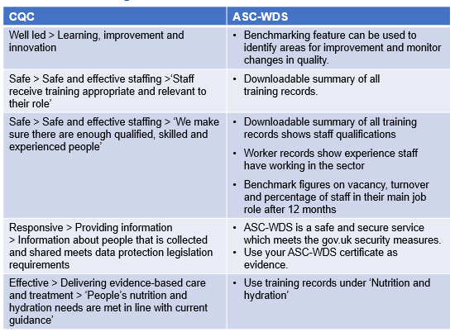
Using ASC WDS to help with CQC inspections

Slide 9
Thank You Holly.Stockdale@skillsforcare.org.uk

