Slide 1
Technology Enabled Care

Slide 2
Technology can optimise an individual’s independence and help them to remain in their own homes and communities for as long as they would like to
Increases independence, choice, control and flexibility
Improves the safety and quality of life in the home or the community
Less demands on family and carers
Better information and support for people with long term health conditions
Improved safety, security and peace of mind at home
Reduces hospital admissions and enables people to return home from hospital sooner

Slide 3
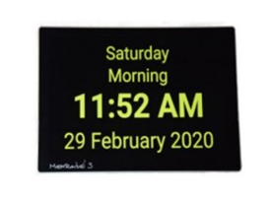
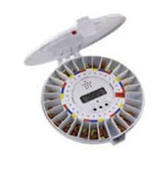
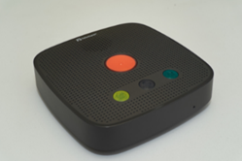
We have commissioned two TEC providers to deliver and install these devices in the homes of the people we support following the identification of an assessed ‘Care Act’ need: ​
1. Somerset Lifeline – provider for monitored / linked devices. ​
2. Medequip – provider for standalone devices which are NOT linked to a monitoring centre​.

Slide 4
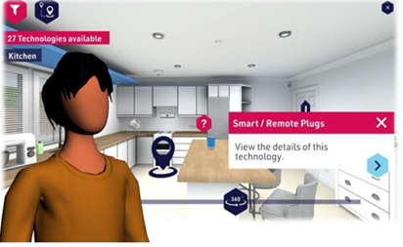
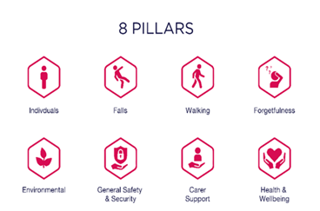
All ASC staff will soon be undertaking training on TEC
An immersive learning experience – user friendly
2 levels of training (online) Explorer and Expert
Content covers :-
What is TEC?
Benefits of TEC
Needs and risks
Roles in TEC
Virtual House – relatable to the types of homes people live in
Selecting the right TEC
Sourcing TEC
Personalising care
Safeguarding
Following ASC staff implementation, we will then start planning the wider roll out and other future opportunities where this resource can be utilised including care providers

Slide 5
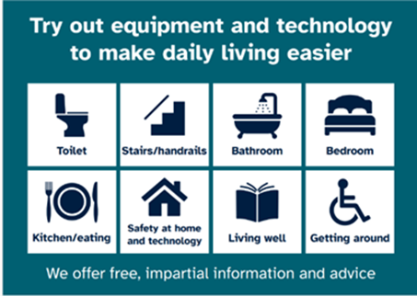
TEC at the Independent Living Centre (SILC’s)
There are lots of different types of TEC to see and try
If the person (or their family) has access to the internet and can look at supporting their own needs around technology, then give them details of the Council’s website area on technology here
https://www.somerset.gov.uk/care-and-support-for-adults/equipment-to-help-you/
This has details on the SILC’s and how to book.
If the person (or their family) does not have access to the internet, then they will need to telephone the Somerset Customer Contact Centre on 0300 123 2224.
Our lines are available Monday to Friday 8.30am to 5.00pm.

Slide 6
Time for Questions
adultsocialcareTEC@somerset.gov.uk

