Slide 1
Customer Services Adults Team
Sarah Ralls – Service Delivery Manager
Victoria Durant – Customer Service Expert
Lianne Haysom – Customer Service Specialist

Slide 2
Somerset Council Customer Services (Adults)
First point of contact for all ASC queries
Single contact number for Somerset Council Contact - calls, email, face to face, SMS text
Provide service for Public and Professional
We aim to resolve 60% of all queries at first point of contact ensuring they receive the right support at the right time
Adults and Mental Health out of hours (5pm – 8.30am)

Slide 3
First point of contact
Strength based, person centred conversation
Reason for the call
Asking the right questions at first point of contact Early Intervention
Focus on the individual
Identify what is important to them
What they would like to achieve
Preferred outcome
Only tell their story once
Help them to remain independent and have choice Help them to help themselves and give them confidence We want to help people and make a difference in their lives
Connect people to the right service at the right time
Ongoing support for those who need it
Enables us to identify carer’s

Slide 4
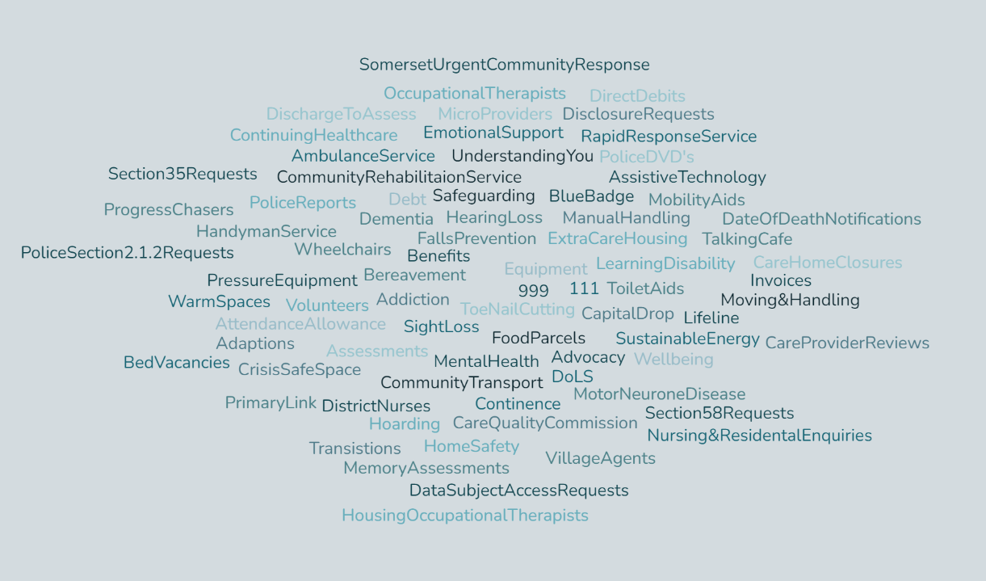
The type of calls we receive

Slide 5
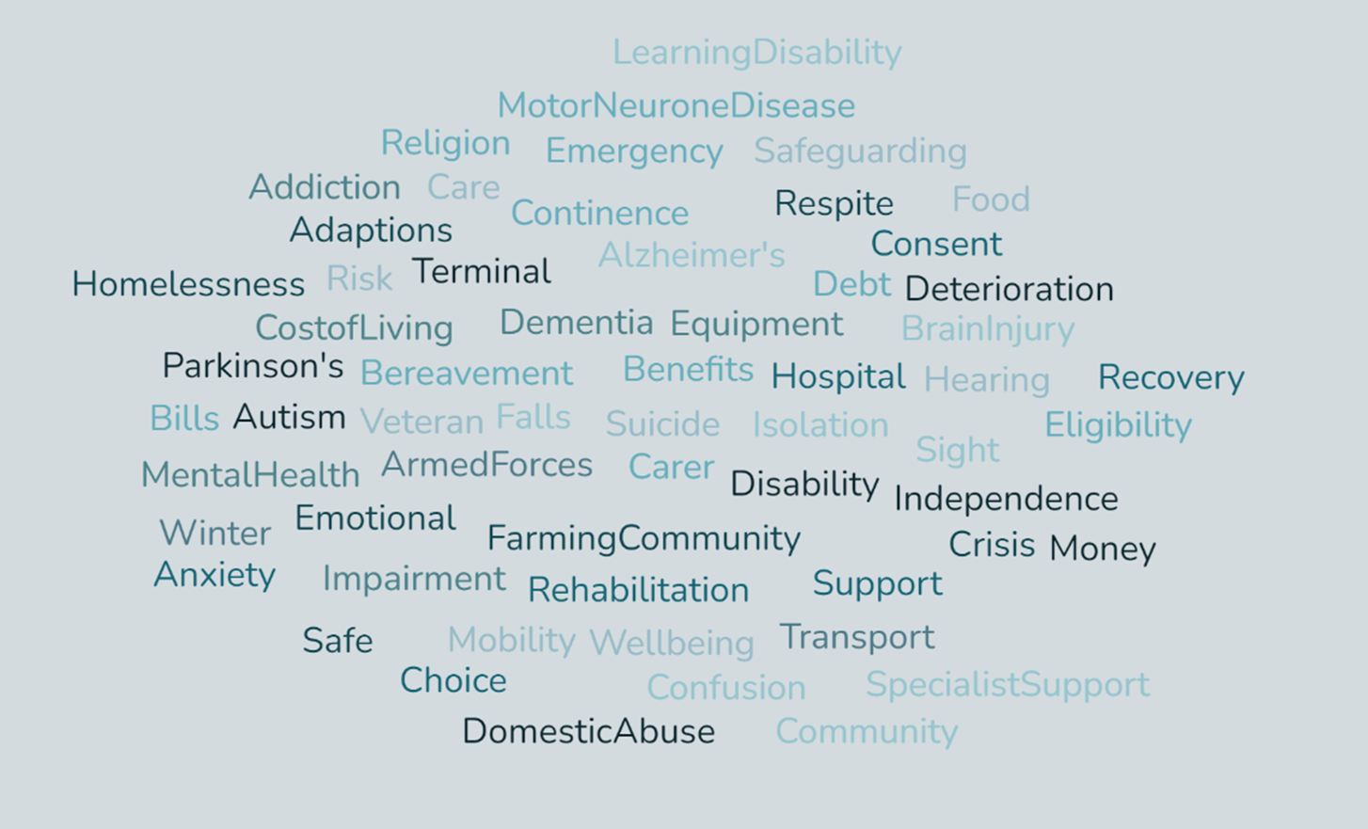
The type of calls we receive

Slide 6
How do we reduce the demand on ASC?
Safeguarding
Mobility concerns
Mental health calls
Social Isolation – We can refer to village agents, talking cafes and other community resources
​ Connecting people to the community - other signposting solutions
​

Slide 7
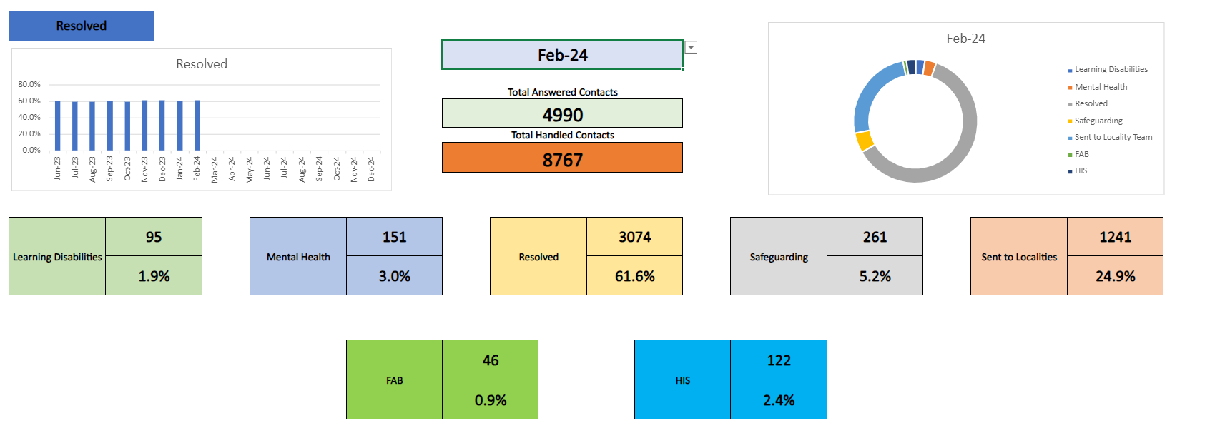
Statistics

Slide 8
How we support our team
Induction and onboarding
Learning, shadowing, buddy support and peer to peer training
Ensuring staff have the right information, tools, processes and systems
Ongoing support:
Nurturing environment, sharing information, knowledge and feedback, supporting each other
Visits to Somerset Independent Living Centres, Talking Cafes, and Community offerings
Safeguarding, Mental Health Social Care, Learning Disabilities Teams

Slide 9
Feedback: Connor- Started Nov 23
I recently joined the contact centre in the last four months with no prior knowledge of ASC and a limited amount of Customer Service experience. I have thoroughly enjoyed learning and progressing within the Adults Team and feel I have been fully supported by all team members throughout this time. My visit to SILC has really helped me with supporting customers on this type of call as I got to see the environment and can set clear expectations on what will happen on their visit.​ Since I joined, I have taken on a lot of knowledge which at times has been slightly overwhelming but using my learning plan and the training I have received, I feel my confidence when speaking with customers has grown massively from the knowledge I have learnt and using the new prompts that have been created when taking calls has played a big part in this.​ ​​

Slide 10
How we evolve and adapt to the needs of the service
Prompt Sheets
Reviewing the customer journey
OT Triage Pilot
Early prevention
Identify trends and gaps in services
Instigated regular meetings – to increase the collaboration between service, Adult Social Care Teams. Mental Health, Safeguarding, HIS (Health Interface Service), FAB (Financial Assessment & Benefits), Learning Disability, Triage teams and Public Health
Commissioners. Village Agents, Somerset independent living centre, Somerset independent plus
Act on feedback received from the services and the Public

Slide 11
Feedback from Angie- Specialist
We reached out to one of our Customer Service Specialist who has been with us for just over 18 months to see how the changes we have made have impacted on the role. ​
​
I joined the Adults Customer Service Team 18 months ago and feel settled and confident in my role. I have seen many changes that have improved the ways we work, helped us to be more efficient and encouraged collaboration between teams.​
There has been close working with adult social care to develop prompt sheets for our main referral types. This means we can be confident we are gathering the information the triage teams need, reducing the time taken to type up the referral and reducing the need for triage to make follow up calls to gather more information.​
We are increasingly using MS Teams chat groups to enable as a way of contacting duty teams and OT’s for advice. This is so much more efficient as it allows for non-urgent enquiries to be looked at between other tasks or for information only messages to be passed to teams without the need to make phone calls. It can also enable us to make sure we are signposting correctly, particularly in respect of OT related enquires. ​
Within my role, I am also part of a small team who screen safeguarding referrals to determine if these need to be triaged by the safeguarding team or not. We have regular Peer Forum meetings with the safeguarding team which have helped to develop strong working relationships between our teams. ​

Slide 12
What is working well
Communication routes within ASC and partnership working
Person centred conversation – what matters and what they can do to help themselves
Being reactive, embracing and adaptive to change
Empower the team to feel confident in what they do. and make sure we have the tools to support them. Signposting A-Z, Prompts, Invite community speakers to our monthly team meetings
Quality assurance calls
Carer call backs – Check in

Slide 13
Area’s that need improvement
Wait times to get through to us are high Calls are more complex
Seen an increase in Mental Health calls
Lack of resource to enable people to self-serve and access support when they need it
More focus on Carer’s, creating a direct route through reducing wait times
More community resources due to increased demand
Transparency with our customers enabling us to set clear expectations

Slide 14
Future
Future Vision e Vision
Continue being Reactive, versatile, and embracing change
Improving the journey online for both the public and professionals
Enable the public to self-serve, as currently the only option is to ring or email
Create a Public version of our Professional referral form
To explore more preventative solutions at the front door

Slide 15
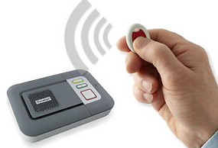
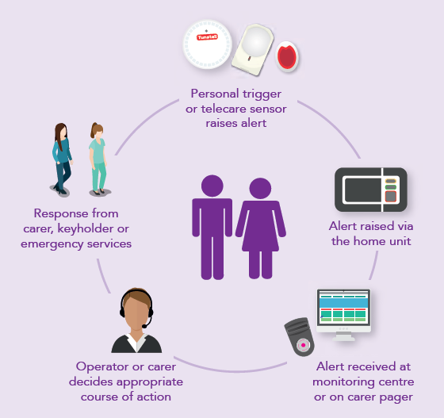
Somerset Lifeline – Richard Burge
Technology Enabled Care
As standard, provision of a Lifeline unit (two-way speech unit) which is activated by a pendant and/or other peripheral devices.
Installation Team
Emergency Response Team
24/7 Monitoring Team

Slide 16
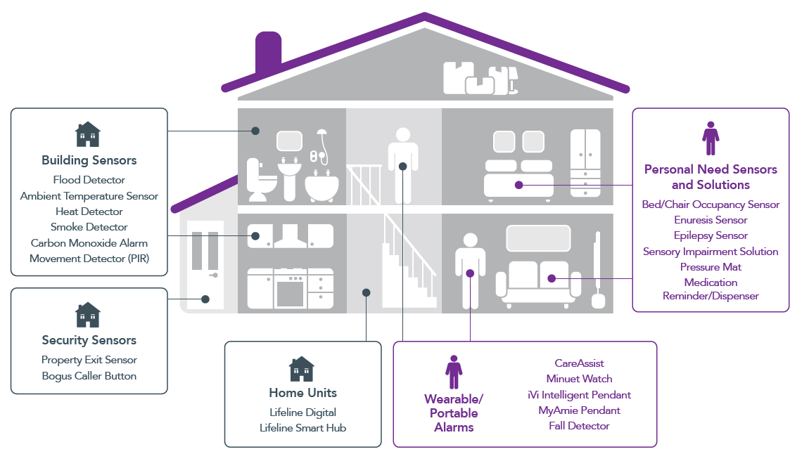
Telecare Sensors

Slide 17
Challenges and Opportunities
Structure – management and administrative support
Digital Switchover – upgrading existing and future Lifeline units and review of current platform.
TEC Project – providing a service that is integrated with Adult Social Care.
Business growth– through increased promotion and marketing, innovation and re-modelling.

Slide 18
Call Examples

Slide 19
Call examples
Example 1
The first example displays the impact being a carer can have on someone. Carers are very important, and we make every attempt to identify them. They can often be at crisis stage when calling customer services.
Example 2
The second example describes how complex and severe some of the calls we receive can be.
It demonstrates why we ensure we listen carefully to someone’s story and what and how we support them to get the right help at the right time from the right service.

Slide 20
Time for Questions
Phone: 0300 123 2224
Email: adults@somerset.gov.uk

