Slide 1
LGA Assurance Peer Challenge
Adult Social Care Welcome Presentation
Tuesday 5 March 2024

Slide 2

We warmly welcome you to Somerset
Somerset has a £12.4 billion economy, with over 25,000 businesses, including major employers and brands such as Leonardo Helicopters, EDF, Thales, Mulberry, and Numatic, as well as a diverse SME base across a range of sectors, including aerospace, energy, tourism, and food and drink. Recent £4bn investment creating jobs and putting Somerset at the centre of the UK’s green energy revolution as part of plans to build a gigafactory producing EV batteries in Puriton.
Somerset is well known for its natural beauty. It has rolling hills, the flat plains of the Somerset Levels, and a 25 mile stretch of the South West Coastal path.
Particular attractions include Cheddar Gorge in the Mendip area, Exmoor National Park and four hill ranges, the Mendips, Blackdowns, Brendons and Quantocks.
Glastonbury Festival is an international musical highlight and sees an influx of approximately 210,000 staff and visitors during June.
Notes:
MEL

Slide 3
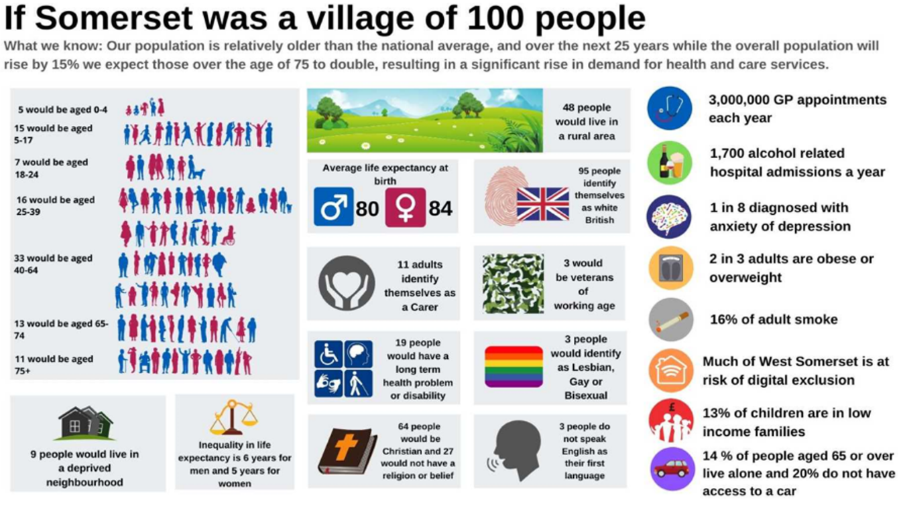
Our county
Our population profile is older than the England average, with 25% being over 65. Over the next 25 years we expect a significant rise in our older population with a doubling in the proportion of those over 75, compared with an overall population rise of 15%.
As our population changes, the support people need from our local services is also changing. People are living longer, and more people are living with long-term conditions. As a result, the Local Authority and our partners have a clear need to work differently, providing more care in people’s homes and within our local communities, and working more effectively in partnership.​
2021 Census data reveals Somerset’s population to be 571,600, an increase of around 41,600 people since 2011
Notes:
MEL

Slide 4
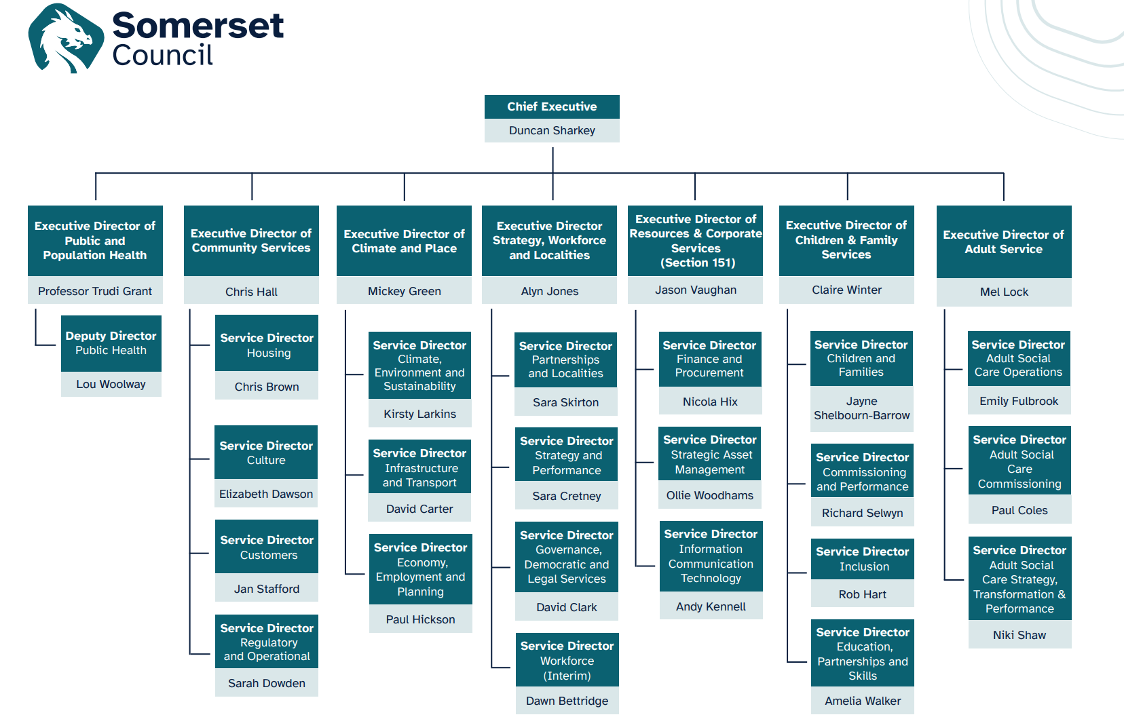
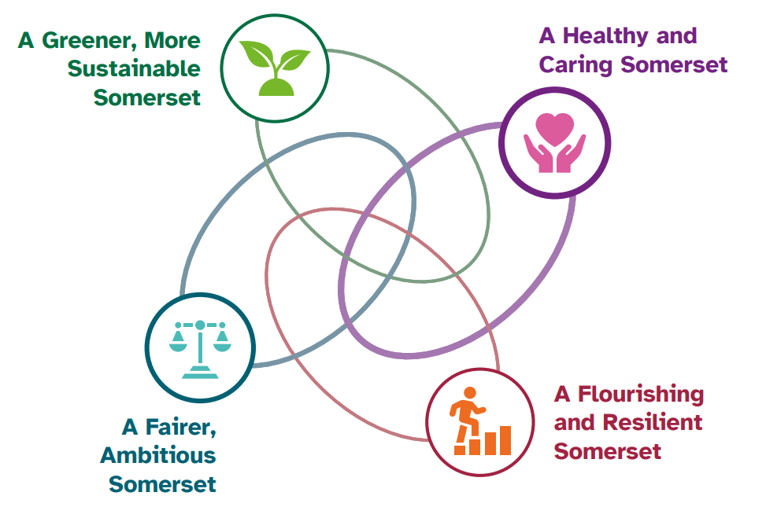
Our Local Authority
New unitary: Somerset Council was formed on 1st April 2023 from 4 District Councils and a County Council.
The political administration of Somerset Council is Liberal Democrat; the Conservative Party had previously been in charge of Somerset County Council dating back to 2009.
Somerset Council’s vision and priorities are set out in the Council Plan (2023-27):
Notes:
MEL

Slide 5
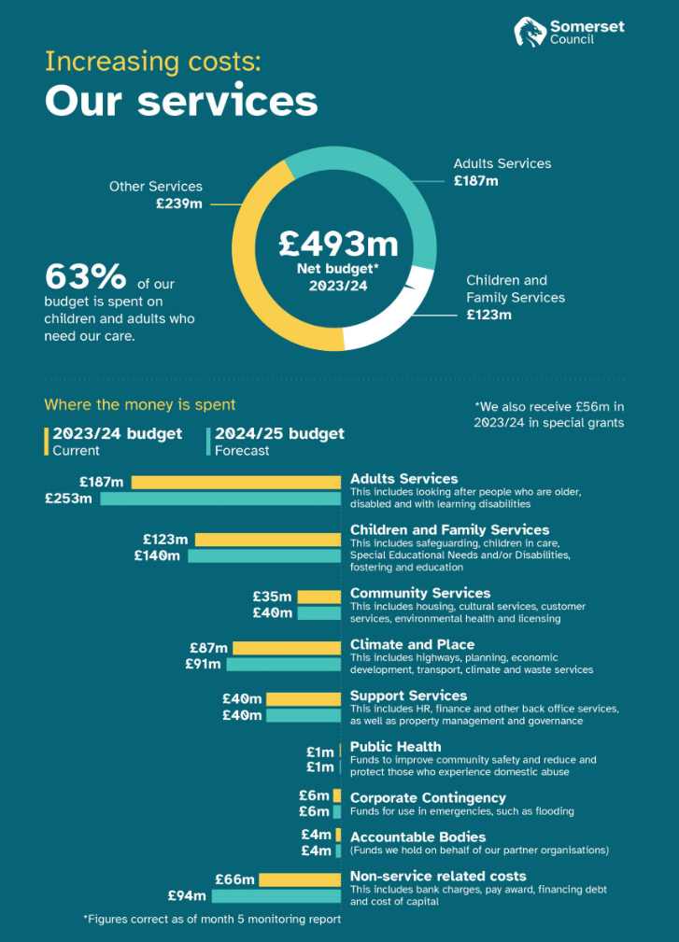
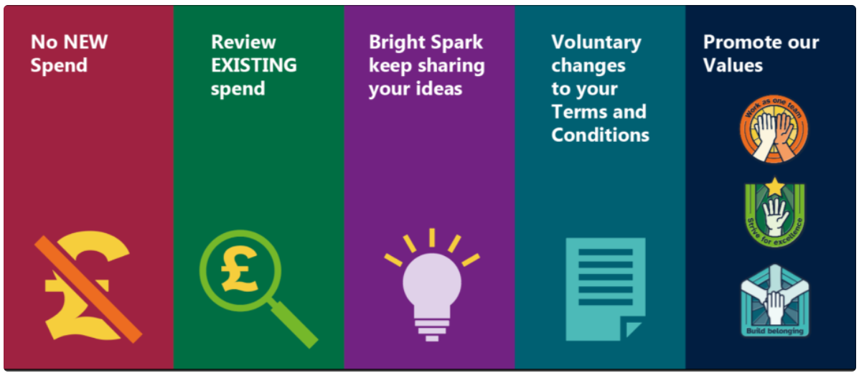
The Council’s Financial Position
Somerset Council declared a ‘financial emergency’ in November 2023.
A 2024/25 budget consultation was launched in December 2023 seeking public views on a range of potential savings options.
A balanced budget was set for the coming year by Full Council on 20/02/24 but, based on current forecasts, there is a high likelihood that a s114 notice will need to be issued in 2025/26. Control Boards have been put in place to help address the in-year overspend and support the 2024/25 budget:
Establishment and Recruitment Board
Commercial and Procurement Board
Spend Control Board
A Voluntary Redundancy programme launched on 09/02/24
Marked the start of a 45-day collective consultation period
Notes:
Financial Emergency - Updates, announcements and FAQs (sharepoint.com)
Appendix 10 - Summary of findings from the budget consultation exercise.pdf (moderngov.co.uk)
https://www.somerset.gov.uk/news/stark-warning-as-somerset-council-sets-balanced-budget-for-2024-25/
MEL

Slide 6
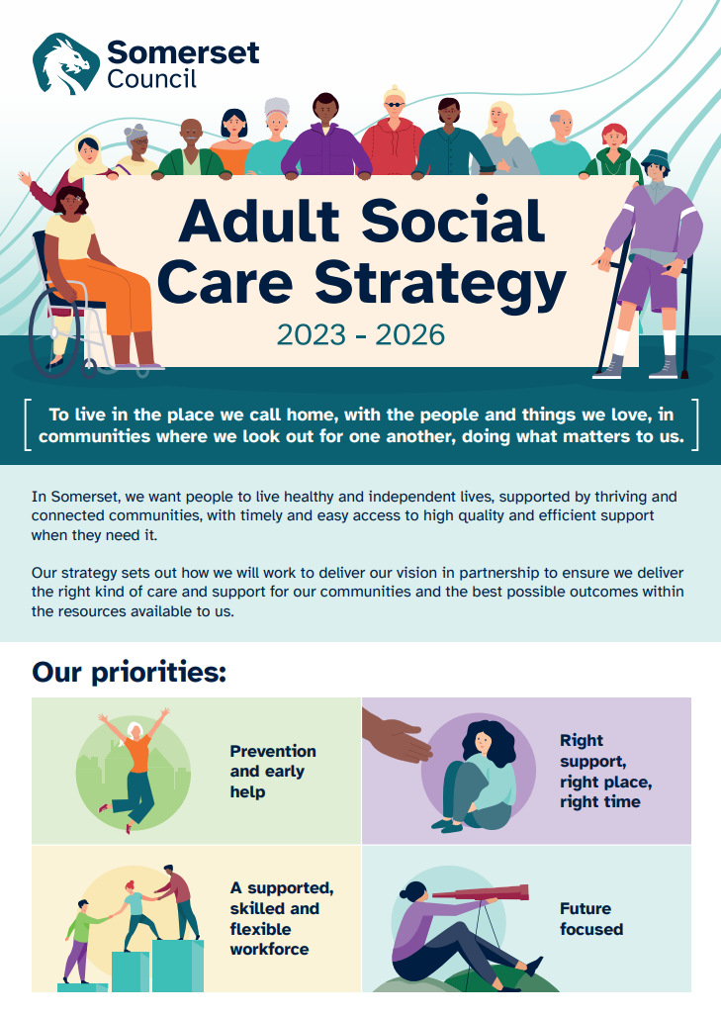
ASC Vision & Strategy
‘We want people to live healthy and independent lives, supported by thriving and connected communities, with timely and easy access to high quality and efficient support when they need it’
Our Adult Social Care Strategy (2023-26) details 4 core priorities for our service to ensure we deliver the right care and support for our communities and the best possible outcomes within the resources available to us.
There is a clear ‘golden thread’ across all key local strategies in Somerset demonstrating a shared local commitment to:​
​Improving people’s health and wellbeing​
Focusing on prevention and early intervention​
Investment in our communities and neighbourhoods ​
Promoting people’s independence ​
Ensuring easy access to high quality support when required​
Reducing inequalities and improving outcomes for those with more complex needs​.
Notes:
MEL

Slide 7
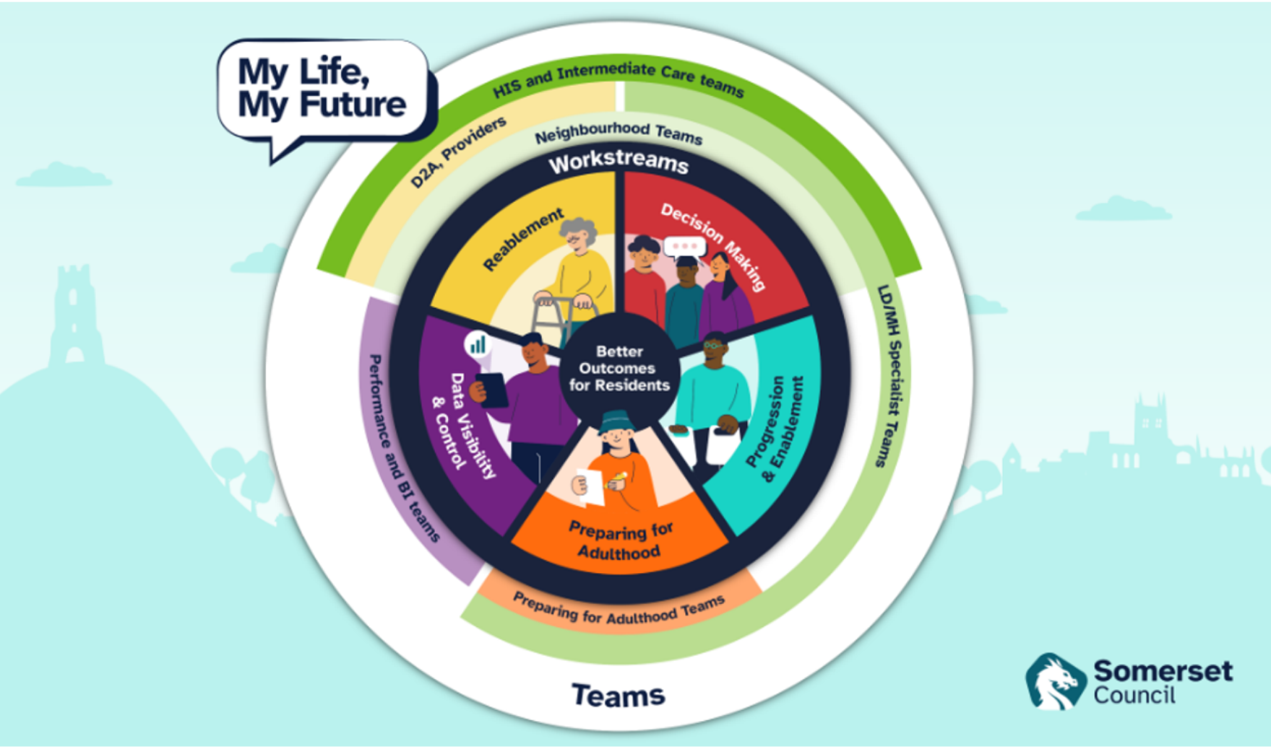
Notes:
MEL

Slide 8
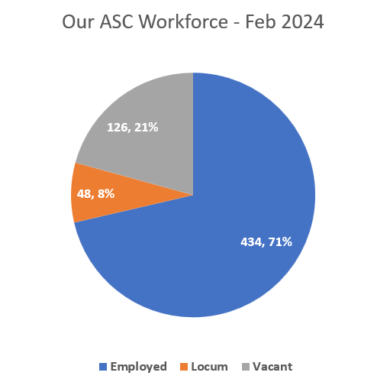
Our Adult Social Care workforce
ASC Workforce Strategy: Themes
Recruitment
Retention
Pay & Conditions
Succession planning
New ways of working
Young People
Learning & Development
Leadership
Partnership working
Implementation and monitoring
68 starters, 44 leavers (last 12 months)
Successfully recruited 12 international Social Workers with 3 more in the pipeline transferring from Childrens. Now recruiting a third cohort of 10
Overall turnover (excluding locums) is at 7.8%. The turnover of Social workers has reduced by 19.5% compared to this time last year
Successful succession planning within our AMHP Service - age profile reduced by 13% with implementation of trainee AMHP role
Phase 1 and 2 of ASC Operations Restructure completed
1,700 training places provided by L&D in 2023/24 on mandatory courses, delivered through 250+ taught sessions
360-degree leadership development activity underway
Notes:
During the last 12 months, we have recruited 68 new starters and have had 44 leavers.​
Successfully recruited 11 international Social Workers through Morgan Hunt, with a further cohort of 10 being sourced.​
Our turnover for ASC overall is 7.8%, excluding locums. Turnover for Social Workers has reduced by 19.55% compared to this time last year, currently 8.36% as at January 2024. ​
Successful succession planning within our Approved Mental Health Practitioner (AMHP) service through implementing a trainee AMHP role, reducing the age profile of the team by approx. 13%. Succession planning for DoLS & MCA commencing imminently.​
Completed phase 1 and 2 of the ASC Operations restructure with a focus on: strengthening leadership and management; improving workforce capacity, practice quality, workforce development and career pathways; enhancing specific areas of practice and aligning boundaries with our partners. Review of the restructure commencing with our staff and partners in March 2024.​
In the year 2023/2024, the Learning & Development team will have provided for over 1700 training places on mandatory courses, delivered through more than 250 taught sessions.​
Leadership development has commenced with our newly formed leadership team commencing with 360-degree feedback.

Slide 9
People’s experience of Adult Social Care - 2023
“From the moment I was first referred, I have never felt so cared for and treated as if I mattered. So much has come from the first meeting, problems I have put up with for years are now being resolved. I am truly grateful for the help and support”
80% of the 282 stakeholder feedback responses we received during 2023 rated the overall service received from our staff as good or excellent.
Responsiveness is a key area for the service to continue to monitor and improve. Most of the poor-rated feedback referenced poor communication from our frontline staff or waits for care and support.
We received 253 complaints in 2023. The majority related to ‘service provision’ but we have also seen a rise in those linked to ‘funding’. In contrast, there has been a reduction in complaints relating to ‘service quality’ during 2023. Just under 1 in 5 complaints (19%) were ‘upheld’ in 2023.
There were 3 upheld Local Government & Social Care Ombudsman complaints linked to Adult Social Care/Somerset Council in 2023.
Feedback and trends inform our Practice Quality Board to ensure learning is taken forward.
“It is very difficult to get information or reach anyone ”
“Sophie was our knight in shining armour. ​
She came into our home at a time where we were feeling very overwhelmed with processes, Sophie came in and explained them in simple terms and made us feel so much more reassured. Sophie is going to arrange for our bathroom to be adapted which is going to make a huge difference to my partners life and enable her to stay living at home for the rest of her life as ​she is desperate to”
“I have received no reply to my complaint regarding this social worker and the time it has taken for a Care Act assessment to be finalised for my son, and a care and support plan put in place as well as a carer’s assessment for myself.”
“I honestly cannot fault the care, communication and hard work provided to help assess my father’s dementia needs.
I have been kept informed every step of the way with very well explained emails & phone calls. It is so refreshing to have someone who really cares about the welfare of all concerned”
Notes:
We are very proud of the many developments and successes achieved over the last 12 months in relation to how we work with people, provide support, ensure safety, and lead our service, as well as the feedback we receive from stakeholders
The following slides sample some of the key successes this past year and areas of ongoing focus for our service.

Slide 10
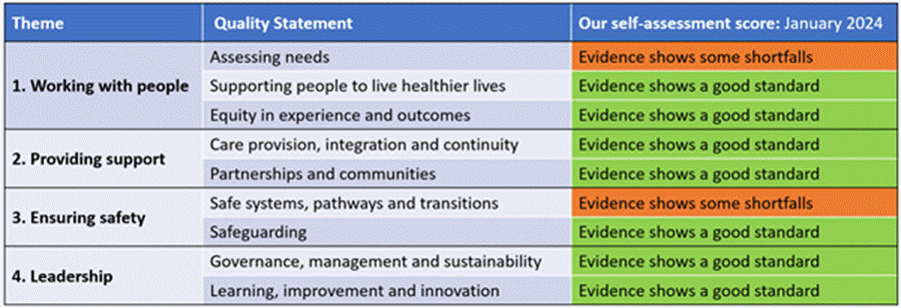
Our Adult Social Care self-assessment
We are very pleased to be able to share our latest self-assessment and supporting documents with you, following widespread engagement with staff and key partners over recent months. This is aligned to the Care Quality Commission’s Assessment Framework and quality statements.
We hope this helps capture and showcase the breadth of activity we deliver and support, and some of the many ways in which we make a difference to people’s lives through the inclusion of case studies and real stories.
Notes:
Published in Feb 2024
MEL

Slide 11
Working with People - what you will see:
A thriving and well-established multi-agency approach to early help enabling people to live healthier lives, promote their independence, and reduce, delay or prevent the need for statutory care and support
A strengths-based approach to assessing people's needs from first point of contact with the Somerset Council
Daily social care triage processes, prioritising and risk-assessing all referrals and contacts
Multi-disciplinary Peer Forums and Enhanced Peer Forums bringing colleagues together to critically discuss individuals’ needs following assessment or review, explore creative solutions and progress funding requests
Specialist learning disability and mental health social care teams, introduced as part of our re-structuring
Higher than national average take-up of direct payments helping local people exercise independence through greater autonomy, choice and control
An enhanced practice quality and development offer, led by our Principal Practice Leads and supported by the work of Practice Development Advanced Practitioners across our teams (including monthly audits and a Practice Quality Board)
Notes:
EMILY

Slide 12
Working with people – what you will see:
Ongoing efforts addressing waiting lists for assessments and reviews, with a focus on driving productivity and enhancing data quality
Multi-agency work to ensure effective support and the best possible outcomes for unpaid carers, with a new Carers Commitment launching later this month
Opportunities to enhance and embed effective and meaningful co-production across our services, supported by the development of our ‘Working Together Board’
A commitment to embedding the learning emerging from the Council’s Equality, Diversity and Inclusion Peer Challenge across the organisation and our own service
Improving the accessibility of information and advice, and further promoting our adult social care ‘offer’ across Somerset
Notes:
EMILY

Slide 13
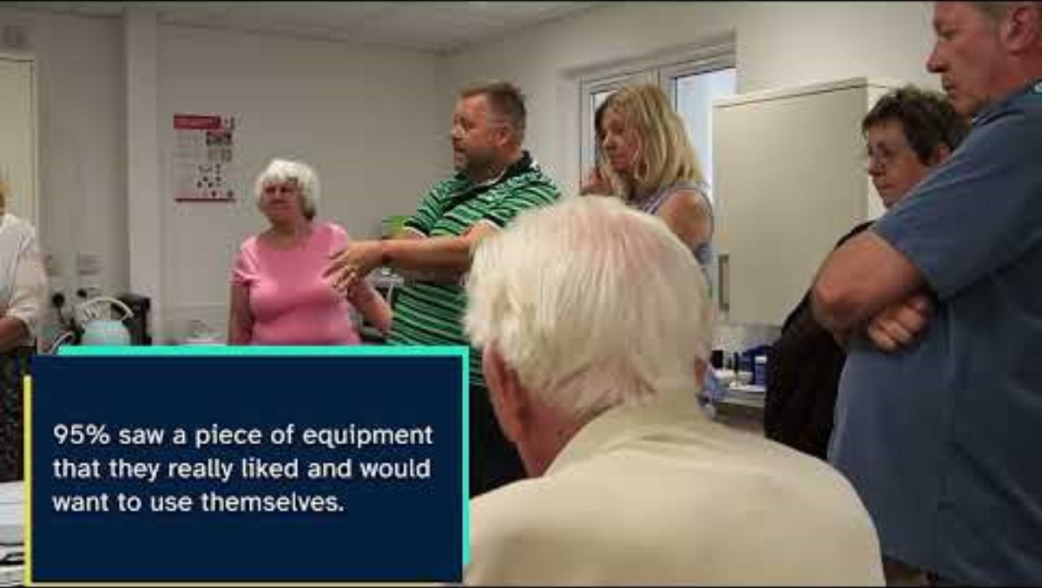
A Somerset story – Working with people
Notes:
EMILY

Slide 14
Providing support - what you will see:
A thriving network of micro-enterprises offering personalised care within our local communities
Low levels of unmet homecare need and care package handbacks consequent to a range of focused and informed commissioning work, and an improving picture in relation to bedded placements
Examples of collaborative partnership working and integration to commission effective models of care and support for our population needs
Robust multi-agency arrangements to support us in monitoring the quality of commissioned services and offer improvement support
A range of activity undertaken and planned to address the current and future care workforce needs as a wider health and care system
Jointly run Intermediate Care Services supporting acute hospital discharges and preventing admissions
People’s independence promoted through the assessment and delivery of housing options and adaptations, supported by our Housing Occupational Therapists and Somerset Independence Plus
Notes:
PAUL

Slide 15
Providing support – what you will see:
A challenged financial environment impacting on care market sustainability
Opportunities for further promotion and publication of our Market Position Statement and commissioning strategies
A focus on enhancing our existing reablement response
Recognised opportunities presented by Unitary to further develop integrated care and support services in partnership with other departments, including housing and planning
Notes:
PAUL

Slide 16
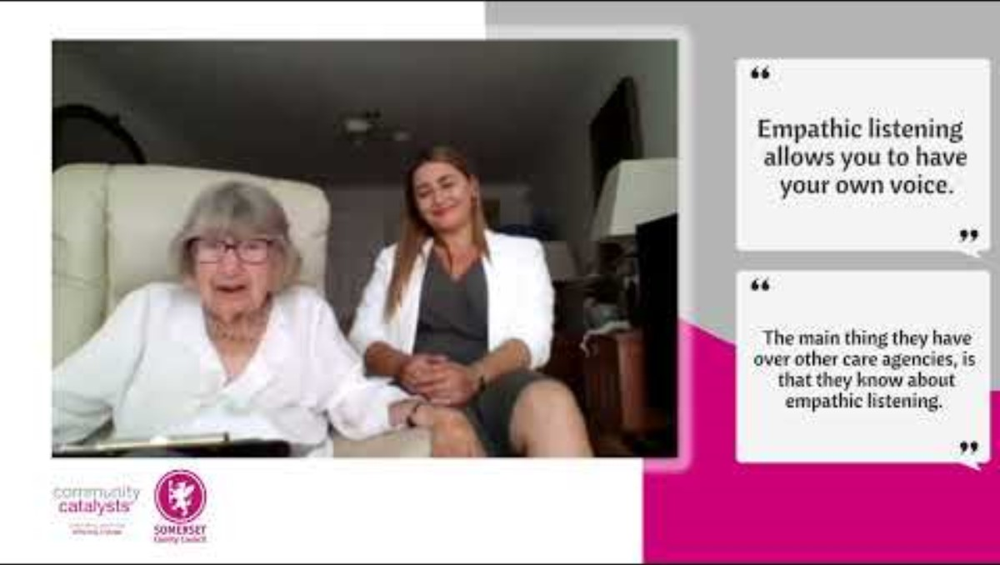
A Somerset story – Providing Support
Notes:
PAUL

Slide 17
Ensuring safety - what you will see:
A focus on ‘Preparing for Adulthood’ (one of our key transformation workstreams) to deliver good transition planning for young people in Somerset
Robust and well-tested arrangements to respond to and support business failures/home closures
A centralised Adult Safeguarding service with a strong focus on ‘making safeguarding personal’
An effective and ambitious Safeguarding Adults Board, led by an experienced Independent Chair and providing a range of communication channels and approaches to promote awareness of abuse and neglect
Safeguarding practice centred on 'making safeguarding personal’ principles, with low levels of complaints
Robust mechanisms in place to ensure the appropriate prioritisation of DoLS applications from care homes and hospitals by experienced assessors, despite the fact that Somerset – in common with most other areas – is unable to fully comply with its statutory duties under the Mental Capacity Act
An AMHP Hub and out of hours service working collaboratively with health partners
Notes:
NIKI

Slide 18
Ensuring safety – what you will see:
A key ‘transformation focus’ on Preparing for Adulthood – increasing independence for young people as they transition to adulthood through earlier intervention and support from Adult Social Care and the adoption of strengths-based approaches
The ongoing development of a Somerset Transfer of Care Hub to ensure we achieve greater consistency in outcomes for people
A focus on improving understanding, identification and multi-agency risk management and practice in relation to rising instances of self-neglect supported by the work of our multi-agency Safeguarding Adults Board
A commitment to embedding and evidencing learning arising from growing numbers of Safeguarding Adults Reviews and further opportunities to hear and learn from the lived experience of those supported through safeguarding processes
Partnership work to develop a ‘through-life exploitation strategy’ to better safeguard Somerset residents and communities
Notes:
NIKI

Slide 19
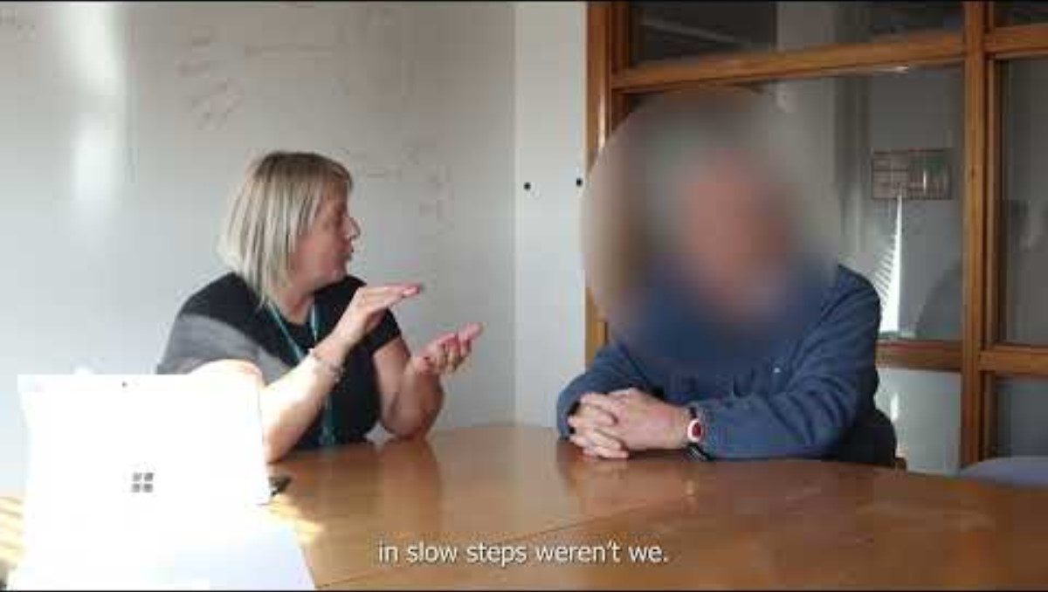
A Somerset story – Ensuring Safety
Notes:
NIKI

Slide 20
Leadership - what you will see:
Strong and well-engaged political leadership, with Councillors well-informed about adult social care risks
Significant budget oversight, accountability and governance arrangements
Active participation and leadership in and across sector-led improvement activity regionally and beyond
Regular opportunities for staff engagement and communications with the Council and Service leadership team including briefings, Q&As and monthly highlight reports
A robust appreciation of our performance and key risks driving and information our strategies and response activity
A long-standing commitment to inviting external expertise and guidance to support our improvement efforts, with an ambitious transformation programme in place across our service
A varied and extensive learning and development offer to support our staff develop and enhance their practice, and examples of supporting national research projects and programmes
Notes:
MEL TO CONCLUDE

Slide 21
Leadership – what you will see:
A recent change in the Lead Member for Adult Social Care (20/02/24)
A strong focus on ensuring the effective delivery of our transformation programme
A recognised need to stabilise our workforce and reduce reliance on locum staff supported by our Workforce Strategy, Board, and overseas recruitment activity
A commitment to managing our budget and spend and enhancing our ability to track live performance
A commitment to enhancing existing mechanisms to hear from and respond to the needs and wants of our workforce
Broader operating environment risks and workforce impacts associated with the Council’s financial pressures and wider risks facing our independent care market requiring us to assess and mitigate these wherever possible in terms of their impacts on our ambitions for our communities and services
Notes:
Published in Feb 2024

Slide 22
Thank you for your work and efforts in supporting our assurance activity.
Any questions?

