Slide 1

Somerset Council Scrutiny Committee Mental Health Workshop

Slide 2
Mental Health Workshop
Agenda
• What is mental health from a lived experience perspective, what does it mean to individuals.
• What is mental health.
• What are our responsibilities; mental health services in Somerset.
• Case studies.
• Challenges, complex behaviours, housing, homelessness, Creative Solutions.
• Public health, investment in promotion and prevention.
• Current Commissioning and future intentions.

Slide 3
What is Mental Health
?
Group Activity

Slide 4
What is Mental Health
Mental health is defined as a state of well-being in which every individual realizes his or her own potential, can cope with the normal stresses of life, can work productively and fruitfully, and is able to make a contribution to her or his community. (WHO, 2014)

Slide 5
Mental Health is part of our overall health- the quality of our mental health might be seen by:
How we feel, think, and behave
How we cope with the ups and downs of life
How we feel about ourselves and life
How we see ourselves and our future
How we deal with negative things in our life
Our self-esteem and confidence
How stress affects us
We all have mental health, and it is part of our health

Slide 6
National Data
• 1 in 4 people will experience a mental health problem in any one year.
This week in the UK…
104 people will take their own life
250,000 people will visit their doctor about a mental health problem
750,000 prescriptions for antidepressants
will be issued.

Slide 7
Somerset Picture
It is estimated that 1 in 10 people at any one time will be experiencing mental distress
Somerset’s population just over ½ million
That means at this moment in time 50,000 people experiencing mental distress in this county alone.

Slide 8
Lived Experience
A lived experience perspective.

Slide 9
Lived Experience
Joined up approach to look at a whole person’s situation, particularly for those with severe mental illness. This could include co-occurring needs (such as substance misuse, homelessness, housing, debt), as well as prevention and crisis situations.
Feel informed, valued, supported and held when looking for support as well as when receiving support, particularly for those experiencing highest inequalities.
Joined up approach to medicine management (including side effects, prescribing and de-prescribing)
Person-centred, co-produced individual support planning, which may or may not include diagnosis. This involves safe, secure information sharing.
Safe and supportive spaces with access to a range of joined up options. This includes social and clinical (peer support, co-occurring needs, different stages of life)

Slide 10
Lived Experience Priorities
Continue to develop positive values and principles around culture, both within OMH and with wider stakeholders. This includes supportive and supported workforce, language and approaches within the system. This includes training offers for partners on different aspects of OMH.
Joined up way of sharing information and support options both within OMH and more widely (includes primary care, physical health services, crisis options, between localities and in communities).
Develop ways of widening awareness of the OMH offers within wider community (using different communications and engagement methods) and understanding where different support options might be needed and could be developed (via data analysis and community listening). This includes prevention/early intervention offers.
Continue to develop supportive, compassionate and informed joined up approaches when moving between services, both within OMH and with wider stakeholders (including social care, primary care, secondary care and community offers).

Slide 11
Mental Health Workshop MH Services in Somerset
For 21 / 22
10 MH inpatient wards
772 MH admissions
223,466 MH outpatient / community appointments
Additional services provided to meet highly specialist health and social care needs outside the County boundaries.

Slide 12
Mental Health Workshop MH Services in Somerset
Mental Health Inpatient wards: –
Acute
Rehab
CAMHS
Older people
2 Health based places of safety
Step up and Step down
Out of area placements
Home Treatment Team and First Response
Relocation of St Andrews

Slide 13
Open Mental Health
What is Open Mental Health
Open Mental Health is a Somerset network of local voluntary, community and charity organisations and the NHS. We are working in partnership to ensure that residents of Somerset get the support they need, when they need it.
Our shared ambition is to ensure that people living with mental health problems get the right support at the right time. Working together, we support people to live a full life, by enabling access to specialist mental health services, housing support, debt and employment advice, volunteering opportunities, community activities and physical exercise, to help support and improve their wellbeing and quality of life.

Slide 14


Open Mental Health
A multi-agency alliance of partners committed to work together to improve mental health support to the people of Somerset

Slide 15
Open Mental Health
Key Principles of Open Mental Health
Preventative engagement
Open access – (no wrong door – no shut door - no door at all)
Co-production – different perspectives equally valued (VCSE, statutory colleagues, Experts by Experience)
All inclusive – no one is left out because of, or in the absence of, a diagnosis, or presenting severity – no-one should hear ‘we can’t help you because you don’t meet the criteria
Warm introductions in, across and between services
Adopting a trauma informed approach across all partners
Flexible and responsive to needs of the individual, outcome focussed, move away from transactional interactions
Whole system approach – NHS and VCSE elements of the services are combined, not separated – we are all part of one team – equal partners – strong links with social care
Building on community assets

Slide 16

Open Mental Health
Key Principles of Open Mental Health
We’ve removed the barriers to getting mental health treatment and support,
so anyone can contact the Open Mental Health hub for an assessment of what
could help and what the person needs. Whether it is for yourself or if you’re a GP, pharmacist,
social worker, police officer or concerned friend, we are Open for Mental Health in Somerset.

Slide 17
Open Mental Health
Experts by Experience
Embedding co-production and the voice of lived experience through the planning, design, implementation, delivery and evaluation of Open Mental Health is key to our shared values
Open Mental Health has a group of Expert by Experience Leaders who meet regularly to guide what Open Mental Health is and how it works
Open Mental Health also has various Expert by Experience Leader roles (eg, locality team member, working group member, Partnership Board member)

Slide 18
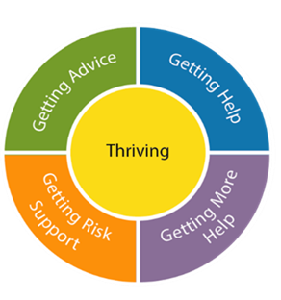
Open Mental Health
Experts by Experience
Locality Teams:
Locality Co-ordinator
Peer Volunteers
Paid Peer Recovery and Wellbeing Workers providing 1:1/group/activity work
Non Peer Recovery and Wellbeing Workers providing 1:1/group/activity/organisation specialism
CAB Case Worker
SWEDA Specialist Worker
Age UK Volunteers
NHS SFT Staff (Psychologists, Therapists, Nurses, Operations, Admin)
Crisis Safe Space Provision
Peer Support Connections Co-ordinators
Countywide Support:
Trauma and complex emotional needs training, coaching, supervision (Second Step)
Eating disorder specialist support (SWEDA)
Money and housing specialist support (CAB)
Peer support training & coaching, peer volunteer support, self-management courses & peer group development (Chard Watch)
Volunteering infrastructure support (Spark)
Activity and groupwork (Mind in Somerset)
Recovery college (SFT)
Peer support and peer mentoring linked to physical health checks

Slide 19
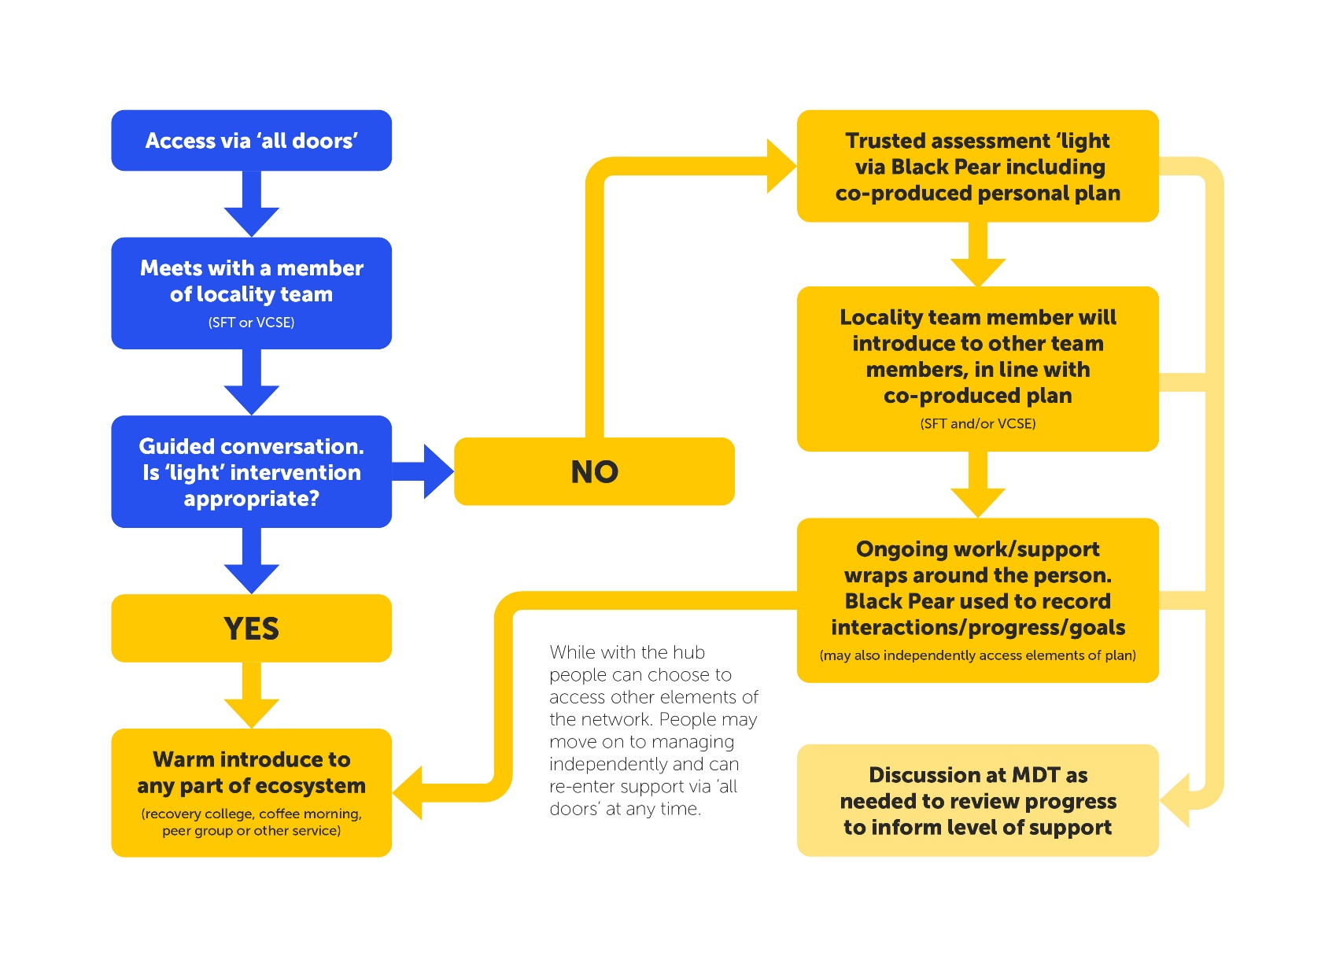
Open Mental Health

Slide 20
Open Mental Health
Supporting Micro Organisations
A grants fund has been established to support grass roots organisations
Maximum impact for modest investment
To date 148 micro providers have received >£900k
These providers can reach communities mainstream services often do not reach, with positive impacts.

Slide 21
Open Mental Health
Mindline
Launched at the start of the pandemic 24/7 now a mixed staff and volunteer model
Averages over 700 calls per week
Open access no criteria offer and key pathway into navigating wider mental health system
Adding innovation to system with specialisms in Mindline SWEDA, Trans+, Live Chat, and planned outgoing calls via Mindline Plus
From Autum 2023 will be part of 111 option 2 pathway for Mental Health, been piloting this in background for last 12 months
British Sign Language offer now part of wider offer of translation and language support

Slide 22
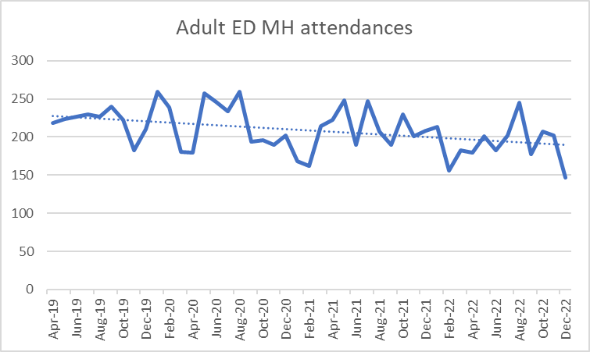
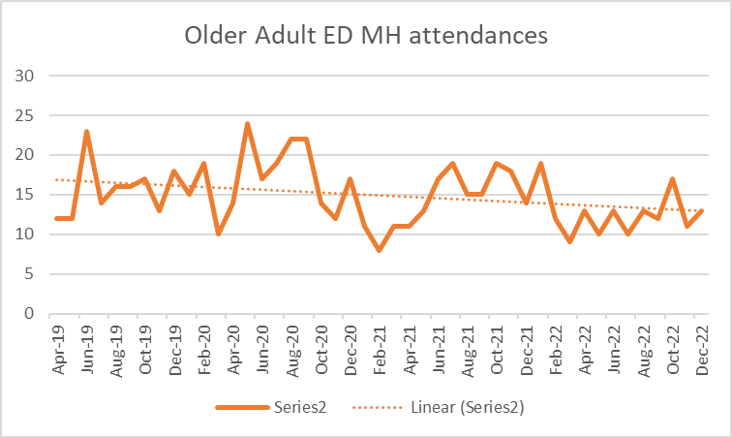
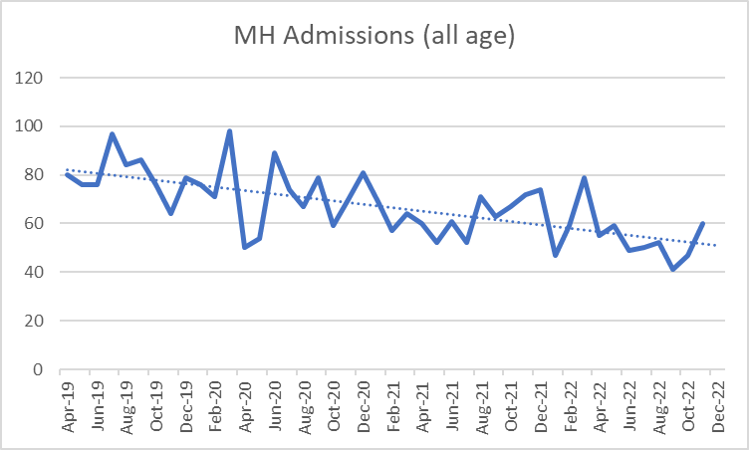
Open Mental Health
Mindline
Decrease in attendance (circa 15% adults / 24% older adults)
Decrease in admissions (circa 30% all ages)

Slide 23
Open Mental Health
Crisis Safe Space
Crisis Safe Space is an out-of-hours service provided by our partners Mind in Somerset and Second Step for anyone who feels like they are really struggling with their mental health.
Instead of going to A&E, making an urgent doctor’s appointment, or suffering in silence, individuals can arrange a one-to-one session with a member of the Crisis Safe Space.
Sessions are held both face to face and virtually depending on the location.
Information on what sessions are available/when for each locality can be found on the OMH website along with information on making a referral: https://openmentalhealth.org.uk/crisis-safe-space/

Slide 24
Open Mental Health
Family Safeguarding
As part of the Open Mental Health model, 8 adult Mental Health Practitioners (Recovery and Wellbeing Workers) are employed by Mind, Second Step and the Balsam Centre and are embedded with the children’s social work teams. These practitioners are embedded within the Open Mental Health locality teams and also link in with the wider Open Mental Health model.
Family Safeguarding teams work using a multi-disciplinary approach, by providing high quality support to families with complex needs, working with adults with mental health issues to achieve their goals and enabling families to remain together improving outcomes.
There is also a VCSE employed Clinical Psychologist who oversees this work. The Psychologist’s role is to oversee the clinical supervision of staff within the Family Safeguarding team, as well as case management and oversight and group supervision.

Slide 25
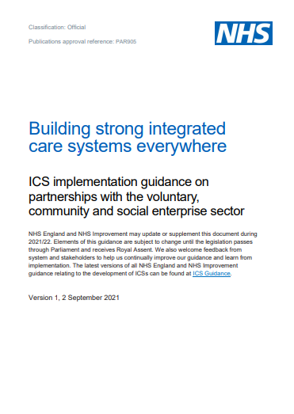
Open Mental Health
Recognition
Somerset’s Open Mental Health model has been cited in the NHS’s national guidance in the Building strong Integrated Care Systems everywhere document as an exemplar. See page 8.
And is featured with its own episode on NHSEI’s Integrated Care podcast
We are also delighted to announce that Somerset Open Mental Health has just won an award for the NHS Big Conversation in Improvement!

Slide 26
Mental Health Workshop
Case Studies
Ms P is a 54-year-old lady diagnosed with mental and behavioural disorders due to use of alcohol, Emotionally unstable personality disorder and Schizoaffective disorder, who is at present placed in a residential service in Devon, jointly funded by SFT and the Local authority through the Complex Care Panel. Ms P has been well known to Mental health services for several years, including a previous admission to a mental health inpatient ward under the Mental Health Act and various referrals to mental health community teams in the early 2000’s. Up until 2019 Ms P had been living in a warden-controlled property. Her mental health began to deteriorate, and she became paranoid about her neighbours resulting in several high-risk incidents. She had presented as chaotic, had longstanding alcohol misuse, and was struggling to maintain her tenancy. Subsequently the placement broke down and Ms P was arrested, went to prison, and then in 2020 she was eventually detained on section 37 of the Mental Health Act to a Low Secure Ward.
Whilst admitted to the low secure ward Ms P engaged in psychology including fire setting course (FIPMO). In October 2021 Ms P moved to the step-down rehabilitation ward at the same hospital until a suitable community placement was identified. Following assessment and collaboration between SFT Mental Health Complex Care team, the Forensic Team and the Local Authority, a placement in shared accommodation with a package of support was identified and she moved in March 2022. Ms P continues to be open to Mental health services and requires ongoing support to oversee her placement. Her beliefs that information held by services is inaccurate is a barrier in her accessing mental health services closer to her new home as she has declined for information to be shared.
Work continues to support Ms P in overcoming this challenge as it has been identified that she will require additional psychological interventions to help support the current community placement. Psychological therapy engagement can be challenging and at times destabilising. However, without this intervention, there is a risk that Ms P may inadvertently sabotage her placement and recovery by resorting to previous unhelpful strategies in dealing with her emotional states and previous traumas. This may be strategies such as using alcohol and substances, self-harming, self-neglecting and increase in paranoia, with a risk of increased risk behaviours such as fire setting. A range of services within the Trust are involved to support Ms P including, Complex Care team, SPI, and the Forensic Personality Disorder service.

Slide 27
Mental Health Workshop
Opportunities for the System
Greater joint working with housing to ensure the availability of appropriate residential options. Traditional residential models are not appropriate for a number of individuals who require more bespoke support and availability of accommodation options in county is extremely limited.
Specific generalised accommodation for individuals who have previously lost tenancies through destructive or anti-social behaviours.
Creative Solutions Boards.
Recruitment and Retention.
Developing integrated services, statutory and non-statutory.
Preparing for Adulthood.

Slide 28
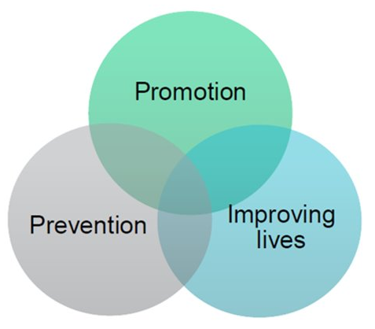
Public Health
Focus on whole population
Improve populations mental health and wellbeing
Prevent suicide and mental health problems
Improve the lives of people living with mental health problems
Universal and targeted support, training and communications
Focus across the whole life course to strengthen protective factors and reduce risk factors

Slide 29







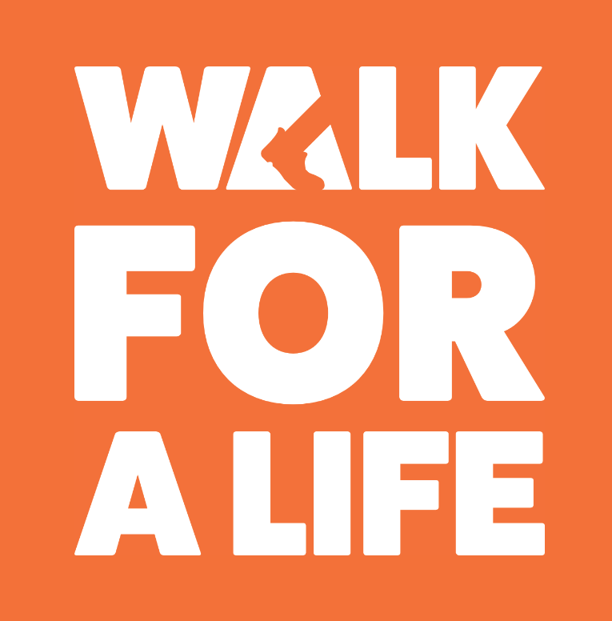
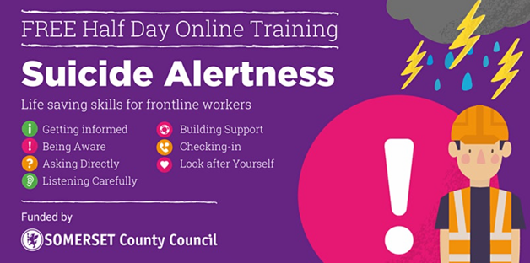
Public Health
Mental Health and Suicide Prevention Training
Funding projects that support
populations ​disproportionately
impacted by mental illness
Communications /
Campaigns

Slide 30
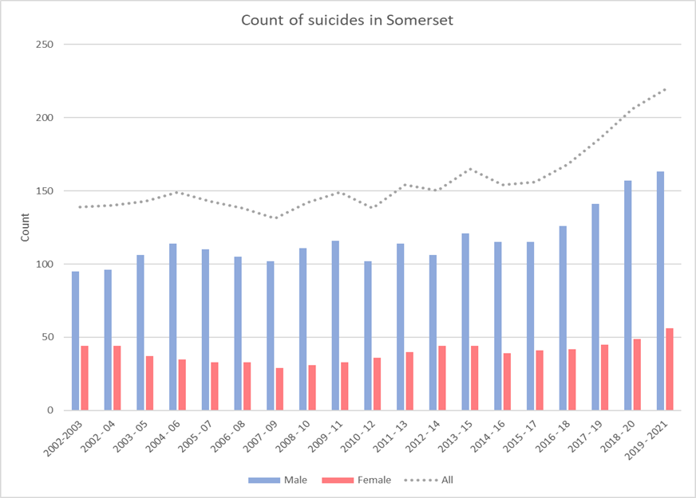
Suicide Prevention
Suicide is a major issue for society and a leading cause of years of life lost.
In Somerset, the suicide rate is 15.1 per 100,000, nationally it is 10.4 per 100,000 (2019-2021).
Suicide is preventable and every life lost is a tragedy.
Public Health work closely with partners across the system through the Multi-agency Suicide Prevention Partnership to reduce suicide in Somerset.
A key role of public health is to analyse suicide and suspected suicide data use this data to inform action to reduce suicide in the county through projects such as the Orange Button Scheme.

Slide 31
Mental Health Workshop
Current Commissioning and Future Intentions – Somerset Council
Current commissioning:
Individual placements in residential care homes, supported living services and domiciliary care where identified. This is where the majority of the Council’s spend sits.
The Mental Health Step Down service - current capacity in Yeovil and Wells.
Mental Wellbeing Service (part of Open Mental Health via Somerset NHS Foundation Trust).
The Council also contributes to the Mental Health Employment and Carers services provided by Somerset NHS Foundation Trust and the Family Safeguarding Service provided by Open Mental Health.
Future commissioning intentions:
Expand the Mental Health Step-Down service to include capacity in Taunton and Bridgwater, if funding can be secured.
Recommission Open Mental Health in partnership with NHS Somerset Integrated Care Board and Somerset NHS Foundation Trust.
Recommission the framework that we use to commission individual services, including expanding the availability of supported living services as an alternative to residential care.

Slide 32
Mental Health Workshop
What do we need from you
Consider Mental Health in everything you do, Parity of Esteem.
Consider the social determinants of mental health.
Consider how you can engaged and support those with mental health needs.
Having sat through this workshop what are your thoughts, reflections?

