Slide 1
People’s Stories
Case stories from individuals impacted through the My Life, My Future work

Slide 2
LD and PFA

Slide 3
Stacey’s* journey through an LD Peer Forum
Stacey* is a woman in her 30s living with Autism and generalised anxiety disorder. She currently lives with her mum and step-dad at their home in Yeovil.
Stacey has recently become quite isolated in her home environment, rarely engaging in activities or venturing outside. Her mum expressed that she’s very interested in how the outside world works however – spending much of her time online researching Politics, Philosophy and Religion.
The social worker assigned to Stacey’s case felt that she could benefit from someone visiting her for 10 hours a week to build her confidence. He wasn’t sure exactly how these hours could be best used so before putting this care in place, the social worker took Stacey’s case to an LD Peer Forum.
In this session, the social worker was able to draw on the experience of other practitioners and MDT peers, one of whom recommended bringing in a community agent to discuss what activities Stacey might be interested in within her local community. Once these activities were identified, around 5 care hours a week could then be built up around them to ensure the hours are targeted towards Stacey’s specific goals.
The social worker left with a clear plan on how to help Stacey achieve greater independence within her daily life, in a way that considers her individual needs and outcomes.
*anonymised

Slide 4
Sophie’s* Story
Sophie* is a woman in her 60s, currently living in a short-term Shared Lives placement in Bridgwater. She is an independent person who can meet most of her own needs with prompting, and she enjoys shopping, meeting her friends, and taking trips through her day services provision.
She moved into the Shared Lives placement on a temporary basis after facing abuse at home. The Shared Lives carer has expressed they are unable to care for her long term, and are keen to support her to find somewhere she can feel settled.
The social worker who took on Sophie’s case first looked at finding another placement through Shared Lives, but nothing suitable could be found in the area. Keen to find somewhere with a sense of community, he next considered Extra Care Housing or Supported Living, while organising an extension of Sophie’s short-term arrangement to ensure her immediate safety. Unsure exactly which route to go down, he brought Sophie’s case to an LD Peer Forum.
During the session, attendees gave steer saying that, as someone who values her independence and autonomy, Sophie wouldn’t be well suited to a Supported Living placement, being unlikely to utilise much of the wraparound support given in those settings. It was felt she just needed somewhere she could be around other people and gain that sense of community, with just a few hours of additional support each day prompting with basic needs.
Coming away from Peer Forum with a clear plan, the social worker got to work sourcing an Extra Care Housing placement. Sophie is due to move in this week, and feels excited about this next stage in her journey.

Slide 5
Reablement

Slide 6
Mary’s Reablement Journey
Mary* lives in a rural area of Somerset and was recently discharged from hospital into our D2A service, she was not physically able to wash & dress, independently transfer or perform any tasks in the kitchen. She was identified as needing a package of care and whilst she was waiting for an assessment for ongoing care, she was a member of our goals trial.
The goals trial involved a therapist completing a task analysis digital form which broke down Mary’s reablement goals into a more granular level. This break down was available to the enablers who were visiting Mary each day, they could see how independent Mary was with each step on her previous visit and could update how she had progressed on each new visit. Mary’s case manager was then able to see how she was progressing day by day.
As the days progressed, Mary became more and more independent. Her 4 visits a day was gradually stepped down to 2 visits a day. Once Mary had achieved her goals of transferring with physical assistance, her goals were reset, and enablers were able to continue working with her using the form to progress each part of her goals. By the end of her time in the service, Mary was able to transfer more independently with the support of equipment.
Having shared visibility of goals, steps to achieve these and Mary’s progress available to all professionals involved in Mary’s care enabled everyone to work together to further increase Mary’s independence.
“I can see progress and make decisions with confidence and evidence” – Provider Case Manager
*anonymised

Slide 7
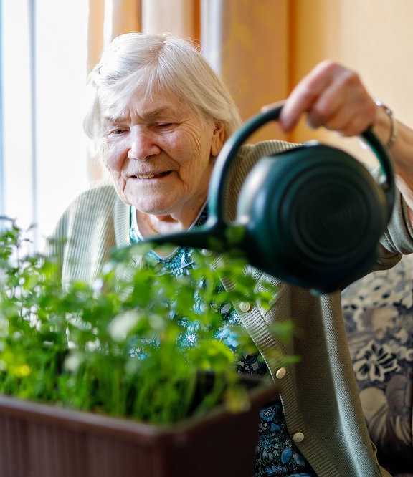
Maddie’s Reablement Journey
Maddie came onto our service in late September needing 4 visits a day. She had identified multiple ambitious goals to work on to build up towards living independently. Throughout Maddie’s time in the service, her reablement provider gave regular updates on Maddie's progress against her goals in cluster calls (regular team meetings) and along with her assigned key worker, actions were agreed to support Maddie’s progress, remove any blockers and delays and continue to increase her independence. For example, when Maddie had progressed with her goals for specific reablement visits and they were no longer required, it would be agreed to remove them.
The provider, key workers and other professionals met regularly during cluster calls to discuss Maddie’s progress, supported by a central excel to record up to date information and any actions taken. When the wrong medication was supplied, the provider was able to flag this quickly, and the key worker worked with a village agent to correct the medication and minimise the impact to Maddie. As more of Maddie’s visits were stepped down, it was noted that she was struggling to remember to take her medication, again this was flagged quicky and the key worker worked with a pharmacy technician to source a blister pack.
When it was discussed, that Maddie was managing fully independently apart from weekly shopping, her key worker took the action to explore support with this. Shortly after which a microprovider was sourced to help Maddie with her shopping and she was discharged without any formal support having achieved all of her reablement goals.

