Slide 1
Health Check 2022
Carolyn Smith, Principal Social Worker (Adults)

Slide 2
Health Check background
In 2020 the Local Government Association published employer standards for employers of social workers in adult and children’s services.
The Health Check asks Social Workers to rate their employer against each of the standards.​
In 2022, the Health Check was broadened to include non-registered practitioners and occupational therapists.
Survey questions were different for different staff groups.

Slide 3
Employer Standards for Social Workers
Standard 1 - Strong and clear social work framework
Standard 2 - Effective workforce planning systems
Standard 3 - Safe workloads and case allocation
Standard 4 - Wellbeing
Standard 5 - Supervision
Standard 6 - Continuing professional development (CPD)
Standard 7 - Professional registration
Standard 8 - Strategic partnerships – includes partnerships and collaboration between employers, HEIs and other training providers

Slide 4
Survey domains for ASCPs
Health and wellbeing
Smarter working

Slide 5
Survey dates
Employers selected a window to run the survey between 17 October and 20 January.
ASC launched the survey in the Carnival of Practice. The window for workforce responses was 9 to 30 November. ​
No national/regional data yet for benchmarking.

Slide 6
Responses
2020 - 36 social workers
2021 – 37 social workers
2022
66 social workers (adults)
19 social workers/AMHPs (mental health)
19 OTs
65 ASCPs (adults)
6 ASCPs (mental health)
Total – 175
Reports received to date are for social workers (adults) and ASCPs (adults) only.

Slide 7
2021 results (social workers only)

Slide 8
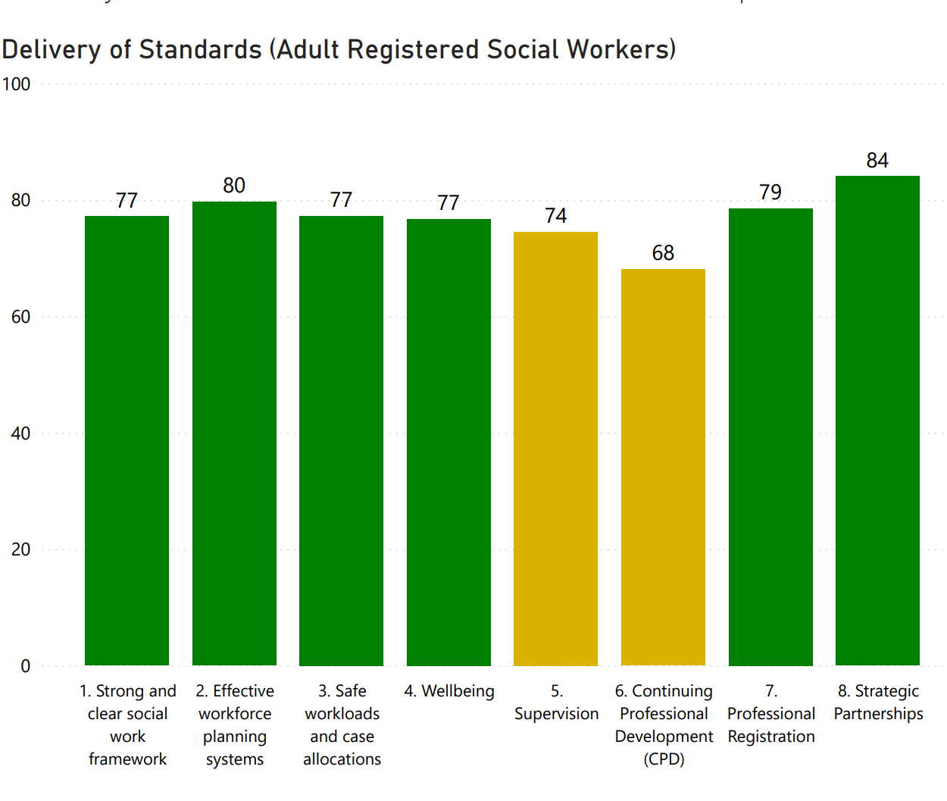
2022

Slide 9
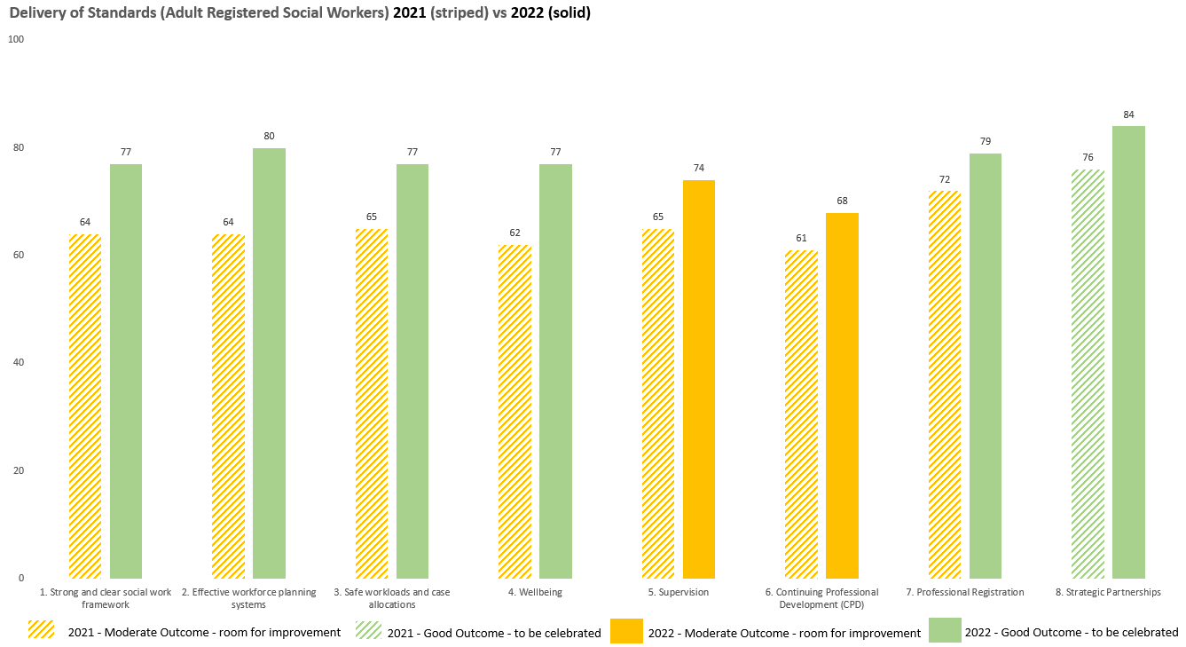
Comparison 2021/22 results

Slide 10
Areas for development and improvement

Slide 11
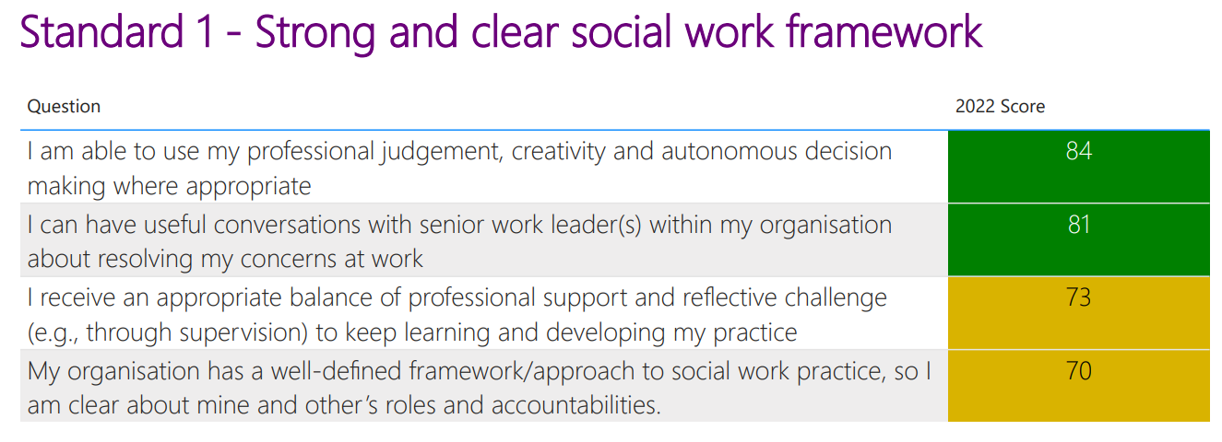
Areas for development within individual standards

Slide 12
Areas for development: Amber domains within ‘green’ outcomes
Standard | Area for development | What we are doing | Further actions needed – see slide 23, action 6
1 | Professional support and reflective challenge | Enhanced Peer Forum Monthly CPD/reflective sessions New Practice Development posts | Yes
 | Well-defined framework/approach to social work practice | Practice Quality Framework re-launch – strengths and relationship-based, co-production, neighbourhoods Embed through every conversation including peer forums, CPD and reflective practice sessions.
2 | Barriers and challenges getting in the way of best work | Workforce re-structure | Yes
3 | Managing the demands of casework and having resources needed | Recruitment and retention International recruitment Restructure Digital front door
4 | Encouraging workforce to make time for self-care and wellbeing |  | Yes
 | Recognition of emotional demands of social work and providing supervision, support and tools needed | Development of post-incident support Psychological safety work | Yes
 | Taking action to deal with risks of violence, bullying and harassment | People Safe devices | Yes

Slide 13
Areas for development Amber domains within ‘green’ outcomes
Standard | Area for development | What we are doing | Further actions needed – see slide 23, action 6
7 | Organisational support for challenging unsafe practice and reporting concerns | Learning review process following incidents to launch in April 2023 | Yes
 | Organisational support for keeping CPD up to date on the SWE website | To be supported by Practice Development Leads from April 2023. Approach to be agreed with Operational Managers and PSW. | Yes
 | Organisational understanding, support and provision of conditions for meeting professional standards |  | Yes

Slide 14
Areas requiring improvement ‘Orange’ outcomes
Standard | Area for development | What we are doing | Further actions needed – see slide 23, action 6
5 Supervision | Promoting professional judgement, creativity and autonomous decision-making in supervision | Supervision audit Post Qualifying Standards for supervisors
 | Critical reflection in supervision on work including relationships, emotions, evidence, theory and approaches | Supervision audit Post Qualifying Standards for supervisors
 | Reflecting about how professional standards are met in supervision | Post Qualifying Standards for supervisors
6 CPD | Dedicated time, resources and opportunities for CPD including recording in line with regulatory requirements | Competency Framework Monthly CPD sessions Practice development lead posts | Yes
 | Effective induction for all new social workers | Re-launch and embedding of induction
 | Access to funded non-mandatory CPD | Competency Framework
 | Updated Professional Development Plans | Review of appraisal and PDPs

Slide 15
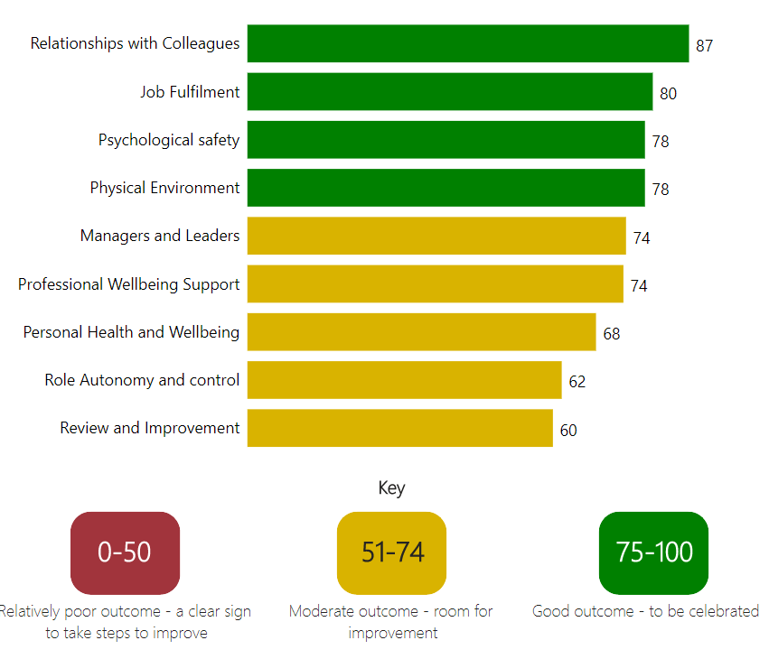
ASCP results

Slide 16
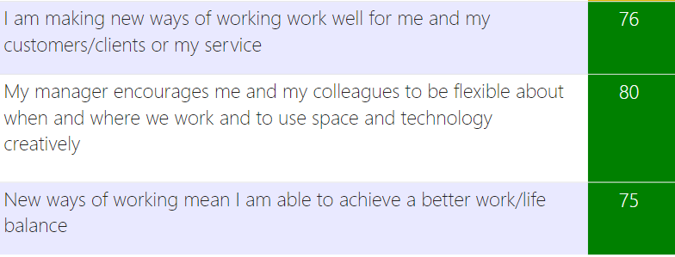
ASCP results to celebrate

Slide 17
Areas for improvement
Domain | Score | Area for improvement | What we are doing | Further actions needed – see slide 23, action 6
Health and wellbeing | 73 | Sufficient materials and equipment to undertake work | Restructure | Yes
 | 52 | Senior managers seek views on decisions that affect work and wellbeing |  | Yes
 | 70 | Feeling positive and able to cope with work most of the time |  | Yes
 | 67 | Making time for self-care and wellbeing is encouraged |  | Yes
 | 69 | Access to facilities (space, refreshments) for rest/recovery during the working day |  | Yes
 | 73 | Wellbeing support is readily available | Development of post-incident support | Yes
 | 60 | The organisation is serious about improving health and wellbeing | Psychological safety work | Yes
 | 60 | I can make improvements happen in my area of work |  | Yes
 | 63 | Changes have made it harder to do my job |  | Yes
Smarter working | 56 | Lack of organisational/managerial support for new ways of working |  | Yes

Slide 18
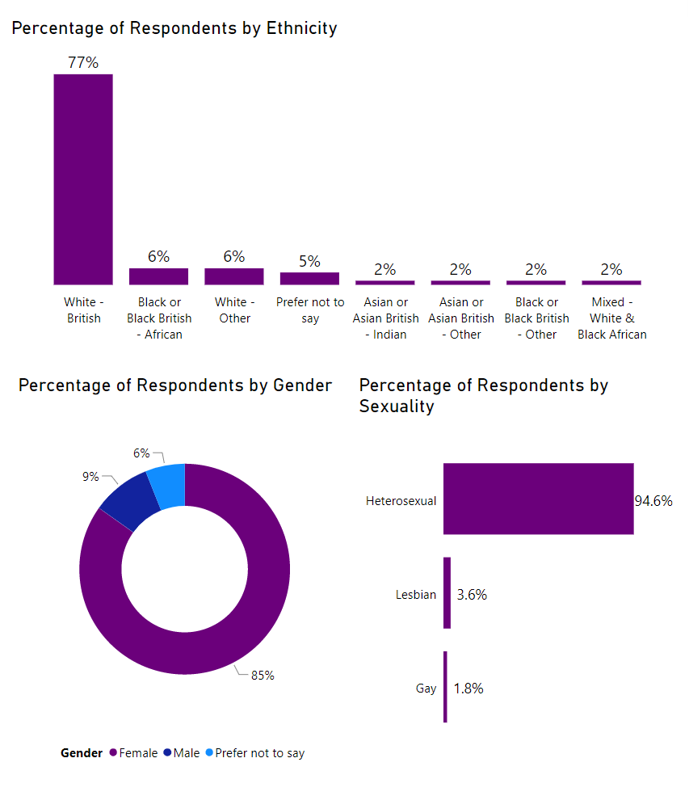
Demographics: Social Workers

Slide 19
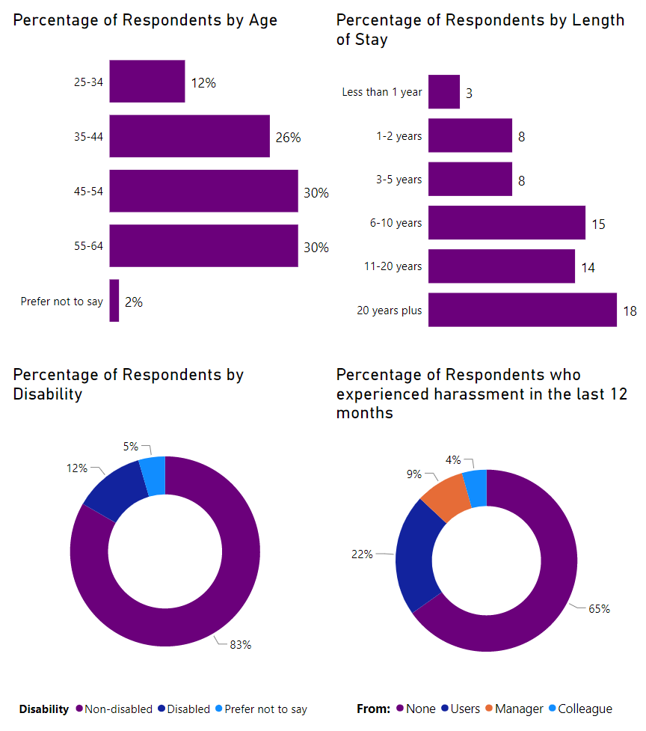
Demographics: Social Workers

Slide 20
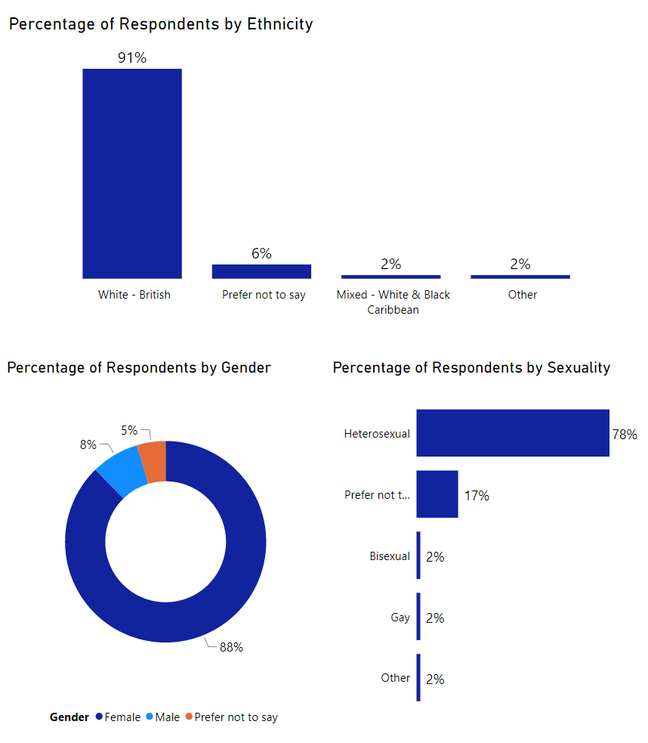
Demographics: ASCPs

Slide 21
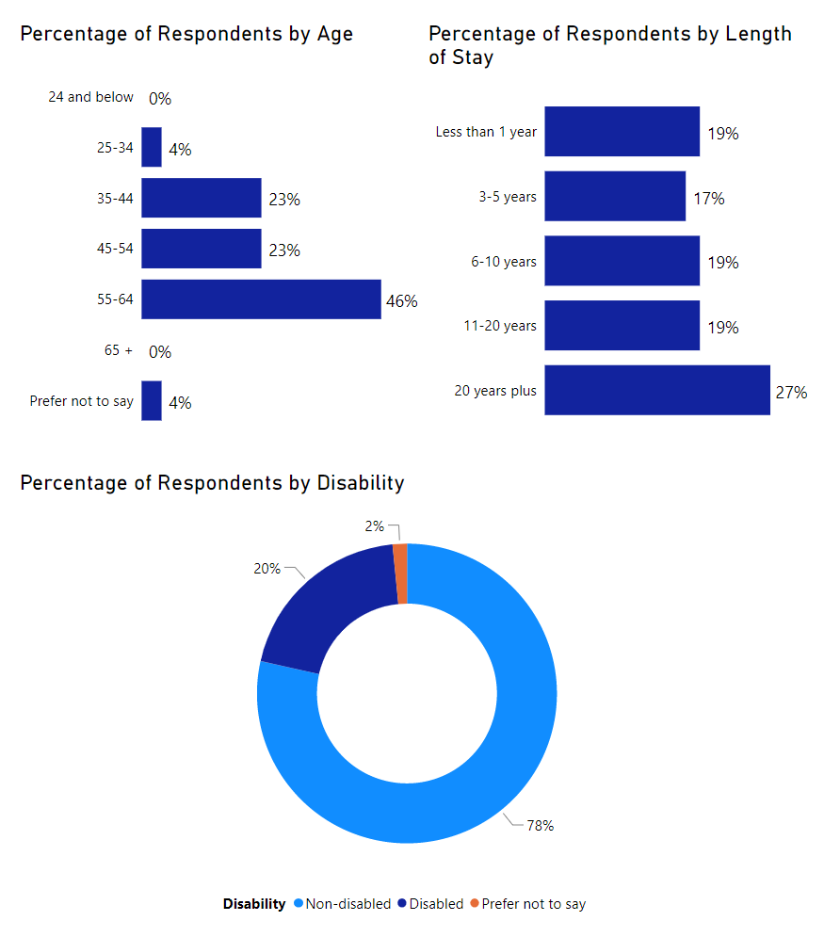
Demographics: ASCPs

Slide 22
Priorities for improvement
Supervision
CPD
Health and wellbeing
Smarter working - organisational/managerial support for new ways of working

Slide 23
Suggested next steps
Action | Responsibility | Timescale
1. Obtain reports for other staff groups (MH and OTs) | Sean Taylor | 31 January 2023
2. National/regional benchmarking when data is available | Sean Taylor | 31 March 2023
3. Update presentation with MH, OT and benchmarking data | Carolyn Smith | 31 March 2023
4. Share initial Health Check findings with workforce via The Loop, Highlight Report and the February Q&A and invite participation in action 6 | Carolyn Smith | 28 February 2023
5. Cross reference existing actions to Workforce Board Action Plan | Carolyn Smith/Claire Anderson | 6 February 2023
6. New actions to be: Co-designed with workforce ‘focus groups’ (links to Health and Wellbeing domain) Discussed at Workforce Board, and Integrated into Workforce Board Action Plan | Carolyn Smith | 31 March 2023

Slide 24
Actions for co-design workshops

