Slide 1
ASC Deep Dive 2024/25

Slide 2
Contents
What our data is telling us
Cost of Care
MTFP – 2024-2025
Saving Options
Summary

Slide 3
What’s Our Data Telling Us

Slide 4
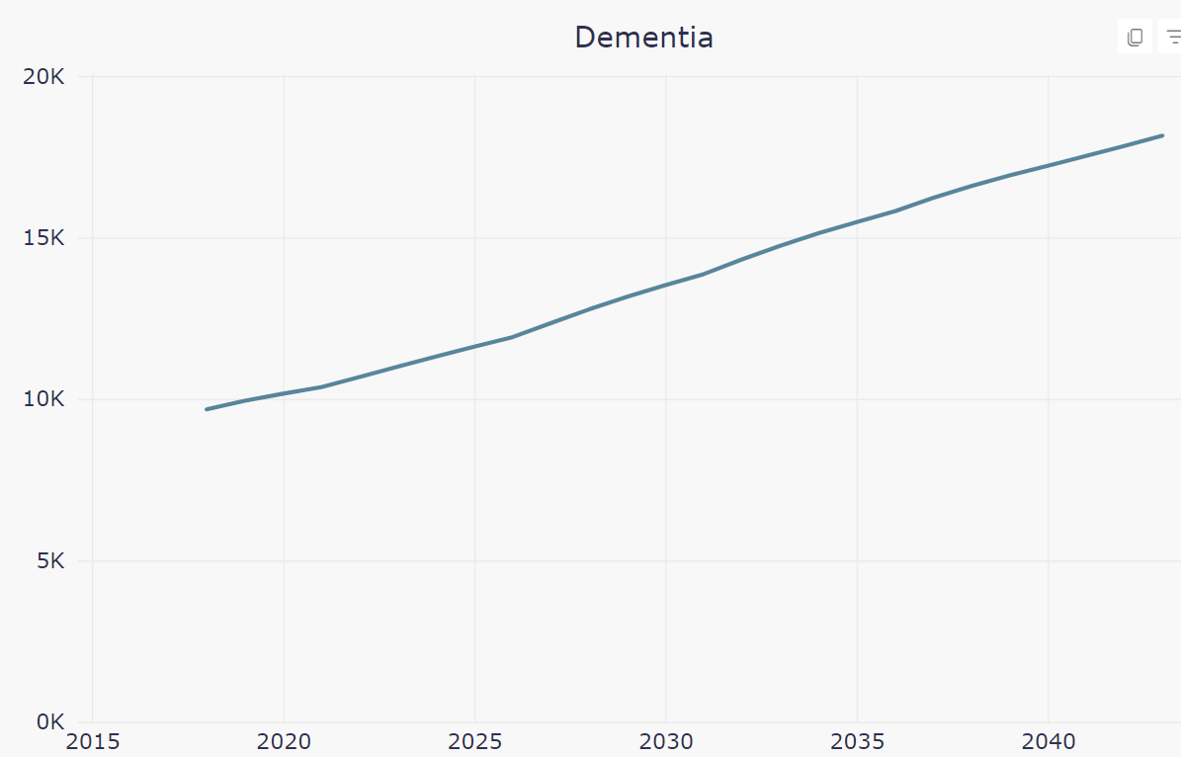
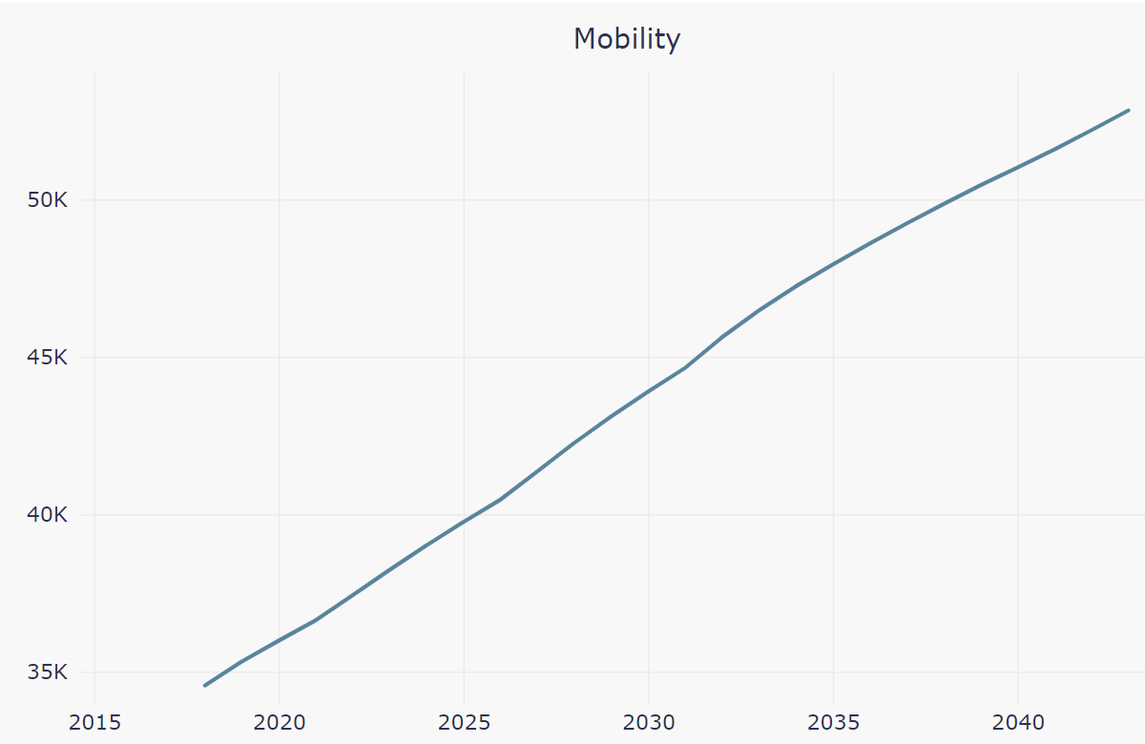
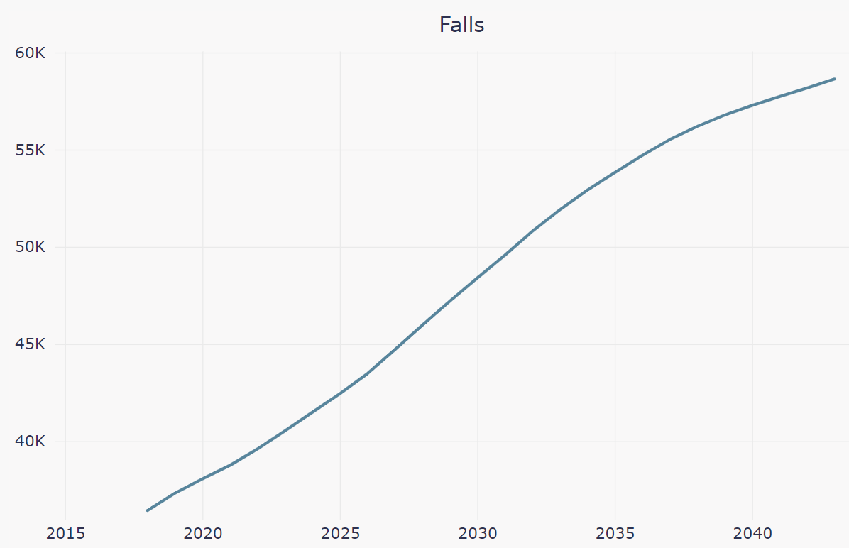
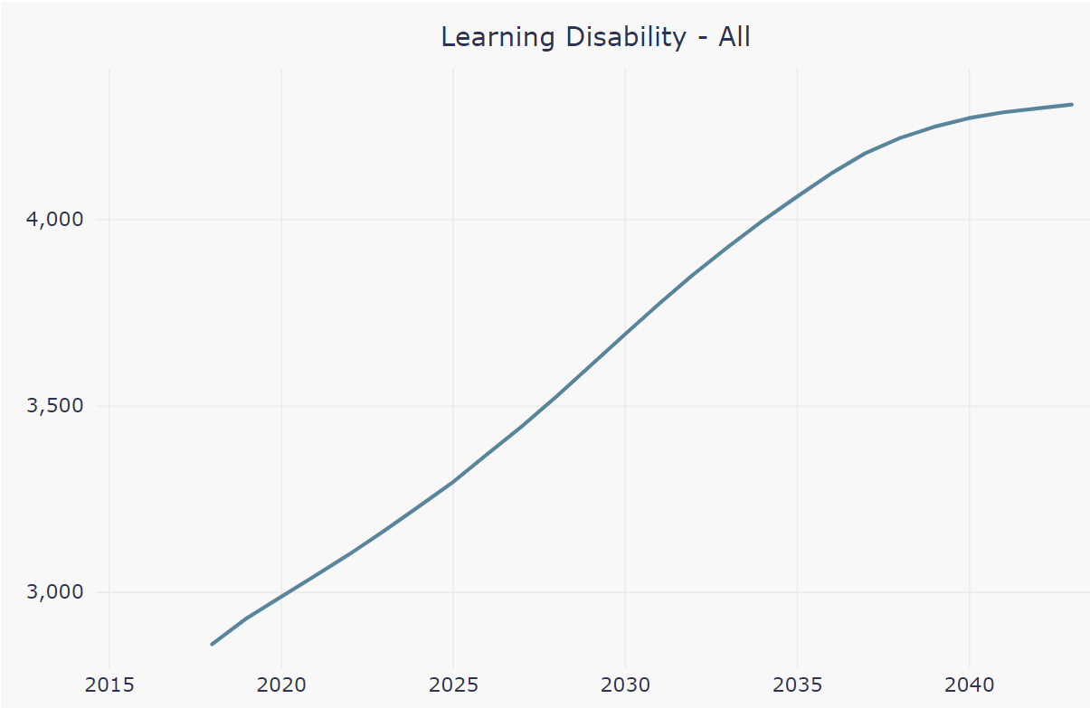
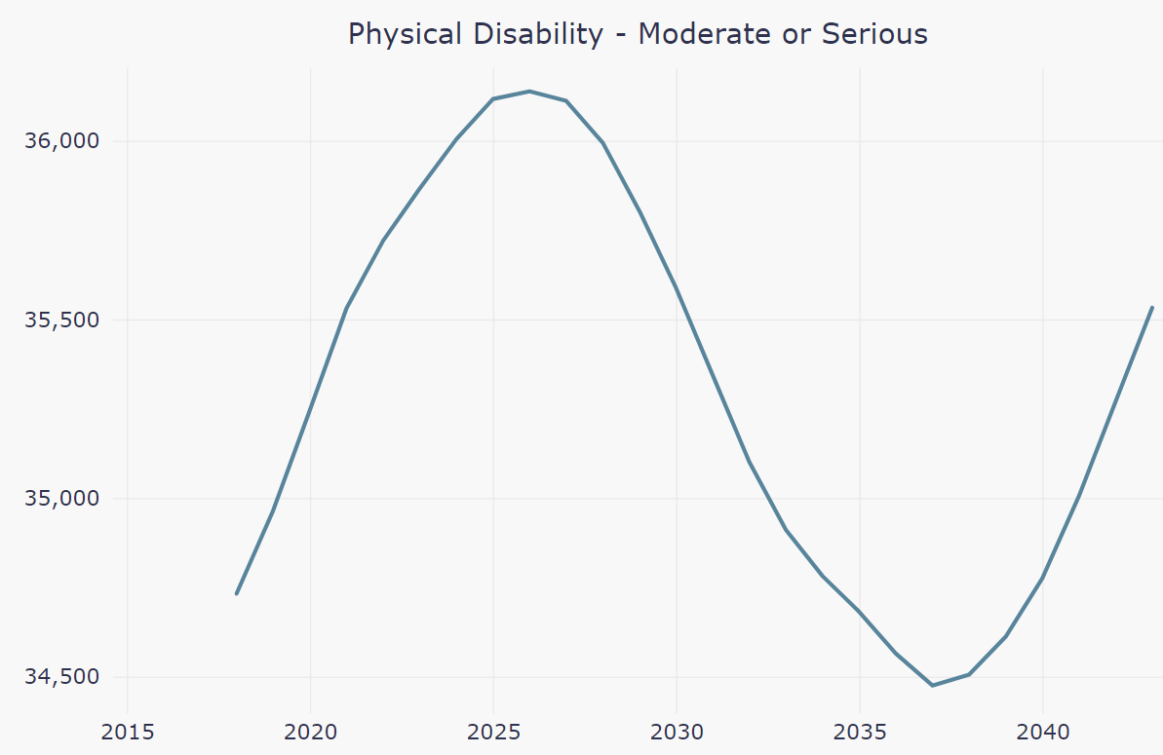
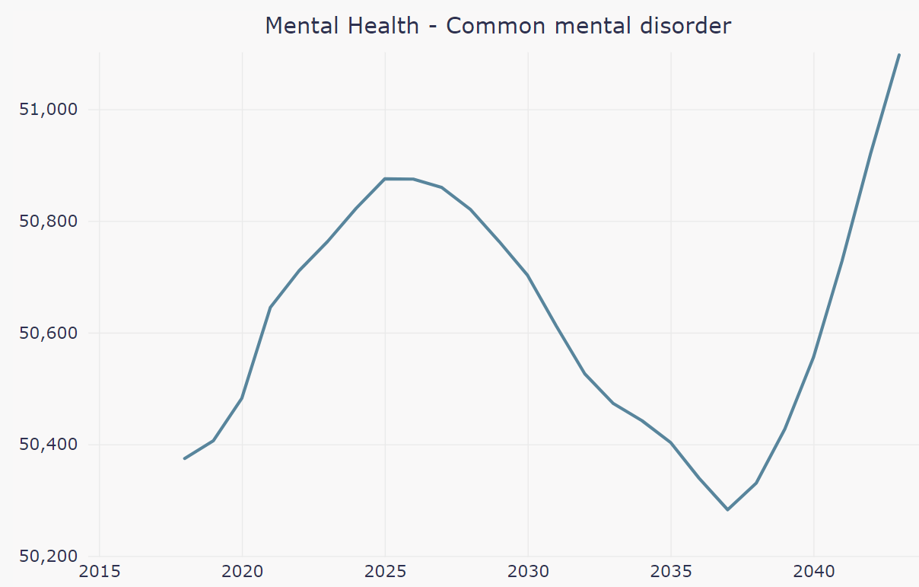
Population Projections,
Population and Prevalence - Power BI
Notes:
This is from PAMMS might be useful. If tech works can use click and interactive charts.

Slide 5
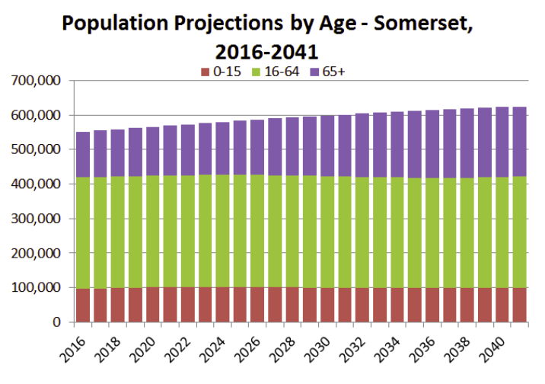

Slide 6
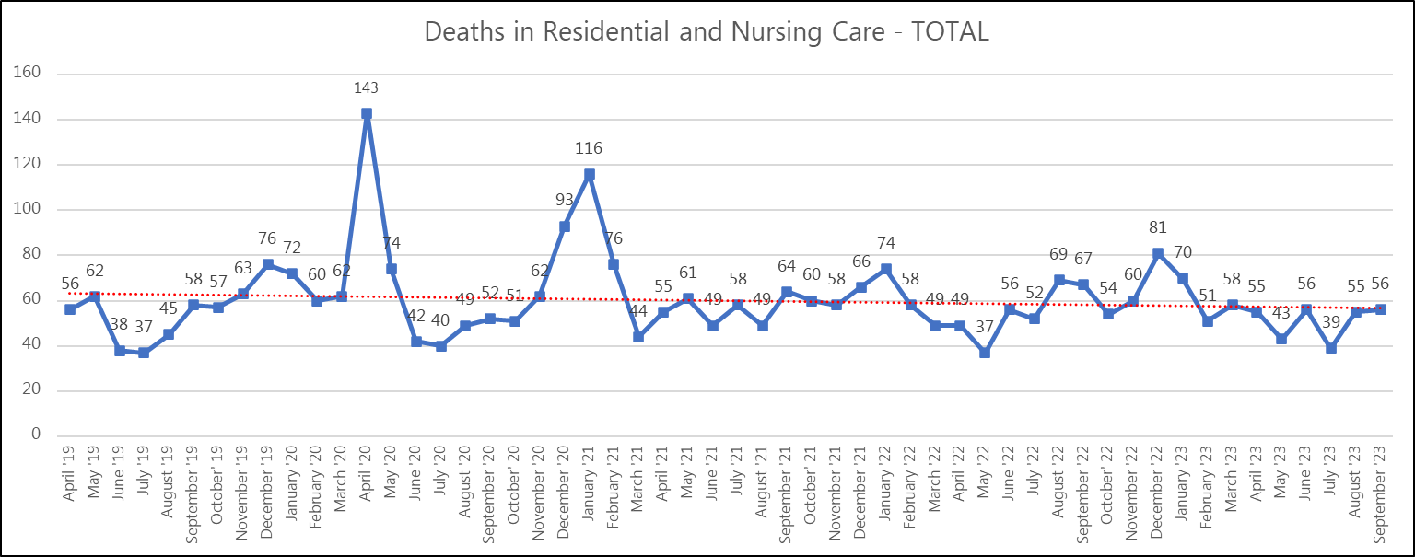
The number of Deaths in Residential and Nursing Homes.
Spikes in April ‘20 and January ‘21 clearly evidence the impact of the pandemic.

Slide 7
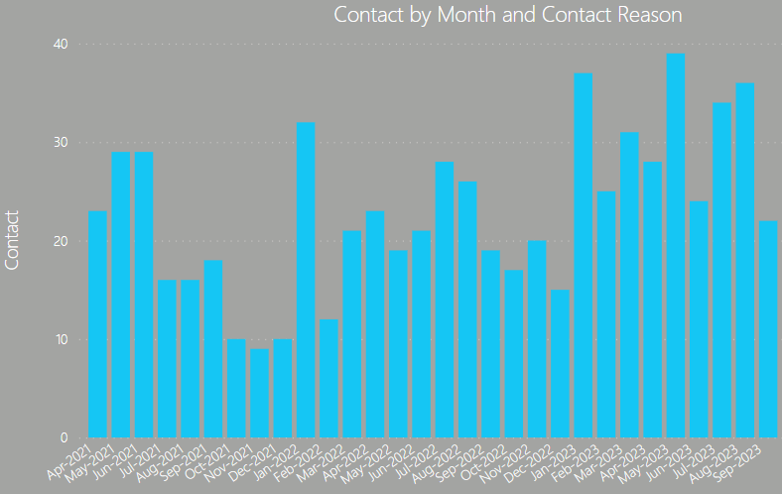
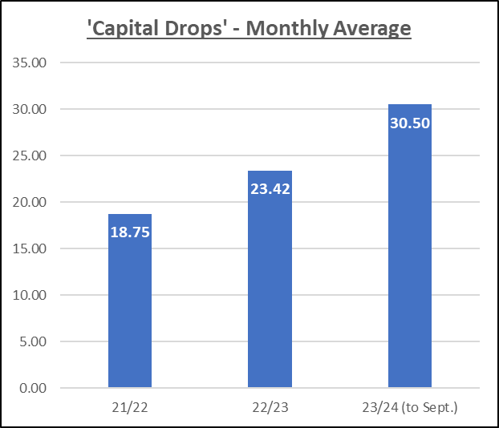
Contacts received from ‘Self funders with depleted funds’ (‘Capital Drops’)

Slide 8
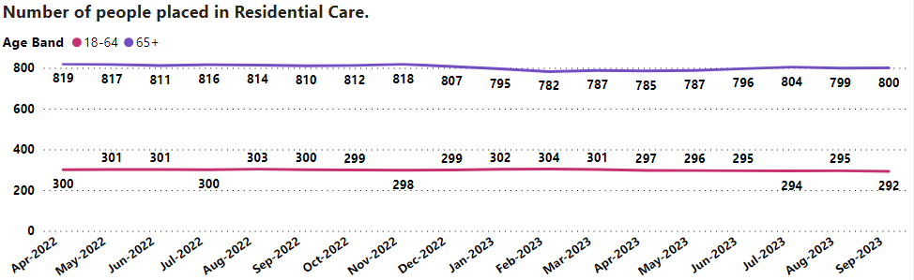
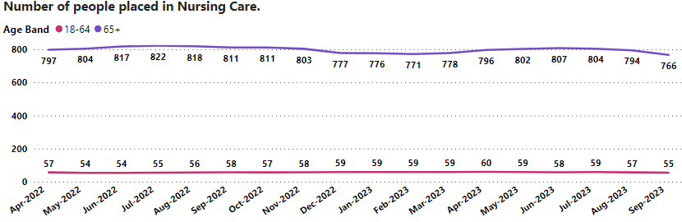
The Number of Open Placements and the Average Length of Service.
At the end of September 2023 there were 1,092 people placed in Residential Care.
The average length of current service is 4 years.
At the end of September 2023 there were 821 people placed in Nursing Care.
The average length of current service is 2 years and 8 months.
Notes:
Of the 1066 people placed in residential care, the average length of service is 4 years.
Of the 842 people placed in nursing care, the average length of service is 2 years and 8 months.

Slide 9
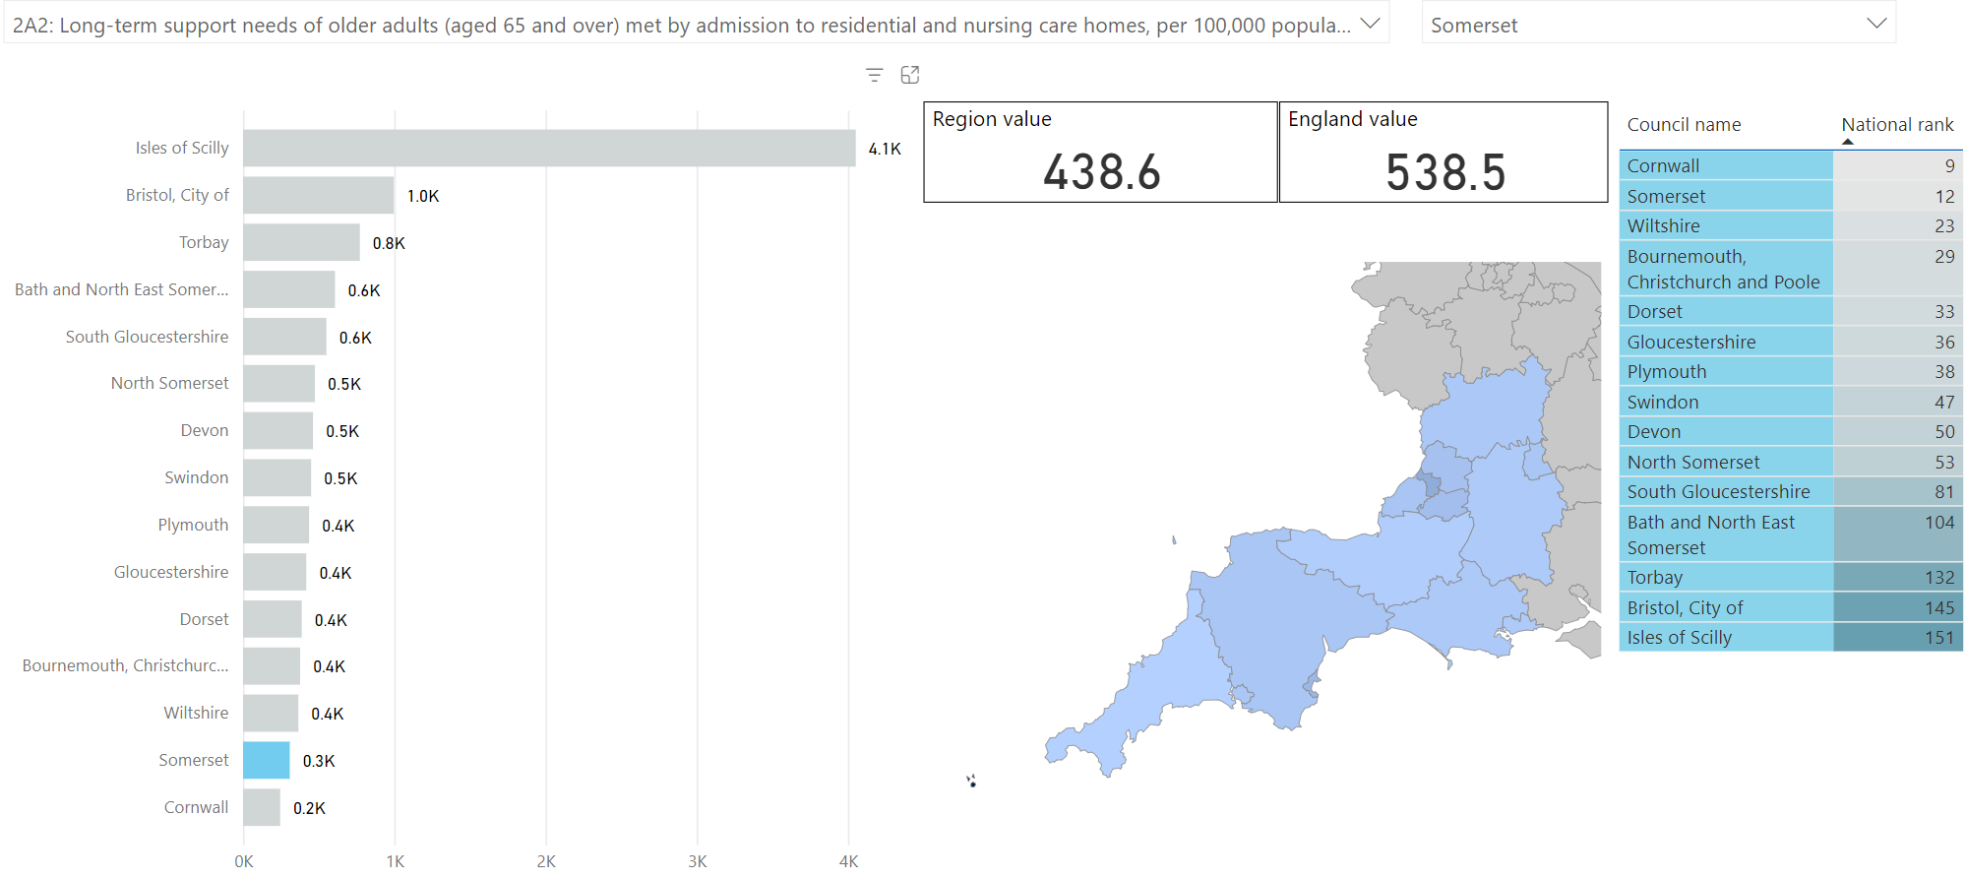
South West Comparison 2021/22
ASCOF 2A(2) - Long-term support needs of older adults (aged 65 and over) met by admission to residential and nursing care homes, per 100,000 population. (lower is better)
Microsoft Power BI link to interactive report
Notes:
These are 2021/22 comparisons. 2022/23 provisional results aren't as good but still better than 21/22 regional and national averages.
SW as a region perform well for this measure.

Slide 10
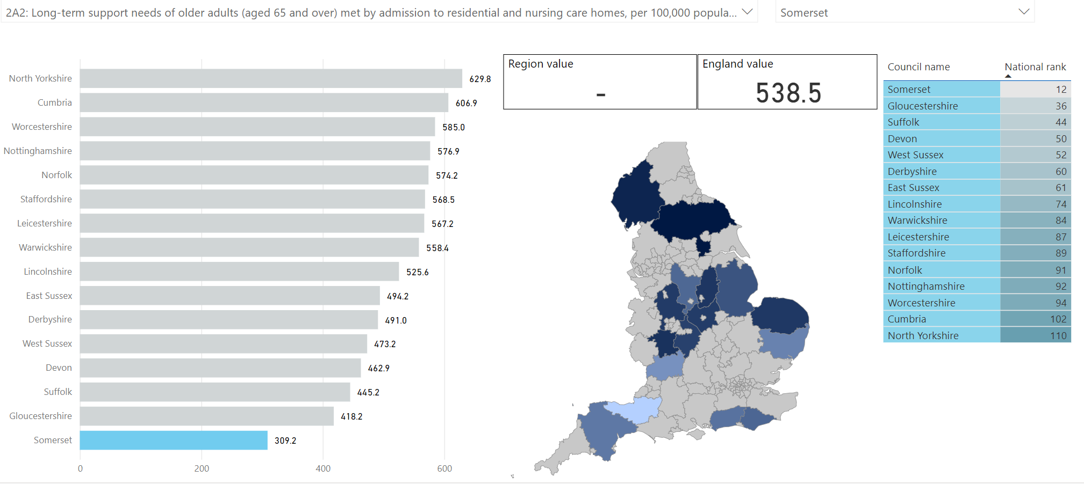
CIPFA Comparison 2021/22
ASCOF 2A(2) - Long-term support needs of older adults (aged 65 and over) met by admission to residential and nursing care homes, per 100,000 population. (Lower is better)
Microsoft Power BI link to interactive report

Slide 11

South West Comparison 2021/22
ASCOF 2A(1) - Long-term support needs of younger adults (aged 18-64) met by admission to residential and nursing care homes, per 100,000 population. (Lower is better)
Microsoft Power BI link to interactive report

Slide 12
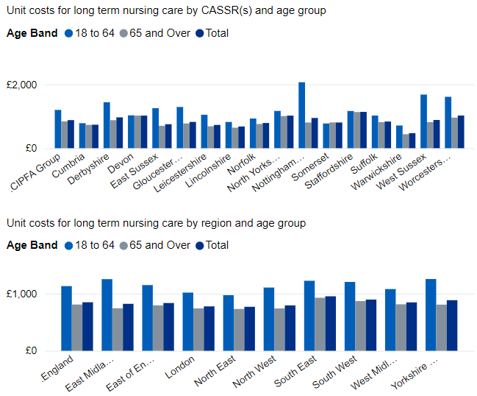
CIPFA Comparison 2021/22
ASC-FR (T10) - Unit costs for clients accessing nursing long term care, by age band (£ per week)
Microsoft Power BI link (T10)
Notes:
CIPFA- Nearest statistical neighbours. The Chartered Institute of Public Finance and Accountancy.
This information is derived from the adult social care finance return. (ASC FR)

Slide 13
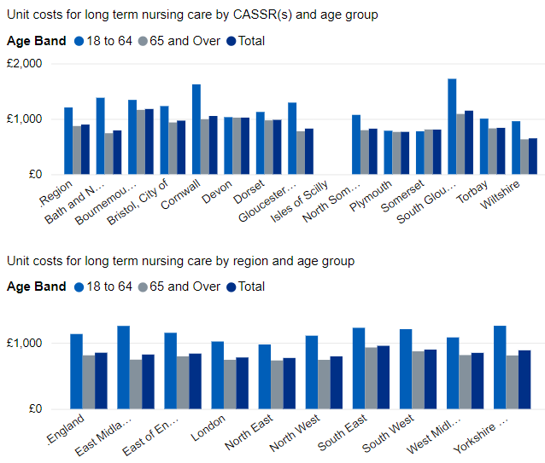
South West Comparison 2021/22
ASC-FR (T10) - Unit costs for clients accessing nursing long term care, by age band (£ per week)
Microsoft Power BI link (T10)

Slide 14
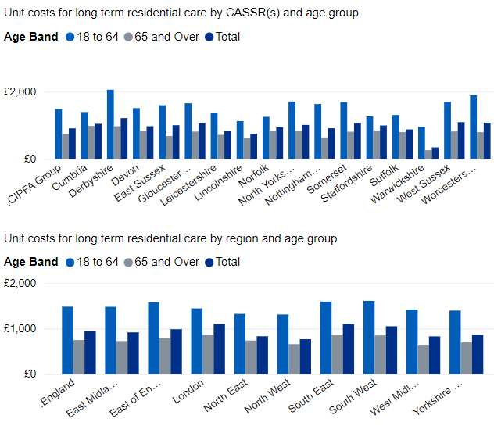
CIPFA Comparison 2021/22
ASC-FR (T11) - Unit costs for clients accessing residential long term care, by age band (£ per week)
Microsoft Power BI link (T11)

Slide 15
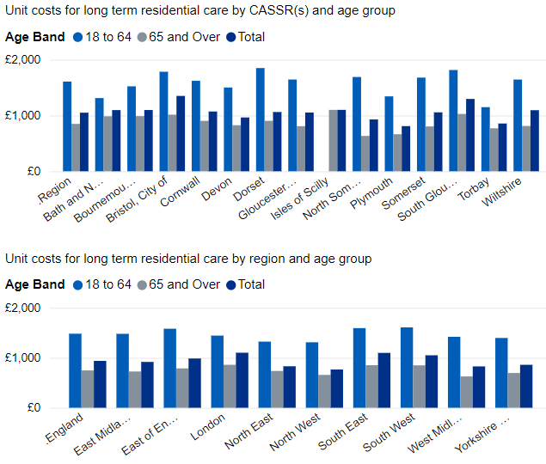
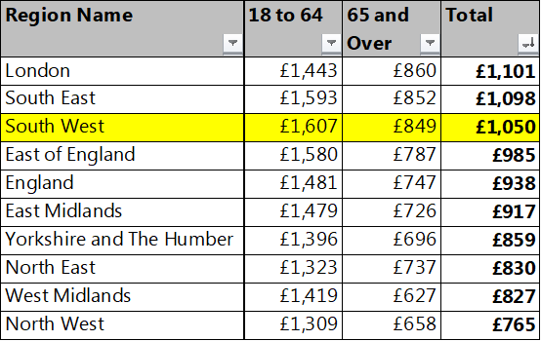
South West Comparison 2021/22
ASC-FR (T11) - Unit costs for clients accessing residential long term care, by age band (£ per week)
Microsoft Power BI link (T11)

Slide 16
Demographic
Local Authority | All persons | Percentage of population aged over 65 years
Dorset Council | 379,600 | 29.58%
Torbay Borough Council | 139,300 | 26.70%
Devon County Council | 811,600 | 25.80%
Cornwall Council | 570,300 | 25.28%
Somerset County Council | 571,600 | 24.83%
North Somerset Council | 216,700 | 24.00%
Wiltshire Council | 510,400 | 21.87%
Gloucestershire County Council | 645,100 | 21.69%
Bournemouth, Christchurch and Poole Council | 400,300 | 21.58%
Bath and North East Somerset Council | 193,400 | 19.34%
Council of the Isles of Scilly | 2,100 | 19.05%
South Gloucestershire Council | 290,400 | 18.63%
Plymouth City Council | 264,700 | 18.47%
England Average | 10,401,200 | 18.41%
Swindon Borough Council | 233,400 | 15.90%
Bristol City Council | 472,400 | 12.87%

Slide 17
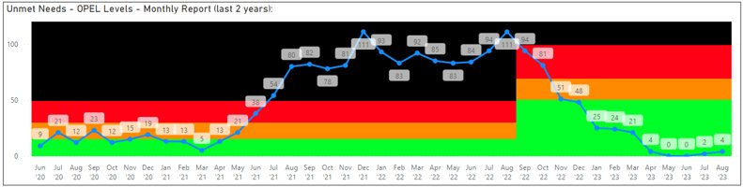
Unmet need (homecare provision)
Somerset has continued to see the impact of additional investment and focused commissioning activity, as well as some pick up in care provider recruitment of new starters over recent months, with levels of unmet homecare need falling to their lowest ever levels since March 2021. This significantly improved picture is partly consequent to:​
Homecare pods funded by system – supported stimulation of the market (5 pods of 200hrs)​
Fee increase 2023/24 to £25 per hour – has enabled providers to pay above national minimum wage, offer contracted hours and improved term and conditions.​
Oversea recruitment and focussed Proud to Care marketing has stimulated recruits coming into homecare market. ​
​
OPEL thresholds were revised in September 2022 to reflect the national care supply challenges / market position.

Slide 18
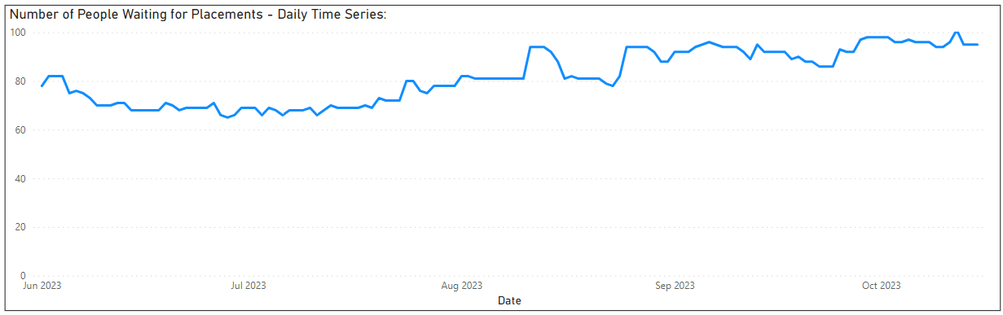
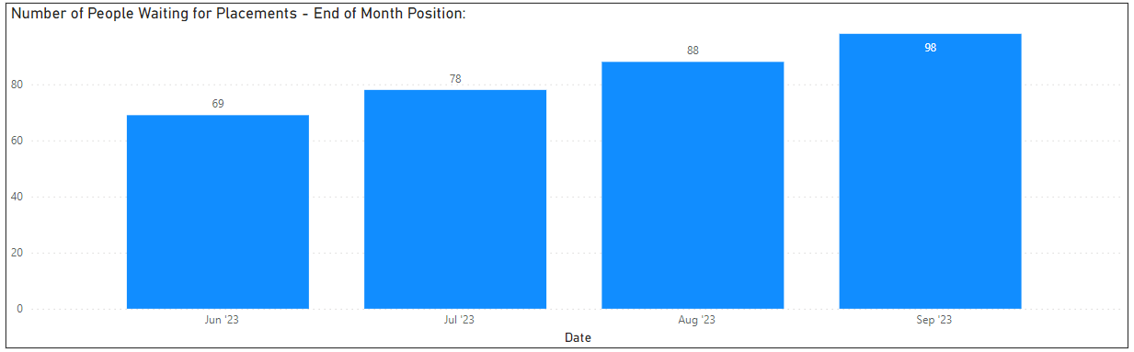
Unmet need (residential and nursing)
Time series showing number of people waiting for placements in residential and nursing care (including OPMH, Residential Dementia etc.)
Month end position highlights the increasing trend in the number of people waiting for a residential/nursing placement.

Slide 19
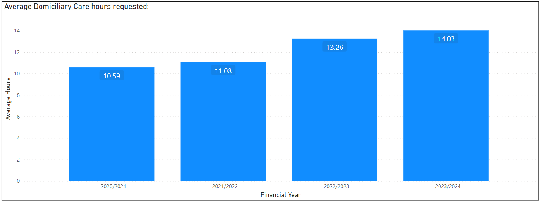
Homecare – average package size
Complexity has increased – evidenced by the increased average number of hours per homecare package,
Between 2020/21 and 2023/24 the average package size has increased by nearly 33%.

Slide 20
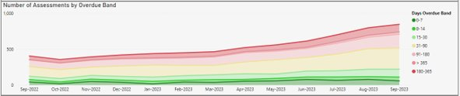
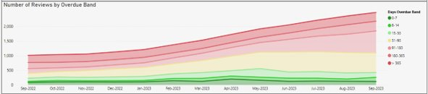
Overdue Care Act assessments & reviews
The number of overdue assessments and reviews continue to remain high, impacted by rising demand, complexity of need and ongoing internal workforce pressures.
A weekly Operational Assurance Group has been established to provide a strategic overview on the completion of assessments and reviews in operational teams, and to support reduction of backlogs through close monitoring of trajectories and regular reporting to governance/assurance boards, including the Safeguarding Adults Board.
For context, between April and August 2023, a total of 1,647 Care Act Assessments were completed - an average of 329 per month.
Between April and August 2023, a total of 2,123 Reviews were completed - an average of approx. 425 per month.

Slide 21
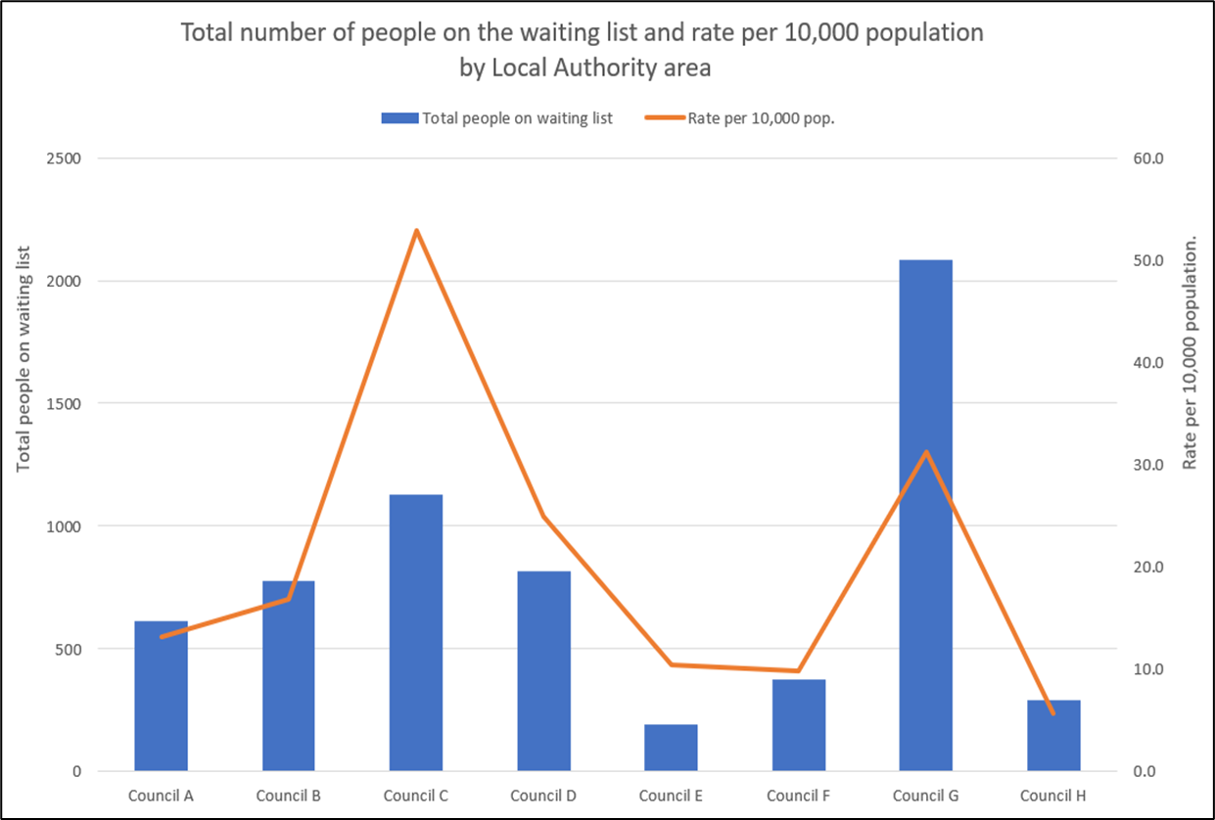
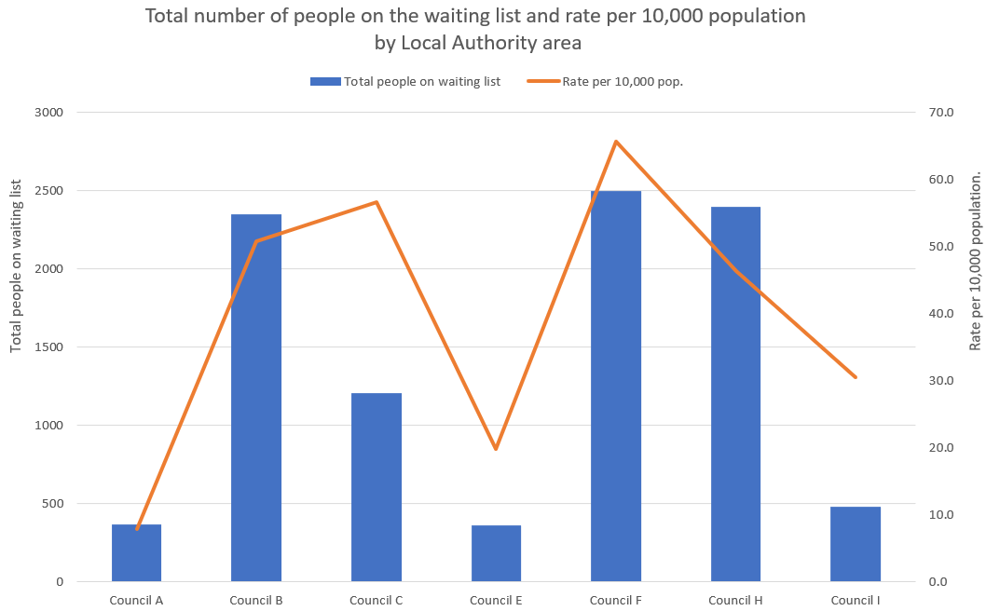
Overdue Care Act assessments & reviews – regional survey
Responses were received from 9 Councils across the South West. Data has been anonymised – Somerset are Council B
Care Act Assessments
Reviews

Slide 22
Cost of Care

Slide 23
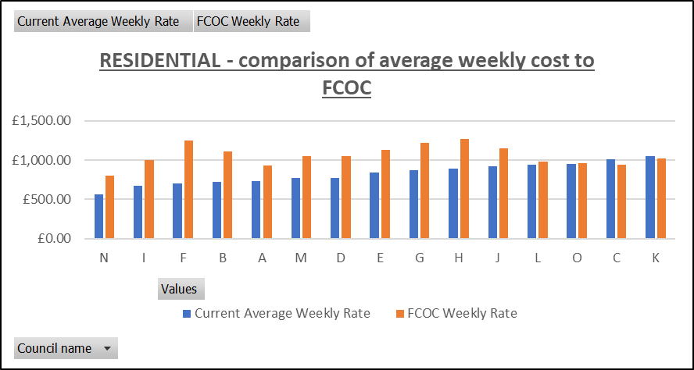
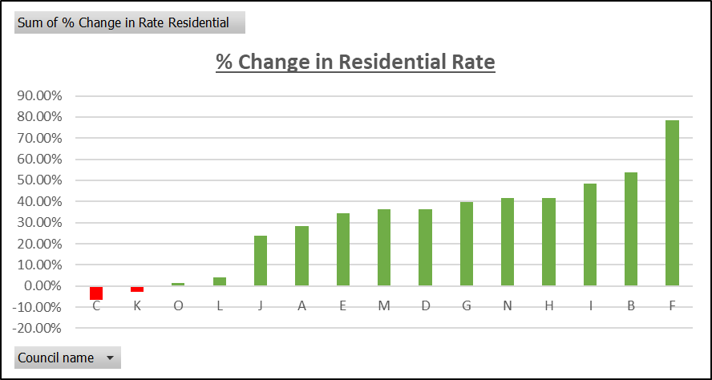
Fair Cost of Care Results: Residential
Current | Full Fair Cost |  | FY23/24 Proposal
Current rate/wk | FCoC rate | % increase | Proposed for Y1 | % increase for Y1
£674 | £1,000 | 48.4% | £800 | 18.7%
Current annual spend (net) | Additional annual spend if increase to full fair cost |  | Additional spend for 23/24 if increase to year 1 level (full year)
£54.7m | +£17m |  | +£7.8m
South West Comparison
Average
Average
Somerset
Residential care sees the biggest % change for Somerset due to our historically low rates.
Despite a 48% uplift, the rates will still remain below the new average for residential care across the South West.
Average
Somerset

Slide 24
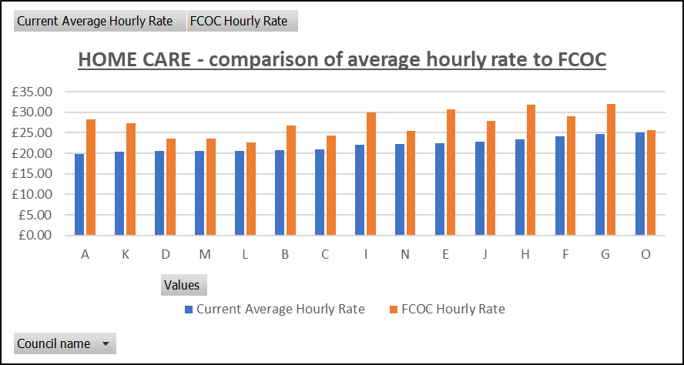
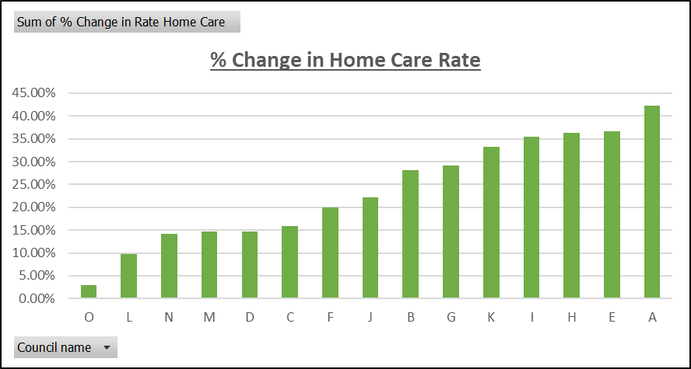
Fair Cost of Care Results: Home Care
Current | Full Fair Cost |  | FY23/24 Proposal
Current rate/hr | FCoC rate | % increase | Proposed for Y1 | % increase for Y1
£22.16 | £30.00 | 35.4% | £25.00 | 12.8%
Current annual spend (net) | Additional annual spend if increase to full fair cost |  | Additional spend for 23/24 if increase to year 1 level (full year)
£25m | + £9.5m |  | +3.4m
South West Comparison
Average
Average
Somerset
Key Risk: If the uplift to full fair cost is phased over 3 years but the full threshold change occurs in year 1, then the self-funder subsidy will decrease faster than the rate increases. This is particularly risky in the home care market as most self-funders in their own homes will become funded individuals from October 23.
Average
Somerset is currently paying average rates for home care when compared with South West. The FCoC result shows this moving above the new average, largely due to the rural nature of somerset. This is similar to other rural authorities.
Somerset

Slide 25
MTFP
2024-25

Slide 26
Placement No’s/Fees

Slide 27
Adults Budget
Current
Statutory Care & Support Budget
£271.5m
93%
Staffing Budget
£18.5m
6%
Commissioning Budget
£2m
1%
Income/Grant Budget
£105m
Proposed
Statutory Care & Support Budget
£356.4m
94%
Staffing Budget
£18.9m
5%
Commissioning Budget
£2m
1%
Income/Grant Budget
£115.7m

Slide 28
Assumptions

Slide 29
2024/25 – current advice: two scenarios based on whether the final NLW increase is at the target or higher
 | “Central” NLW | Higher NLW
NLW | 7.1% | 9.7%
CPI | 2.7% | 2.7%
Overall | 5.78% | 7.60%
Notes:
The Low Pay Commission is consulting on an increase in the National Living Wage between £10.90 and £11.43, with a central estimate of £11.16.
https://www.gov.uk/government/consultations/low-pay-commission-consultation-2023
The central estimate (£11.16) would mean an increase of 7.1%.
The higher figure (£11.43) would be an increase of 9.7%.
CPI figure taken from the Bank of England.

Slide 30
My Life, My Future
Modelled as reductions against budget, assume forecast growth is accurate
 | Opportunity | Outcomes / operational impact | Key metric impacted | Opp.
Older Adults | Prevention (or delay) of social care need from escalating to the point of requiring formal support. | More people able to live independently in the community | Reduced hours of homecare Reduced resi/nursing starts | TBC
 | Outcomes from decision making | Increased use of more creative alternatives to formal support | Reduced hours of homecare Reduced S-D.S Packages Reduced resi/nursing starts | £2.2M
 | Short term services (including D2A / reablement) effectiveness and efficiency. | More people accessing short term services (who need it) Greater effectiveness of short term services | Increased reablement finishers Reduced hours of homecare | £7.0M
 | Discharge to assess / intermediate care optimisation. | More people going home after a stay in hospital | Reduced resi/nursing starts from hospital | TBC
 |  | Shorter Length of stay in Short Term Care Beds | Reduction in Int. Care Beds Required | £0.7M
 |  | Fewer discharges to Short Term Care Beds | Reduction in Int. Care Beds Required | TBC
 | Older Adults Total |  |  | £9.9M
Working Age Adults | Effective transitions to adulthood | Increased independence for young people as they transition to becoming an adult | Reduced average package cost 18-25 | TBC
 | Outcomes from decision making | Reduced use of higher-dependency settings for working age adults | Reduced residential/supported-living starts Reducing Home care Hours | £0.5M
 | Progression / enablement | More working age adults living independently in their community | Moves completed toindependent settings Reduced Homecare* | £3.2M
 | Working Age Adults Total |  |  | £3.7M
Short Term | Appropriate funding sources | Increased funding | Income | TBC
 | Financial assessments / income | Reduced wait for financial assessment, maximisng appropriate income | Income / client contribution | TBC
 | Voids optimisation | Greater utilisation of commissioned placements / fewer voids | Number of voids | TBC
 | Short Term Impact Total |  |  | TBC
 | Opportunity Matrix Total |  |  | £13.6M

Slide 31
Additional Requirement - Demographic Growth
Total AFR £10m

Slide 32
Additional Requirement – Provider Inflation

Slide 33
Additional Requirement – Provider Inflation
Total AFR £64.2m

Slide 34
Saving Options

Slide 35
In Year - Mitigations
Mitigations Spreadsheet

Slide 36
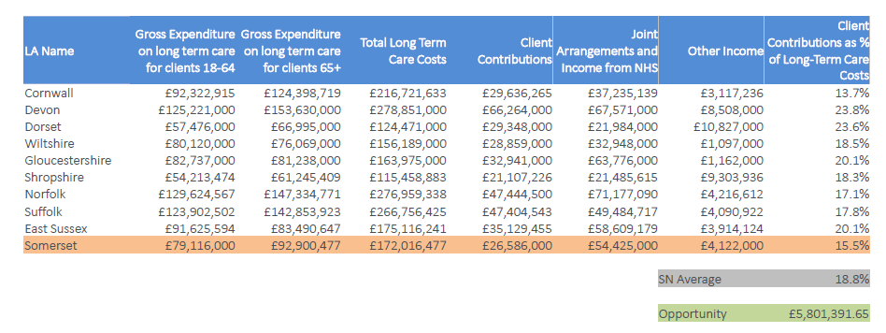
Income
Peopletoo
Based on analysis of the 21/22 ASCFR and SaLTreturns, it can be seen that Somerset’s level of client contributions
income, as a proportion of gross cost of long-term care, is lower than statistical neighbour averages. Applying
the average rate of client contributions to total cost of care to Somerset’s reported spend would equate to an
additional £5.8m income.

Slide 37

Acquired Brain Injury Service
Contract Value | No of People Supported | Weekly Cost per Person | Risk
£95k | 200 | £9
Recommission process taking place
Contract ends September 24
Specialist Service for the provision of people with an acquired brain injury
Opportunity to joint commission with ICB
£18k Contribution from ICB, up to £36k potential for an increase in contribution from health for new model of delivery
Provide support & advice
Current review will feed into the neuro pathway review
No other service in Somerset delivers this
91,000 people like with a brain injury in Somerset (includes people with strokes)
Provide an outreach service
Increased costs for supporting service users in Residential/Nursing placements
Serious case review in 2017 that highlighted the need for more specialist provision for ABI

Slide 38

Creative Solutions for Complex Adults
Contract Value | No of People Supported | Weekly Cost per Person | Risk
£840k | 162 | £99
Public Health removing contribution £90k
Contract ends March 2024 with the ability to extend for a further 2 years
Targets service users with complex needs
Housing Support for people with alcohol abuse, mental health, drug abuse, self-harm and potential loss of life
Impact on Health & ASC
High Risk if removed
Work with private landlords and service users to secure accommodation
Therapy model
Potential for recommissioning with health as part of the open mental health therapeutic service, provided by Second Step

Slide 39

Employment Service - Discovery
Contract Value | No of People Supported | Weekly Cost per Person | Risk
£690k (Budget £350k) | 223 | £59.50
223 individuals accessing the service as at 16/10/2023 at a mean average cost of £59.50 per week
Service is focused on enabling people with learning disabilities to achieve real, paid, employment
Commissioned to support responsibilities under sections 6.61, 15.73, 16.1 and 16.2 of Care & Support Statutory Guidance
There is a risk of people falling back into higher cost, long term, day service type supports with poorer outcomes in terms of both progression and independence either directly commissioned over via Direct Payments
Impact on family carers and the sustainability of these arrangements
39 young people accessing supported internships – the decommissioning of this service would see these end unless external funding secured
Young people with a SEN in the 0-25 age group requiring alternative services
Loss of aspiration and progression for young people transitioning to adult services would have a long term financial consequence for SC as the further people are from employment, for example accessing a long term day service type provision to give their carers a break, the less likely they are to achieve employment
While the provider is required to support individuals to apply for DWP funding for the support it provides to retain employment (unless otherwise agreed with SC), the loss of the core service would put this element at risk
Notes:
Utilises the Individual Placement and Support (IPS) model which is recognised as best practice by the British association for Supported Employment (BASE). This is not a ‘day service in disguise’ as may have been seen by external challengers elsewhere (we have been firm on this since the NDTi reviewed our employment support offer in 2012).
Age breakdown:
17-24 – 158
25-30 – 32
31-35 – 12
36-40 – 7
41-50 – 4
51-58 – 9

Slide 40

Employment Service – Mental Health
Contract Value | No of People Supported | Weekly Cost per Person | Risk
£61k | 212 | £5.53 (SC contribution)
Contribution from SC to support the service operated by Somerset NHS Foundation Trust
212 individuals (188 people with mental ill-health and 24 carers) accessing the service as at 16/10/2023 at a mean average cost of £5.53 per week based on the SC contribution.
Service is primarily focused on enabling people (currently 188) experiencing acute mental ill health to retain employment while in hospital or gain it as part of their support on discharge
Also supports carers (currently 24) of people with acute mental ill-health to retain their own employment
Impact on family carers and the sustainability of these arrangements
Retention/gaining of employment is strongly linked to good mental wellbeing
Risk of people who lose their employment requiring other services e.g. housing
Contribution supports SC responsibilities under sections 2.16, 6.61, 6.121, 11.40, 11.41, 16.10 of Care & Support Statutory Guidance
Notes:
Utilises the Individual Placement and Support (IPS) model which is recognised as best practice by the British association for Supported Employment (BASE).

Slide 41

Floating Dementia Service
Contract Value | No of People Supported | Weekly Cost per Person | Risk
£140k | 60 | £45
Supports service users with a diagnosis of dementia living in the community
60 service users access the service per annum
Cost £45 per week per service user
Increase in expenditure on homecare, residential & nursing
Service is being recommissioned and redeveloped as part of the dementia alliance service health will contribute towards cost of the new development

Slide 42

Keyring
Contract Value | No of People Supported | Weekly Cost per Person | Risk
£33k | 13 | £48.82
Provides very low-level support in Glastonbury and Frome areas
Each individual will need to be reassessed, which could potentially result in a higher cost service being required
Contract breach paperwork is currently being processed for this financial year.

Slide 43
Grants
Grant | Provider | Value | Risk
Carers | Community Council for Somerset – Supported 3000 carers direct support, plus information and advice. Includes CAMHS. Contribution 50 per cent split between ASC/NHS Somerset total system spend £454,000 – Statutory | £223,500
Sensory Loss | Deaf Plus/Somerset Sight/Sense - Contribution towards costs £40,000 communicator guide, interpreter £21,275 Sensory Loss £179,000 Somerset Sight/Deaf plus – Statutory | £240,275
Community Agents Service | CCS – Over 12month period agent service supported 13,700 people, providing support, information, advice – Cost savings to ASC £1.5million Will be moving to contractual arrangement, 4 year + 4 years. | £400,000
Age UK | Contribution towards core service, befriending and activities for older people | £61,200
Local Assistance Scheme | CAB - One off funding, when people are in crisis, purchase of white goods, electric etc. | £107,000
Somerset Independence Plus | SIP Service – DFG/Home adaptation/Minor works. | £250,000

Slide 44
Summary
Total possible savings in addition to MTFP 2024-2025 and My Life, My Future
£2.8m
Additional Income
Up to £5.8m
ASC financial ask for 2024 – 2025
£74m
*potential additional savings with the above

