Slide 1
Role and duties of Safeguarding Adults Board
The overarching purpose of an SAB is to help and safeguard adults with care and support needs. It does this by:
assuring itself that local safeguarding arrangements are in place as defined by the Care Act 2014 and statutory guidance
assuring itself that safeguarding practice is person-centred and outcome-focused
working collaboratively to prevent abuse and neglect where possible
ensuring agencies and individuals give timely and proportionate responses when abuse or neglect have occurred
assuring itself that safeguarding practice is continuously improving and enhancing the quality of life of adults in its area.
Working in partnership to enable adults in Somerset to live a life free from fear, harm or abuse

Slide 2
SABs have three core duties
They must:
develop and publish a strategic plan setting out how they will meet their objectives and how their member and partner agencies will contribute
publish an annual report detailing how effective their work has been
commission safeguarding adult reviews (SARs) for any cases which meet the criteria for these.
Working in partnership to enable adults in Somerset to live a life free from fear, harm or abuse

Slide 3
Links to other boards and partnerships
The SAB works with other boards and partners including:
Somerset Safeguarding Children's Partnership
Safer Somerset Partnership
Health and Wellbeing Boards
Health Forums
Domestic Abuse Boards
Working in partnership to enable adults in Somerset to live a life free from fear, harm or abuse

Slide 4
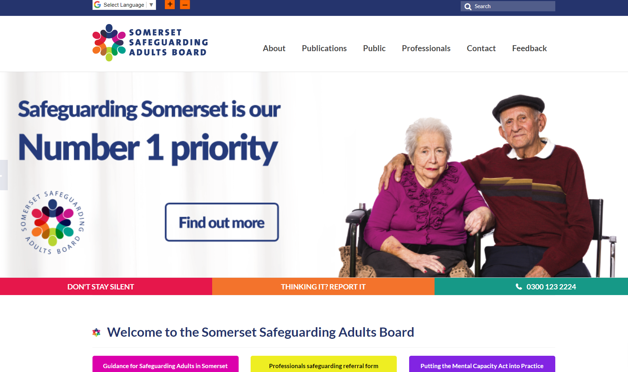
Somerset Safeguarding Adults Board Website
On the website, you will find policies, procedures and information about safeguarding:
Working in partnership to enable adults in Somerset to live a life free from fear, harm or abuse

Slide 5
Safeguarding Adult Review (SAR) Criteria
A Safeguarding Adult Board (SAB) must arrange for there to be a review of a case involving an adult in its area with needs for care and support (whether or not the local authority has been meeting any of those needs) if:
There is reasonable cause for concern about how the SAB, members of it or other persons with relevant functions worked together to safeguard the adult, and
Condition 1 or 2 is met:
Condition 1
Condition 1 is met if:
The adult has died, and
The SAB knows or suspects that the death resulted from abuse or neglect (whether or not it knew or suspected the abuse or neglect before the adult died).
Condition 2
Condition 2 is met if:
The adult is still alive, and
The SAB knows or suspects that the adult has experienced serious abuse or neglect.
Working in partnership to enable adults in Somerset to live a life free from fear, harm or abuse

Slide 6
Safeguarding means protecting an adult’s right to live in safety, free from abuse and neglect.
It is about people and organisations working together to prevent and stop both the risks and experience of abuse or neglect, while at the same time making sure that the adult’s wellbeing is promoted including, where appropriate, having regard to their views, wishes, feelings and beliefs in deciding on any action.
Care and Support is the term used to describe the help some adults need to live as well as possible with any illness or disability they may have
Working in partnership to enable adults in Somerset to live a life free from fear, harm or abuse
Notes:
Facilitator notes/script
Since 2020 in Somerset there have been at least 4 DHR’s relating to victims over 60 – 2 homicides and 2 domestic abuse related suicides. In these four cases the significant other / person causing harm was their spouse.
Of the homicide victims one was male, one was female
Of the suicide victims one was male, one was female.
Learning from these reviews highlight the importance of understanding the complexities of different relationships dynamics ie Son/daughter- Mother/son- father/son-
Professionals have ben found to be ‘dismissive’ of concerns around elder domestic abuse suggesting victim has lived with abuse for many years and the risk for significant harm in assessed as being relatively low
Local learning reviews drew out the importance of health professionals understanding of the Domestic abuse Routine Enquiry ensuring that health professionals are aware of the indicators of domestic abuse, the associated risks to victims of domestic abuse and know how to utilise their professional curiosity combined with their inherent patient care skills, to sensitively ask questions, listen to the patient’s response/disclosure, assess the risk and take appropriate action to keep the patient safe.
The Department of Health has recognised Domestic Violence and Abuse as a serious Public Health issue. Health Service colleagues have a valuable contribution to make in the identification and response to patients exposed to domestic violence and abuse. The NHS is the one service that almost all victims of abuse will encounter at some point in their lives.

Slide 7
Types of Abuse...
Physical abuse
Domestic violence or abuse
Sexual abuse
Psychological or emotional abuse
Financial or material abuse
Modern slavery
Discriminatory abuse
Organisational or institutional abuse
Neglect or acts of omission
Self-neglect
Working in partnership to enable adults in Somerset to live a life free from fear, harm or abuse

Slide 8
What if I have a Safeguarding Concern about Someone?
If you are worried about a child, a young person under the age of 18, or a vulnerable adult you should contact Somerset Council on 0300 123 2224.
If you or the person you are concerned about is in danger and immediate action is required, you should ring the emergency services on 999.
Your concern will be triaged - Safeguarding Team
Working in partnership to enable adults in Somerset to live a life free from fear, harm or abuse

Slide 9
Section 42
A section 42 enquiry relates to the duty of the Local Authority to make enquiries, or have others do so, if an adult may be at risk of abuse or neglect. This happens whether or not the authority is providing any care and support services to that adult. It aims to decide what, if any, action is needed to help and protect the adult.
Working in partnership to enable adults in Somerset to live a life free from fear, harm or abuse
Notes:
The scale of the enquiry, who leads it, the format it takes and how long, will depend on the particular circumstances.
It will usually start with asking the adult about their view and wishes, which will often determine what next steps to take.
All those involved in an enquiry must focus on improving the adult's well-being and work together toward that shared aim. At this stage, the local authority also has a duty to consider whether the adult requires an independent advocate to represent and support the adult in the enquiry.
The objectives of an enquiry into abuse or neglect are to:
establish facts
be certain of the adult's views and wishes
assess the needs of the adult for protection or support and redress, and how they might be met
protect the person from abuse and neglect, in line with the wishes of the adult
make decisions about what action should be taken with the person or organisation responsible for the abuse or neglect
enable the adult to achieve resolution and recovery
An enquiry could range from a conversation with the adult, or their representative or advocate, prior to initiating a formal enquiry under section 42, right through to a much more formal multi-agency plan or course of action.
What happens as a result of the enquiry should reflect the adult's wishes where possible, as stated by them or by their representative or advocate.
If the adult lacks the capacity to engage with the process, any decision made must be in their best interests and be the correct response to the concern.

Slide 10
The Six Safeguarding Principles
Empowerment: people being supported and encouraged to make their own decisions and give informed consent
Prevention: it is better to take action before harm occurs
Proportionality: the least intrusive response appropriate to the risk presented
Protection: support and representation for those in greatest need
Partnership: local solutions through services working with their communities – communities have a part to play in preventing, detecting and reporting neglect and abuse
Accountability and transparency in safeguarding practice
Working in partnership to enable adults in Somerset to live a life free from fear, harm or abuse
Notes:
Facilitator notes/script
Since 2020 in Somerset there have been at least 4 DHR’s relating to victims over 60 – 2 homicides and 2 domestic abuse related suicides. In these four cases the significant other / person causing harm was their spouse.
Of the homicide victims one was male, one was female
Of the suicide victims one was male, one was female.
Learning from these reviews highlight the importance of understanding the complexities of different relationships dynamics ie Son/daughter- Mother/son- father/son-
Professionals have ben found to be ‘dismissive’ of concerns around elder domestic abuse suggesting victim has lived with abuse for many years and the risk for significant harm in assessed as being relatively low
Local learning reviews drew out the importance of health professionals understanding of the Domestic abuse Routine Enquiry ensuring that health professionals are aware of the indicators of domestic abuse, the associated risks to victims of domestic abuse and know how to utilise their professional curiosity combined with their inherent patient care skills, to sensitively ask questions, listen to the patient’s response/disclosure, assess the risk and take appropriate action to keep the patient safe.
The Department of Health has recognised Domestic Violence and Abuse as a serious Public Health issue. Health Service colleagues have a valuable contribution to make in the identification and response to patients exposed to domestic violence and abuse. The NHS is the one service that almost all victims of abuse will encounter at some point in their lives.

Slide 11
Any Questions......
Working in partnership to enable adults in Somerset to live a life free from fear, harm or abuse
Notes:
Facilitator notes/script
Since 2020 in Somerset there have been at least 4 DHR’s relating to victims over 60 – 2 homicides and 2 domestic abuse related suicides. In these four cases the significant other / person causing harm was their spouse.
Of the homicide victims one was male, one was female
Of the suicide victims one was male, one was female.
Learning from these reviews highlight the importance of understanding the complexities of different relationships dynamics ie Son/daughter- Mother/son- father/son-
Professionals have ben found to be ‘dismissive’ of concerns around elder domestic abuse suggesting victim has lived with abuse for many years and the risk for significant harm in assessed as being relatively low
Local learning reviews drew out the importance of health professionals understanding of the Domestic abuse Routine Enquiry ensuring that health professionals are aware of the indicators of domestic abuse, the associated risks to victims of domestic abuse and know how to utilise their professional curiosity combined with their inherent patient care skills, to sensitively ask questions, listen to the patient’s response/disclosure, assess the risk and take appropriate action to keep the patient safe.
The Department of Health has recognised Domestic Violence and Abuse as a serious Public Health issue. Health Service colleagues have a valuable contribution to make in the identification and response to patients exposed to domestic violence and abuse. The NHS is the one service that almost all victims of abuse will encounter at some point in their lives.

