Slide 1

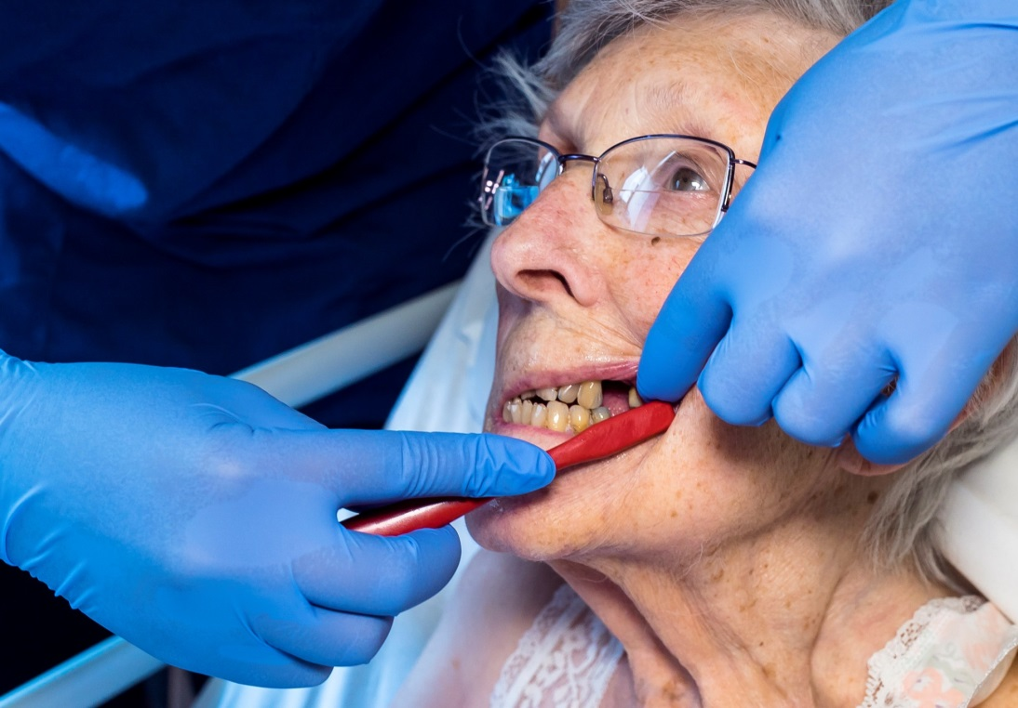

Oral Health Training in Somerset
Health and socialcare settings

Slide 2
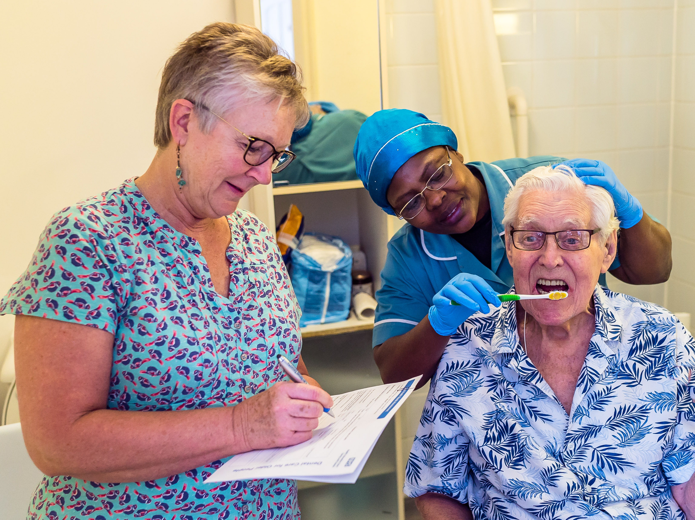
What is Mouthcare?
Toothbrushing
Denture cleaning
Relieving dry mouth
Removing dried secretions
Providing hydration
Treating infections
Recognising issues/abnormalities
Seeking appropriate help if needed

Slide 3

Why is it important?
Comfort
Nutrition/Hydration
Communication
/Speech
Dignity
Prevention

Slide 4
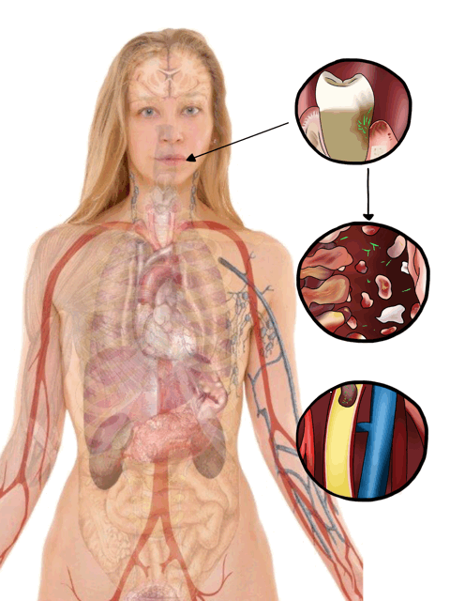
Systemic health link
Heart disease
Diabetes
Mouth cancer
Lung conditions
Strokes
Dementia

Slide 5



Key Lines of Enquiry (KLOE)
Oral health for adults in care homes (NG48) 2016
June 2019
Notes:
Published in June 2019, this CQC reports now puts oral health the inspection agenda, - dentist visited 100 residential homes, 47% staff had no OH training, 52% no OH policy in place.

Slide 6
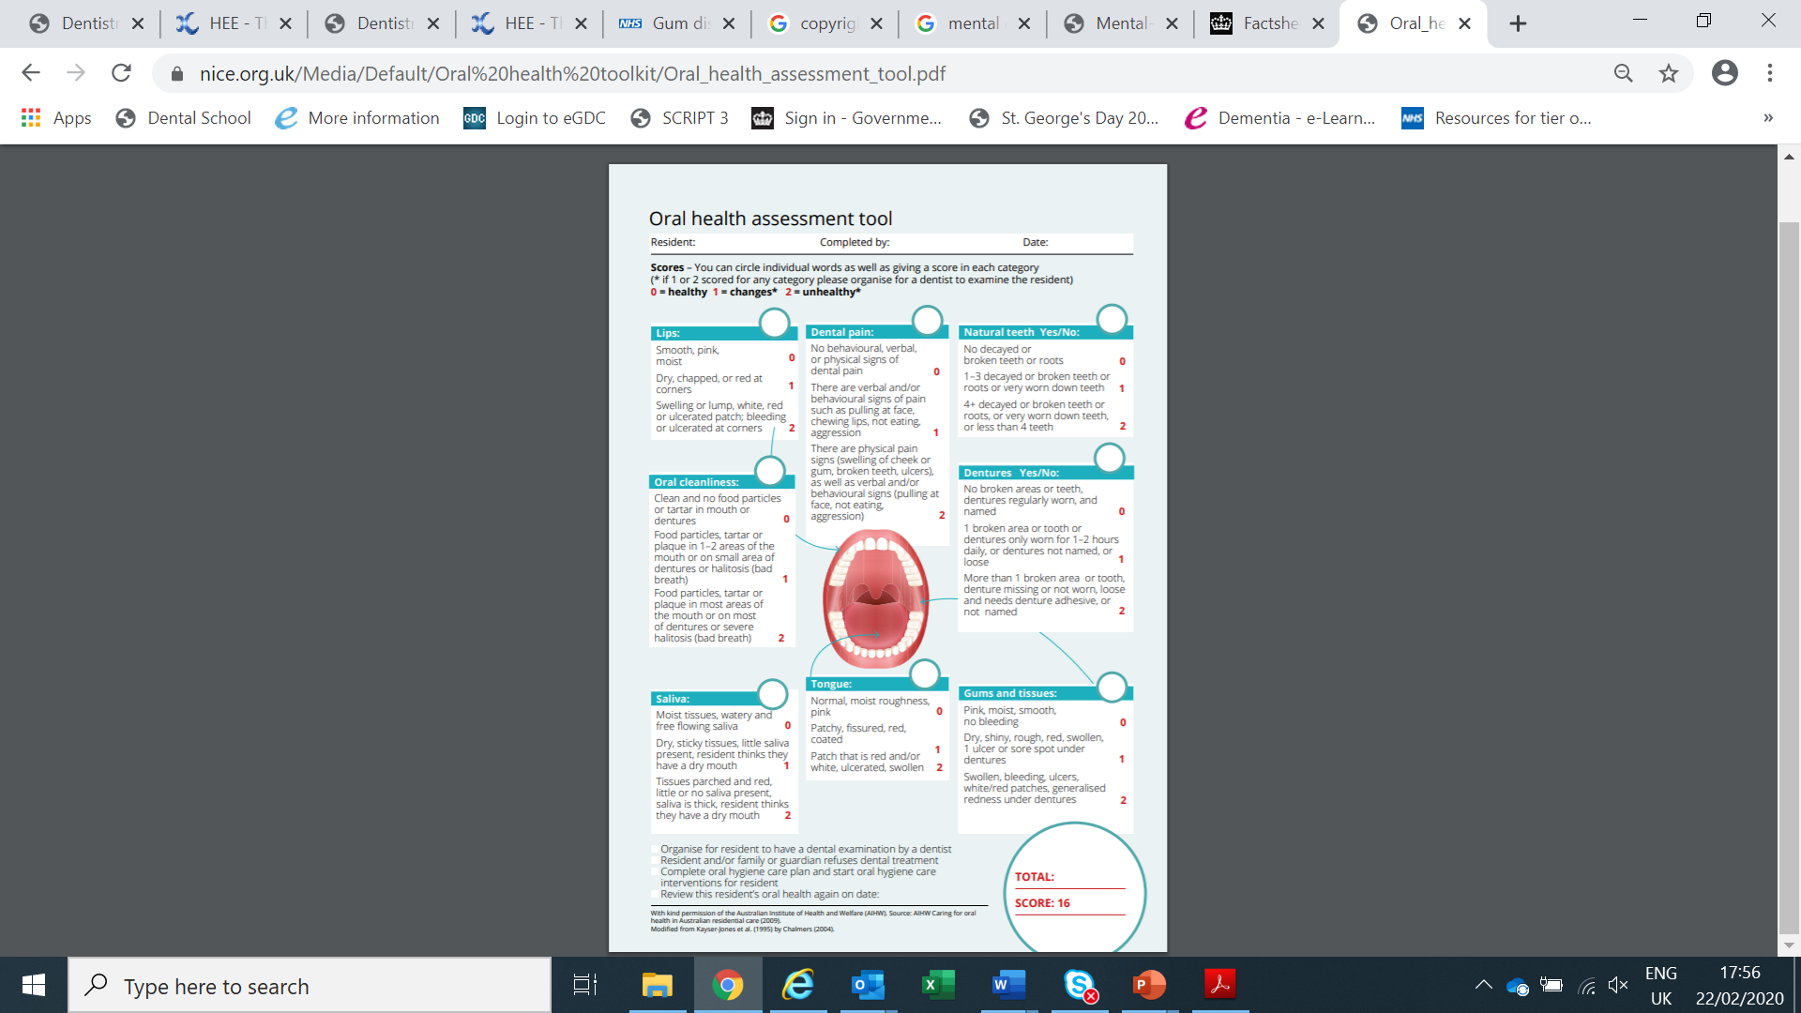
Mouth Assessments:
When to complete them
Why we complete them
What to document
What to escalate/refer
What to do with this information once collated

Slide 7
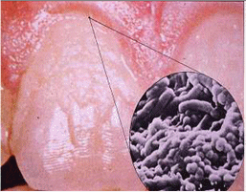
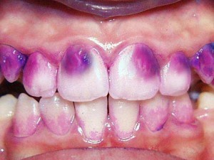
Dental Plaque

Slide 8
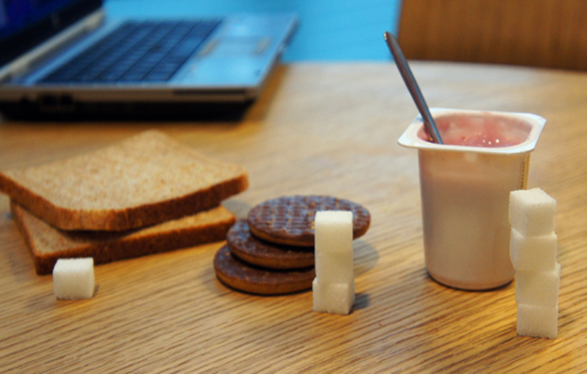
Sugar

Slide 9
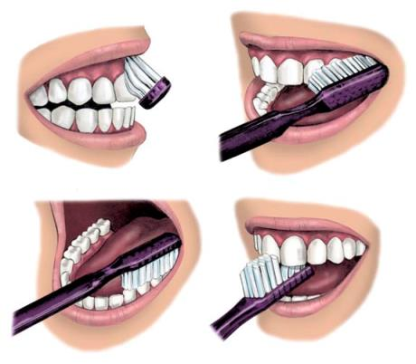

Slide 10

‘
I can clean my own teeth
‘I need a little support’
I need a lot of help

Slide 11
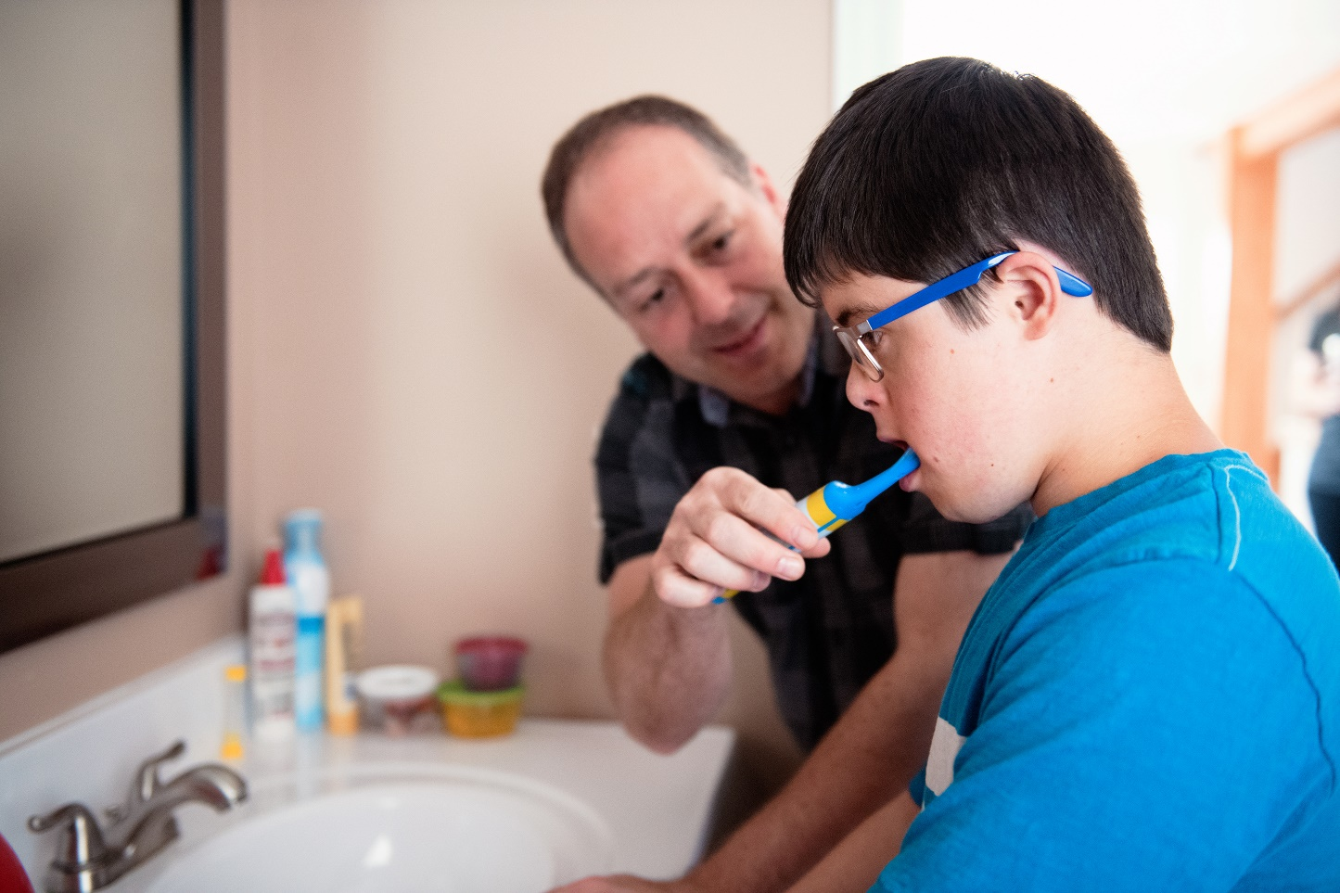
Care resistant behaviours

Slide 12
If the person refuses care
Someone can refuse verbally or non-verbally
If they have capacity to make that decision then it is their right to make it, explain why mouth care is important and the possible consequences of their choice
If they lack capacity, then investigate why they are refusing, then:
Document and report if a resident persistently refuses mouth care

Slide 13
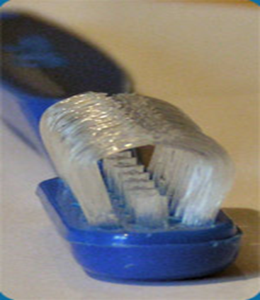

Specialist tools
Different types of toothbrushes:
Electric
Manual
3 sided
Adapting a handle
Suction
Different types of toothpaste:
SLS free (non foaming)
Low flavour
Fluoride
High Fluoride (prescription only)
Sensitive

Slide 14
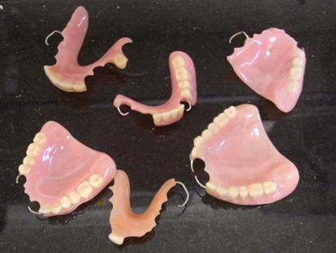
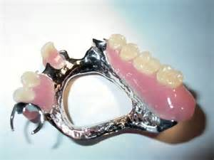
Dentures

Slide 15
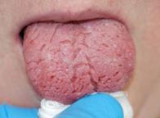
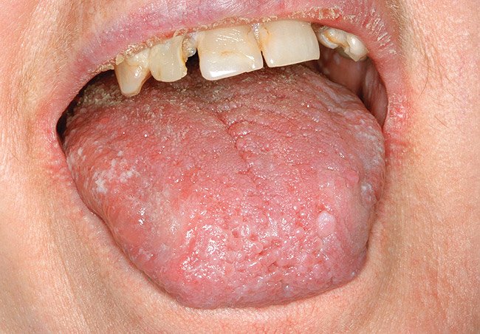
Xerostomia/Dry Mouth
Difficulty talking
Difficulty eating
Difficulty swallowing
Unpleasant sensation
Tooth decay

Slide 16

Difference between end of life and palliative care
Differences between EOL and Palliative care
Involving relatives in EOL mouthcare
Risks involved with using pink sponges and other alternative available

Slide 17
Resources
Delivering Better Oral Health
https://www.gov.uk/government/publications/delivering-better-oral-health-an-evidence-based-toolkit-for-prevention
Oral Health Toolkit for Adults in Care Homes
https://www.gov.uk/government/publications/adult-oral-health-in-care-homes-toolkit/oral-health-toolkit-for-adults-in-care-homes
Mouth Care Matters a guide for Health Professionals
http://mouthcarematters.hee.nhs.uk/wp-content/uploads/sites/6/2020/01/MCM-GUIDE-2019-Final.pdf
gayle.kime@nhs.net

