Slide 1









Your Digital Journey
Digital Security & Protection Toolkit
NHS Mail
Digital Social Care Records
GP Connect
Proxy Access
Other Technology: Sensor Based Falls Prevention, Movement Sensors
Future NHS Community: Hospital, Ambulance, Community services

Slide 2
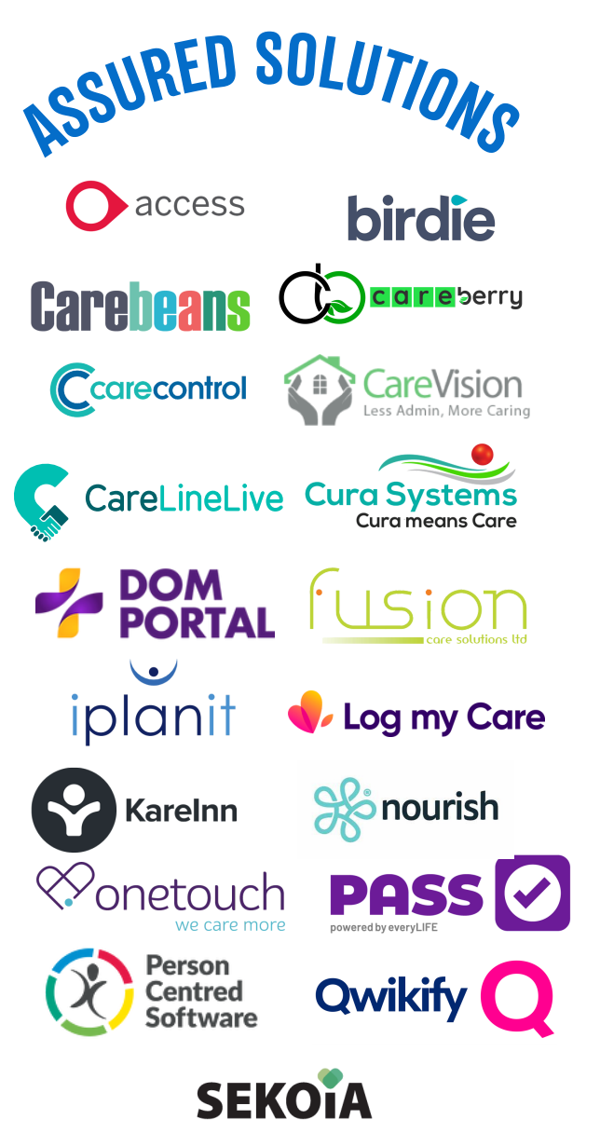
Programme Updates
DSCR - Digital Social Care Records
  70% of Care Providers are using a Digital Records system.
  We have funding available until March 2024
  50% of implementation costs, up to £4711 per CQC registered provider,
  this can include training hours, devices, licenses.
  Retrospectively backdated to April 2022
  For Dom Care & Care homes.
  Team members can also help with NHSmail and
  Data Security and Protection Toolkit (dsptoolkit.nhs.uk)

Slide 3
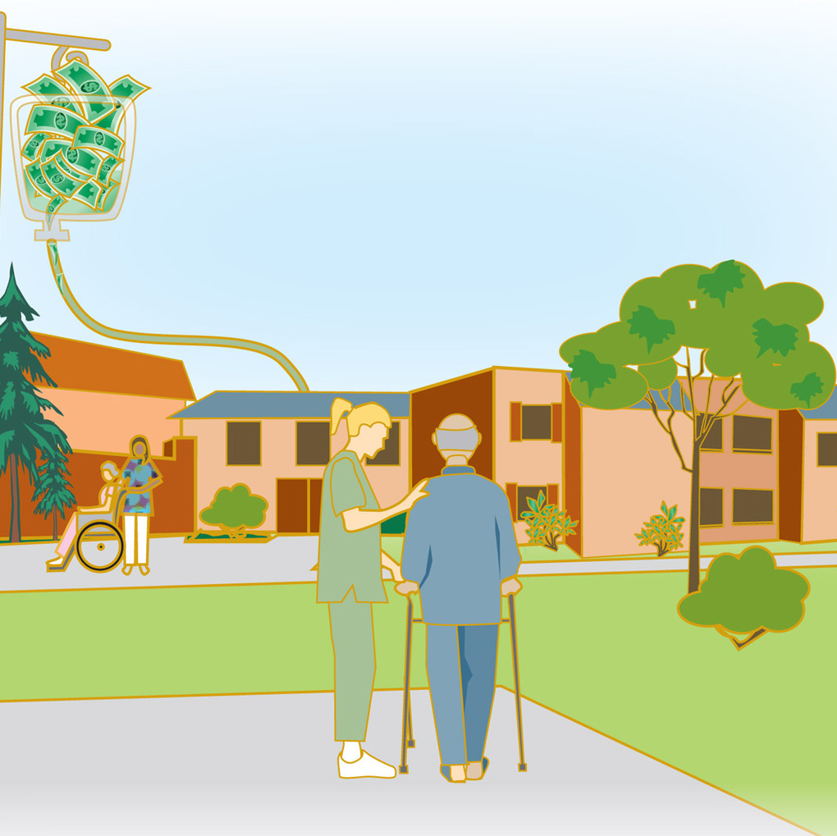


DSCR in action in Somerset

Slide 4
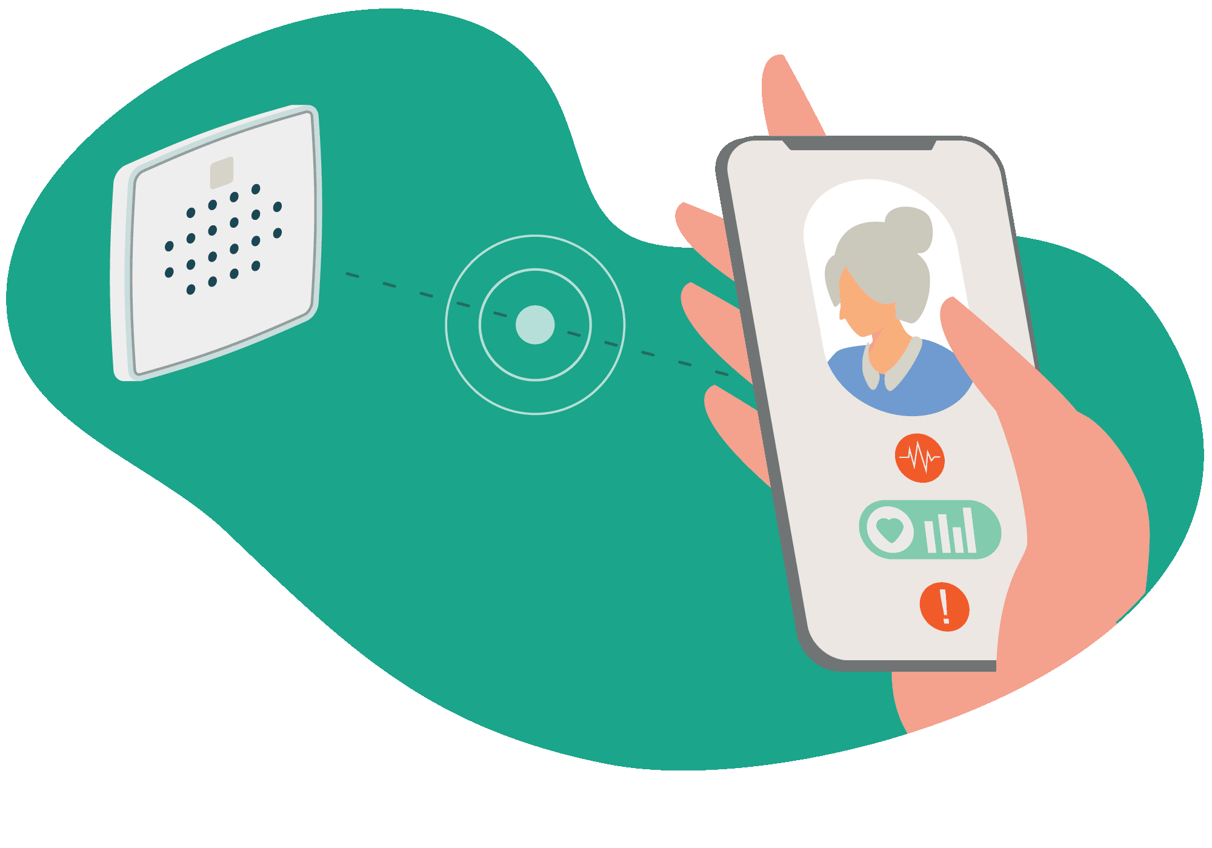
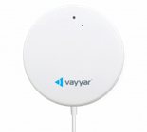



Sensor Based Falls Detection & Prevention
Reduce the frequency and severity of incidents such as falls or medication errors leading to hospital admissions
Give care staff more time to spend on other tasks interacting with people and delivering personalised care
Grant Funding available NOW
100% of 1st years costs. Capped at £500 per user.
Must be acoustic sensor based.

Slide 5
GP Connect
From January 2024 all assured solution DSCR’s will have GP Connect.
It’s a core part of the DSCR system, and so any provider who chooses an assured supplier will be able to eventually access GP connect free of charge as part of their system.
GP connect supports nonclinical roles listed below to have tailored access to GP medical records for people in their care using GP connect.
Registered manager / Care Manager
Deputy Home Manager / Deputy Care Manager / Senior Carer /Team Leader
Pharmacist / Pharmacy technician
Social worker
Nurse
This view of the GP record includes
Summary covering the last 3 encounters, active problems & issues free text notes are viewable.
Allergies and adverse reactions
Current Medications
Immunisations

Slide 6


Benefits feedback
Data entry times for DSCR are going down from 45 minutes per resident per day to 18 minutes per resident per day.
Staff & Managers
It speeds up every part of the process from pre-admission to daily notes, nutrition monitoring and discharge.
Care plans are now at our fingertips
System is very popular, intuitive, quick to complete. Staff really like the mobile interface and Near Field Communication (one touch log system) technology.
Improved falls data, more personalised care plans and useful to have access from home.
What are staff saying?
Quick to complete
Intuitive
More personalised care plans
Secure access
Speech to text is a revelation
Notes:
Staff have more time to deliver person centred care.
Personalised details in the care plan allow for staff deliver more personalised care e.g., Remembering to give Mrs Miggins orange juice with her medicine in the morning.
Staff have a better understanding of the people they are caring for and can have more meaningful conversations with them.
Family of those in your care have access to parts of their relatives DSCR and can see what they are up to and speak with them through the family portal.

Slide 7



Digital Security & Protection Toolkit
Dan Plummer
Project Delivery Officer
admin@rcpa.org.uk
NHS Mail
NHS Mail
Joe Stapleforth & Beth Mee
Digital Outreach Team
Proxy Access
Proxy Access
somicb.digitalcarehomes@nhs.net
Digital Social Care Records
DiSC Funding Team
Jo Jones
Maria Tutton
Sensor Based Falls Prevention
Digitisation in Social Care (DiSC) - Expression of Interest Form (office.com)
Digitisationinsocialcare@somerset.gov.uk
We will help you on your digital journey.

Slide 8
Your Digital Journey
Digital Security & Protection Toolkit
NHS Mail
Digital Social Care Records
GP Connect
Proxy Access
Other Technology: Sensor Based Falls Prevention, Movement Sensors
Future NHS Community: Hospital, Ambulance, Community services

