Slide 1
THE NEW OUTBREAK REPORTING & RESPONSE PROCESS

Slide 2
BACKGROUND
An online Outbreak Risk Assessment Tool for Care Settings (Care OBRA Tool) has been used by the SW UKHSA Health Protection Team (HPT) since 31/01/22
It is used by Adult Social Care (ASC) settings reporting new outbreaks of Acute Respiratory Infections (ARI’s) including: COVID-19, Influenza, unidentified ARI (e.g. chest infections), and single cases of Influenza
It is not used for: Single COVID-19 and single ARI (unknown micro-organism) cases (do not need reporting), Children’s Care Homes, any healthcare setting that is not ASC (including Hospitals, Hospices, Dental surgeries, GP surgeries), or updates on existing outbreaks.

Slide 3
THE NEW WEB-BASED CARE OBRA TOOL
Due to its success, the Care OBRA tool has been developed further to allow care settings to report directly online without the need to call/email the HPT first.
This new web-based Care OBRA tool is being launched on 22nd AUGUST 2023

Slide 4
AIM OF THE NEW WEB-BASED CARE OBRA TOOL
To allow ASC settings to:
Report their outbreaks and single cases of flu without the need to ring or email the HPT beforehand
Collect all the relevant information and enter it into an electronic platform at a time that suits them
Receive a summary of the data entered in the Care OBRA Tool
Receive immediate email advice on how to manage their situation and automatically identify the higher risk situations

Slide 5
THE CURRENT OUTBREAK REPORTING & RESPONSE PROCESS

Slide 6
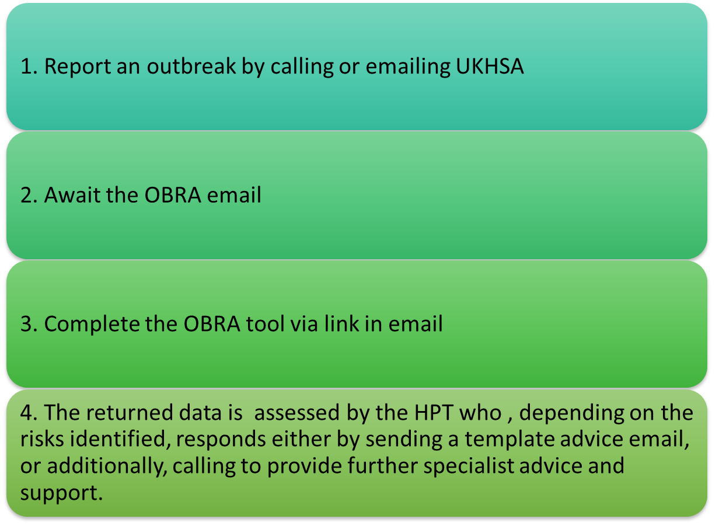
THE CURRENT OUTBREAK REPORTING and RESPONSE PROCESS
What the setting does now…

Slide 7
THE NEW OUTBREAK REPORTING & RESPONSE PROCESS

Slide 8
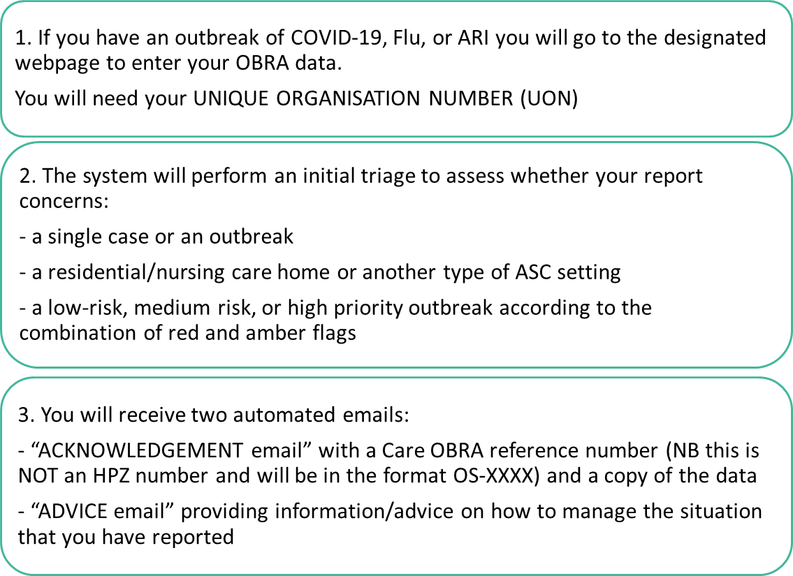
THE NEW OUTBREAK REPORTING and RESPONSE PROCESS
What the setting will do …

Slide 9
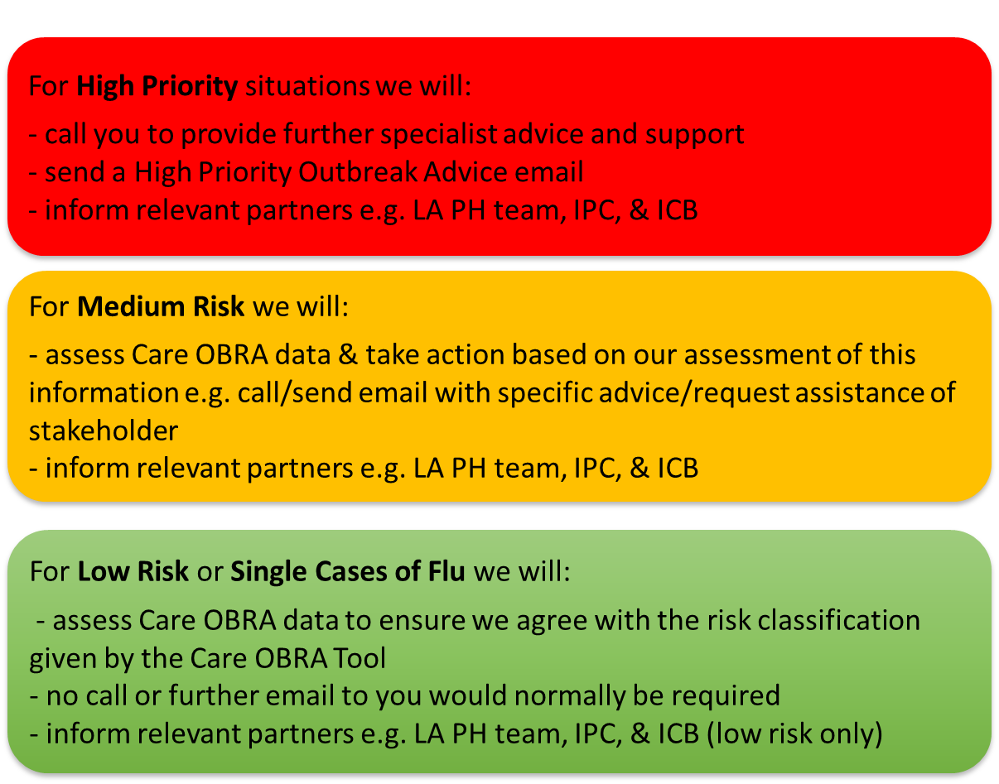
THE NEW OUTBREAK REPORTING and RESPONSE PROCESS
What UKHSA will do …

Slide 10
FURTHER INFORMATION
Please be aware that if you leave the Care OBRA tool part-way through, after 20 minutes of no activity, your answers will be reset and you will have to start again. Therefore, we suggest you have the following information before you start:
The postcode and UON and/or CQC Location ID of your setting
Total no. of residents/clients and staff in your setting
No. of residents/clients who have had a letter saying that they are especially vulnerable to COVID-19 and are, therefore, eligible for COVID-19 treatments
No. of residents/clients and/or staff that are LFD confirmed AND No. of residents/clients and/or staff that are symptomatic who have not been tested
Dates of symptom onset for first case and most recent case
No. of residents/clients and staff vaccinated for both COVID-19 and Influenza

