Slide 1
The Somerset Integrated Diabetes Service
Working together to put diabetes knowledge closer to the person with diabetes
a.k.a. “Helping people to help people with diabetes look after themselves”

Slide 2
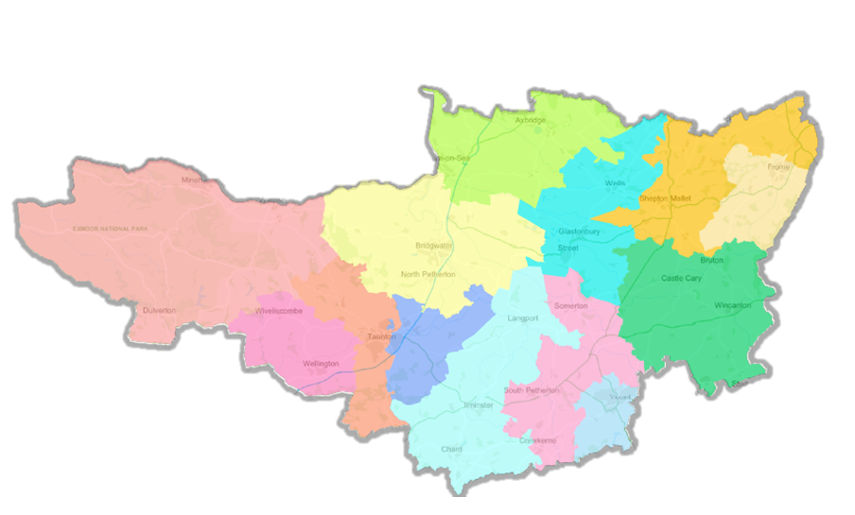
“S” is for Somerset
Stop diabetes
Prevention (NDPP) and Remission (T2DR)
Self-care
Shared decision making
Partnership working between people with diabetes and support team
Seamless pathways of care
Centred around the person with diabetes
Local to the person with diabetes
Easy access to specialists

Slide 3
Somerset Diabetes Programmes – September 2023
Programme | Project Lead/Project Manager | Provider
Diabetes Prevention Programme (Pre-Diabetes) | Anthea Pryce(ICB), Dulcie Bowditch (Xyla) | Xyla
Diabetes Recovery Programme - Risk Stratification - Digital Diabetes | James Loder (SPH, Programme Manager) Karen Anderson (SPH, Project Manager) Karen Baker (SPH, Project Manager) Stuart Fisher (MWDH, Project Manager) | MyWay Digital Health
Type 2 Diabetes Path to Remission Programme (T2DR) | Lesley Harper (ICB) | Momenta
Structured Education | Lesley Harper (ICB) | DESMOND
Peri-Operative Programme | Louise Lewis (SFT) | Somerset Foundation Trust

Slide 4
NHS Diabetes Prevention Programme (NDPP)
NDPP identifies people at risk of developing type 2 diabetes and refers them onto a nine-month, evidence-based lifestyle change programme.
Available as a face-to-face group service and as a digital service.
People on the face-to-face group service receive personalised support to manage their weight, eat more healthily and be more physically active
The digital service offers similar support but using digital tools such as wearable technologies, apps, online peer support groups and the ability to set and monitor goals electronically.
Research shows NDPP has reduced new diagnoses of type 2 diabetes in England and cuts the risk of developing type 2 diabetes by more than a third.
The NDPP is delivered in Somerset by Xyla Health and Wellbeing.
What is it?

Slide 5
NHS Diabetes Prevention Programme (NDPP)
Who is it for
Aged 18 years and over
HbA1C between 42-47 mmol/mol (6.0-6.4%) or Fasting Plasma Glucose between 5.5-6.9 mmol/l within the last 12 months
If patient has a history of Gestational Diabetes (GDM) then patient is eligible with HbA1c <42 mmol/mol or FPG <5.5mmol/l
Not pregnant
Able to take part in light/moderate physical activity
How do patients' access
Complete the referral form which is embedded into EMIS.
Alternatively, provide your patient with their eligibility information so they can self-refer

Slide 6
Diabetes Recovery Programme
What is it?
Supporting practices to catch up following the impact of COVID
Who is it for?
Practices struggling to meet National Institute for Health and Care Excellence (NICE) guidance for managing Type 2 diabetes in adults (aged 18 and over).
NICE recommends that patients with Type 2 diabetes should undertake an annual review that involves health checks (known as care processes)
NICE guidelines for PWD focus on patient education, dietary and lifestyle advice, personalised goal setting to manage cardiovascular risk and blood glucose levels, and identifying and managing long-term complications.

Slide 7
Diabetes Recovery Programme
What are we doing?
Completion of 8/9 care processes
Attainment of 3 NICE treatment targets for adults
HbA1c
Cholesterol
Blood pressure for adults
Managing High Risk Patients – DSN and consultant led virtual clinics
Overdue care processes
HbA1c >86mmol/mol
HbA1c >65mmol/mol + ≥ 1 other risk factor (i.e., BP / Retinopathy or foot disease / CKD / CVD / BMI)
HbA1c rise of ≥20mmol/mol since 2020

Slide 8
Digital Diabetes - MyWay Diabetes
What is it?
Digital Platform and website with huge number of resources for PWD
Patients can also register using NHS login to get access to:
Their personal NHS diabetes data (and understand their results)
Set personal diabetes goals
Access to QISMET accredited structured education.
Who is it for?
Persons living with diabetes or identified as pre-diabetic
How do people access
Via MyWay Diabetes Somerset website and can register/login via website to patient portal
Weekly webinars for clinicians

Slide 9
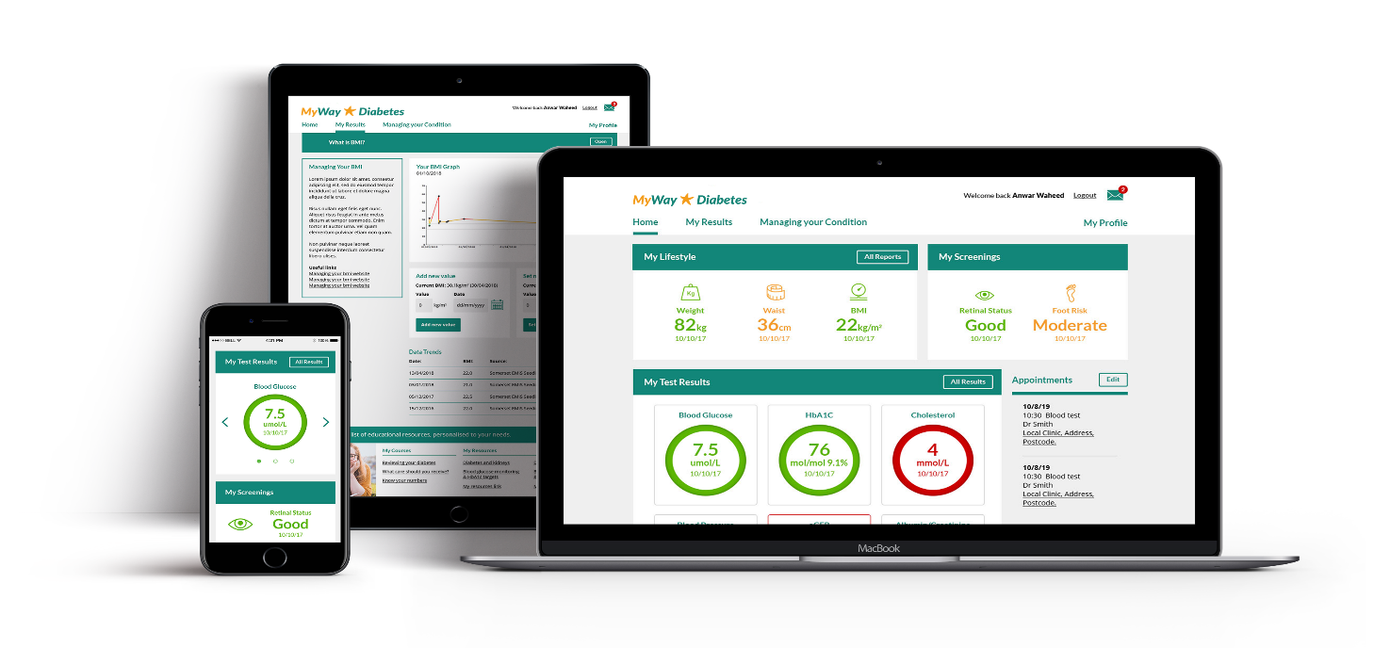
For people with Diabetes
For Patients
Live in SOMERSET since 2018
≈ 10,500 people with diabetes registered
= almost 1 in 3 people with Diabetes in Somerset
Improves self-management, delays and reduces long term risk of complications.
Notes:
Mention Somerset- support early day establishing

Slide 10
Digital Diabetes - TeamNet
What is it?
Web-based information sharing portal, akin to an intranet
Who is it for?
For all health and care organisations and professionals represented within Somerset ICS
How do people access?
Via TeamNet web-based portal
https://teamnet.clarity.co.uk/Topics/ViewItem/e5cb48fb-0824-40b8-b1c5-aeb700e1420f

Slide 11
Cambridge Diabetes Education Programme (CDEP)
What is it?
A diabetes competency-based E-learning platform
Based on nationally recognised framework of competencies for healthcare practioners
Improve knowledge
Boosting confidence
Promoting safer patient care.
Each CDEP topic generates a CPD certificate and reflection document for revalidation and appraisal purposes as well as CDEP rewards
Why might CDEP be helpful?

Slide 12
Cambridge Diabetes Education Programme (CDEP)
CDEP has 4 competency levels
Core – for staff who have any contact with people living with diabetes
Intermediate – for registered staff supporting people living with diabetes
Diabetes Specialist – those delivering the majority of diabetes care
Diabetes Expert – those delivering intensive care to complex diabetes cases
Bite sized learning modules

Slide 13
E-learning – Essential Topics
Hypos at home
Driving with diabetes
Physical activity with pre-diabetes, gestational and T2DM
Caring for the diabetic foot
Safe use of insulin in the community
Delivering the diabetes care processes
Nutrition and more

Slide 14
E-learning – CPD Topics
Diabetes 10-point training – adult social care workers
Oral therapies
Injectable therapies
Promoting self-care
Hyperglycaemia
Hypoglycaemia
Mental health and diabetes and more….

Slide 15
Diabetes 10-point training - ASCW
1 hour module (can be done as bite sized chunks)
Point 1: The Person
Point 2: Know the Difference Between the Types of Diabetes
Point 3: Glucose Monitoring
Point 4: Hypoglycaemia (low glucose levels)
Point 5: Hyperglycaemia (high glucose levels)
Point 6: Insulin and Medication Safely
Point 7: Feet
Point 8: Eating with Diabetes
Point 9: Referring to the GP, Diabetes Care Provider, Mental Health or Podiatry Team
Point 10: Ensure Access to Diabetes Care, Information and Review

Slide 16
Access to CDEP
Somerset ICB has commissioned 500 registrations for health care workers to access this service for free
Visit www.cdep.org.uk
Register using the code: SOMERSETDIABETES

Slide 17
Questions?
Notes:
17

