Slide 1
A Patient Safety Initiative co-produced by
West Hampshire CCG & Wessex Patient Safety Collaborative
This presentation has been collated by Jonathan Davies Somerset ICB
with thanks to
West Hampshire CCG & Wessex Patient Safety Collaborative
for allowing the use of a selection of their RESTORE2 slides
2019

Slide 2
CORE LEARNING OUTCOMES
Restore2 background and training in homes
Recognise the benefits to Patients and Patient Safety
Understand how RESTORE2 can improve communication with General Practice Teams
to understand and respond when carers use RESTORE2 and describe:
soft signs NEWS2* scores Use SBARD
*Only used by Homes with staff who have competencies in taking physical observations

Slide 3
Main Features of RESTORE2
SOFT SIGNS: Recognising soft signs that may indicate a patient is deteriorating
NEWS2 SCORE: This is a score, based on physical observations, that informs clinical staff about the condition of the patient. Only homes with staff competent in taking physical observations will provide a NEWS Score.
SBARD: The care staff will contact the GP practice if the patient is unwell, deteriorating or they need further help or advice
SITUATION, BACKBROUND, ASSESSMENT, RECOMMENDATION, DECISION

Slide 4
Why ?

Slide 5
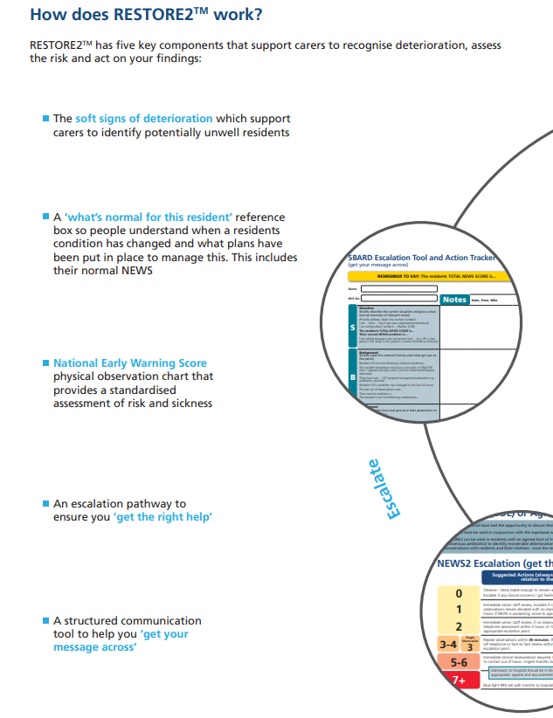
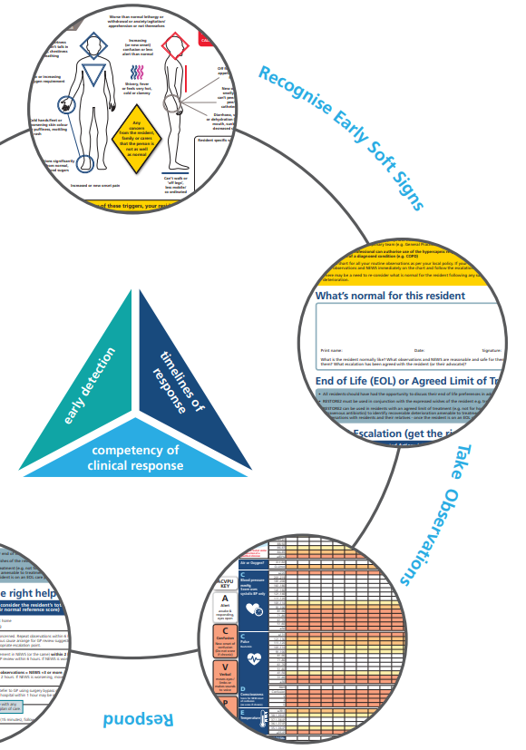

Slide 6
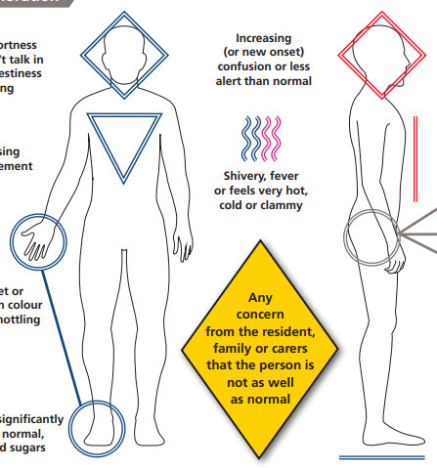
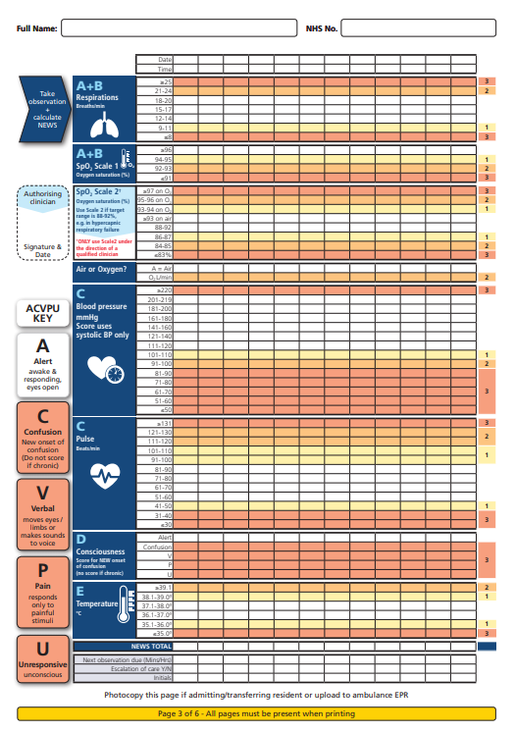
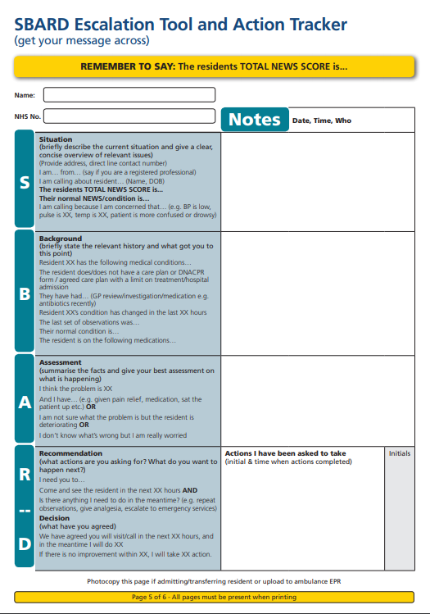
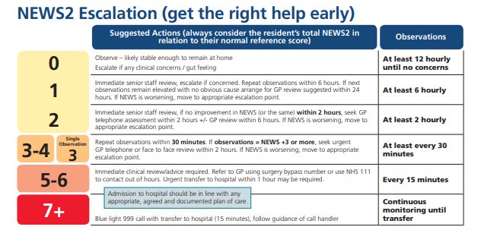
5 key elements of managing Deterioration
2 Knowing what’s normal (including EoL preferences)
1 Early Detection (Soft Signs)
4 Knowing what to do next
3 Understanding how unwell they are (NEWS2)
5 Communicating your concerns

Slide 7
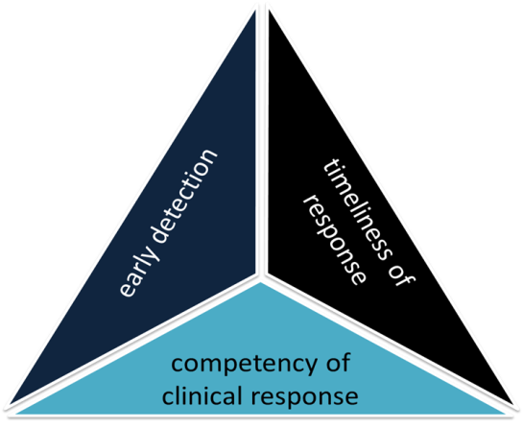
RESTORE2 the whole package
Recognise Soft Signs
Take observations
Calculate NEWS
Escalate using Escalation Tool
Communicate using SBARD
RESTORE2 combines soft signs with NEWS2, a clear escalation pathway designed around care homes and an SBARD communication tool and Action Tracker
RESTORE2Mini combines soft signs and SBARD
Recognise Soft Signs
Get your message across
Take Observations
Get the right help early
Calculate NEWS2
Notes:
Mention that carers are usually the first to recognise soft signs but found it difficult to communicate this concern. NEWS2 allows the carer to escalate their concern to a GP or another professional.

Slide 8
First “Know your patient” and Treatment Escalation plans
Edward is normally fit and active but is often mildly confused in the mornings before breakfast. Normally NEWS score is 0 but in the morning Edward may trigger the ACVPU scale – only call a GP if the confusion continues to lunchtime. Edward is for full treatment and admission to hospital if required. Edward becomes agitated when he is becoming unwell which is a good soft sign for him.
D. Davids 12/4/18 DDAVIDS

Slide 10
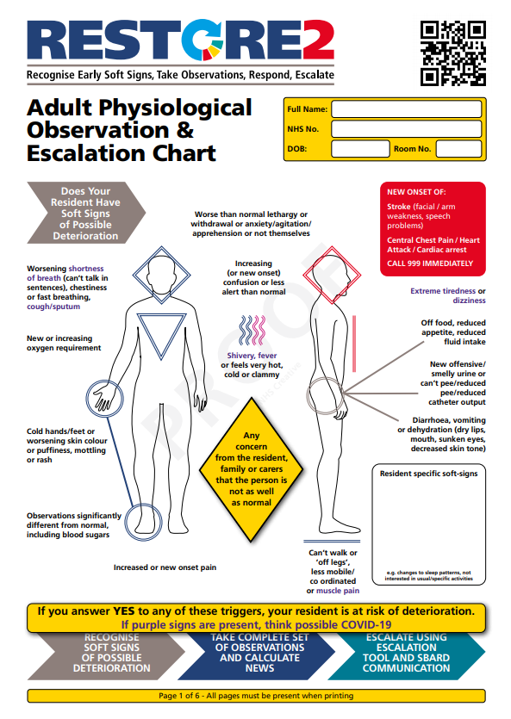
Check you have the latest version…
From: https://westhampshireccg.nhs.uk/restore2/
With purple (possible Covid-19) Soft Signs:
Shortness of breath
Cough/sputum
Shivery/fever
Muscle pain
Tired
dizzy

Slide 11
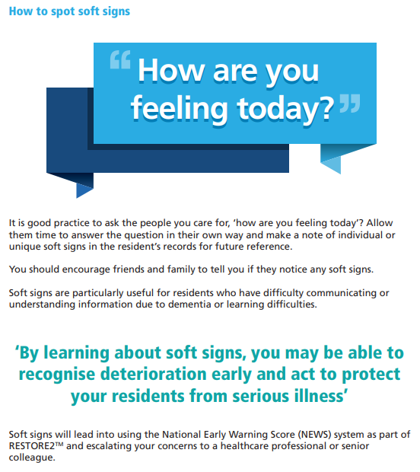

Slide 12
SOFT SIGNS - changes to Mental, Physical, Behaviour
How many times do we say:
Mr A is unwell and needs to see a doctor
Mrs B is poorly….not herself
SOFT SIGNS may be communicated by saying:
Mr A has new confusion, a temperature and is breathless
Mrs B is not able to mobilise independently today, shows poor appetite and, where normally very active, has stayed in bed.

Slide 13
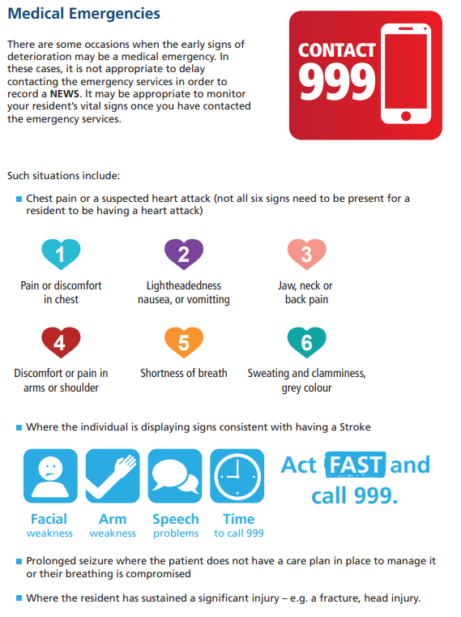

Slide 14
Physical Observations
Validated tool widely used in acute care comprising six biological measurements:
Respiration Rate
Oxygen Saturations
Temperature
Systolic Blood Pressure
Heart Rate
Level of Consciousness (defined by ACVPU)
The ACVPU Scale
Level of alertness is measured using ACVPU: Alert,
Newly Confused
responsive only to Voice
responsive only to Pain
Unresponsive

Slide 15
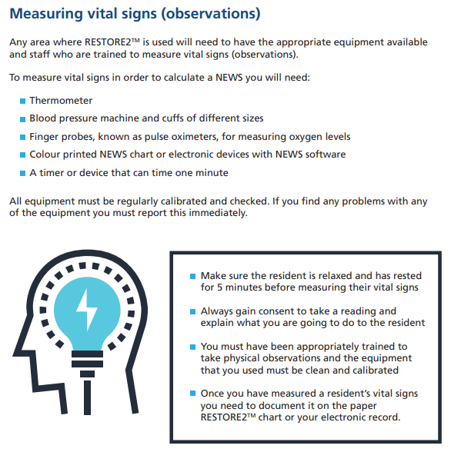

Slide 16
Always take RR over 60 seconds
Don’t let person know are about to count their RR
Consider persons posture and ensure regular deep breathing.
2019

Slide 17
Please remember: NEWS2 has two scoring scales for Sp0₂
The new Sp0₂ scoring Scale 2 is only for patients with a prescribed oxygen saturation requirement of 88–92% (e.g. in patients who normally retain Carbon Dioxide and need to do this to drive their respiratory effort (hypercapnic respiratory failure)
This should only be used in patients confirmed to have hypercapnic respiratory failure on blood gas analysis on either a prior, or their current, hospital admission
The decision to use the new SpO₂ scoring Scale 2 should be made by a competent clinical decision maker and should be recorded in the patient’s clinical notes
In all other circumstances, the regular NEWS SpO₂ scoring scale (Scale 1) should be used
For the avoidance of doubt, the SpO₂ scoring scale not being used should be clearly crossed out
If you think a Resident is on the wrong scale please raise this with the GP
2019
Notes:
Reference RCOP National early warning score news 2 December 2017
Hypercapnia respiratory failure
hypercapnia (a high concentration of carbon dioxide in the blood) – main cause copd but are other causes

Slide 18
The two scoring scales for Sp0₂

Slide 19
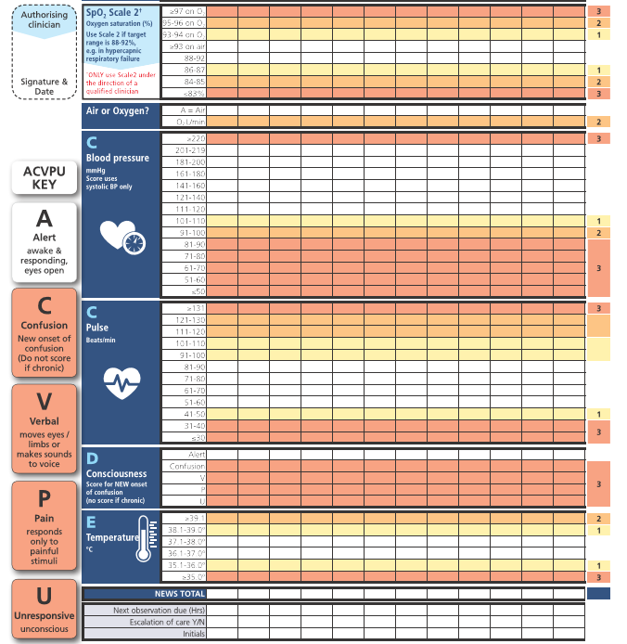

Slide 20
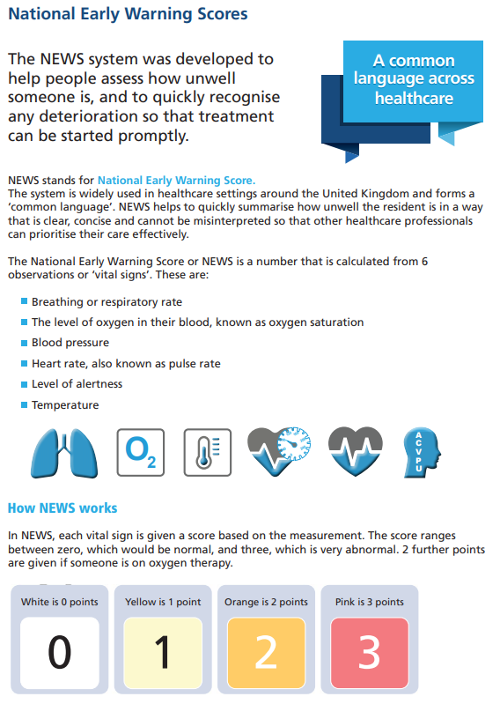
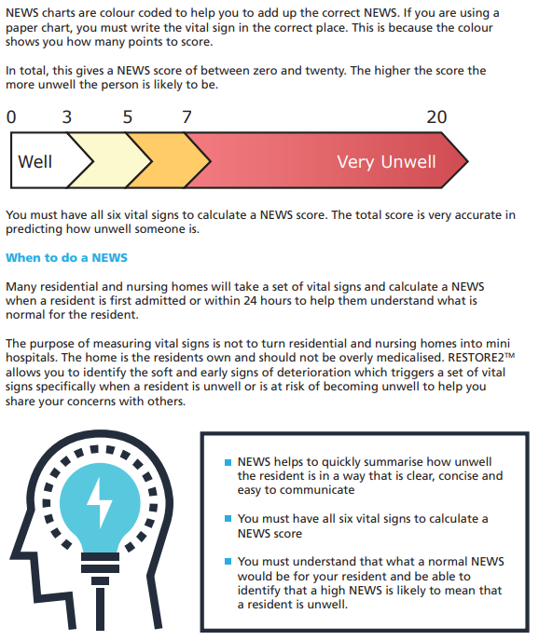
NEWS2

Slide 21
Escalation – get the right help
Notes:
This does not replace clinical judgement. By working with homes we have learnt that observations were not recorded regularly. NEWS2 makes you go back and review your resident and start a conversation with another professional.

Slide 22
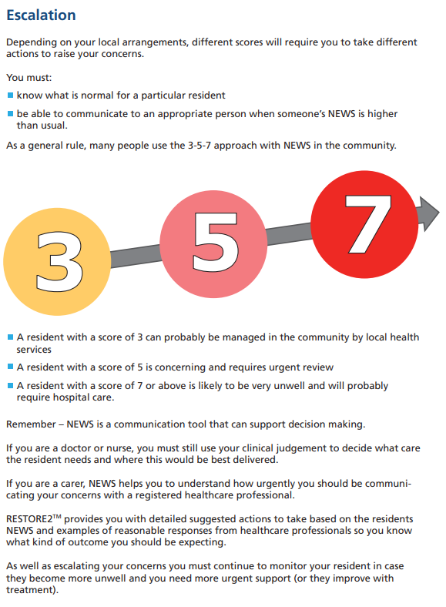
The basics for those busy and worrying times

Slide 23
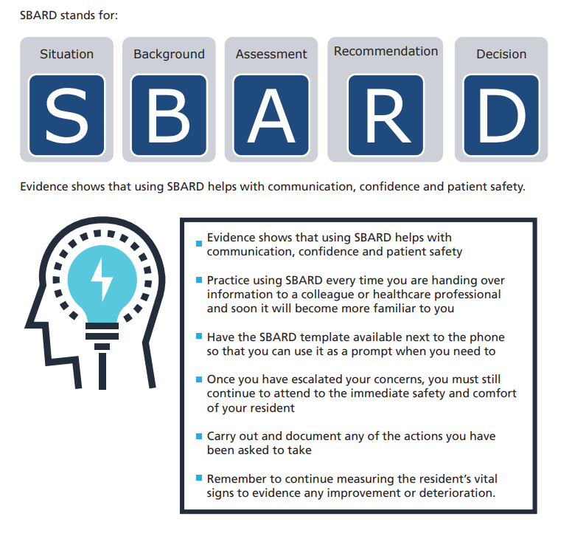

Slide 24
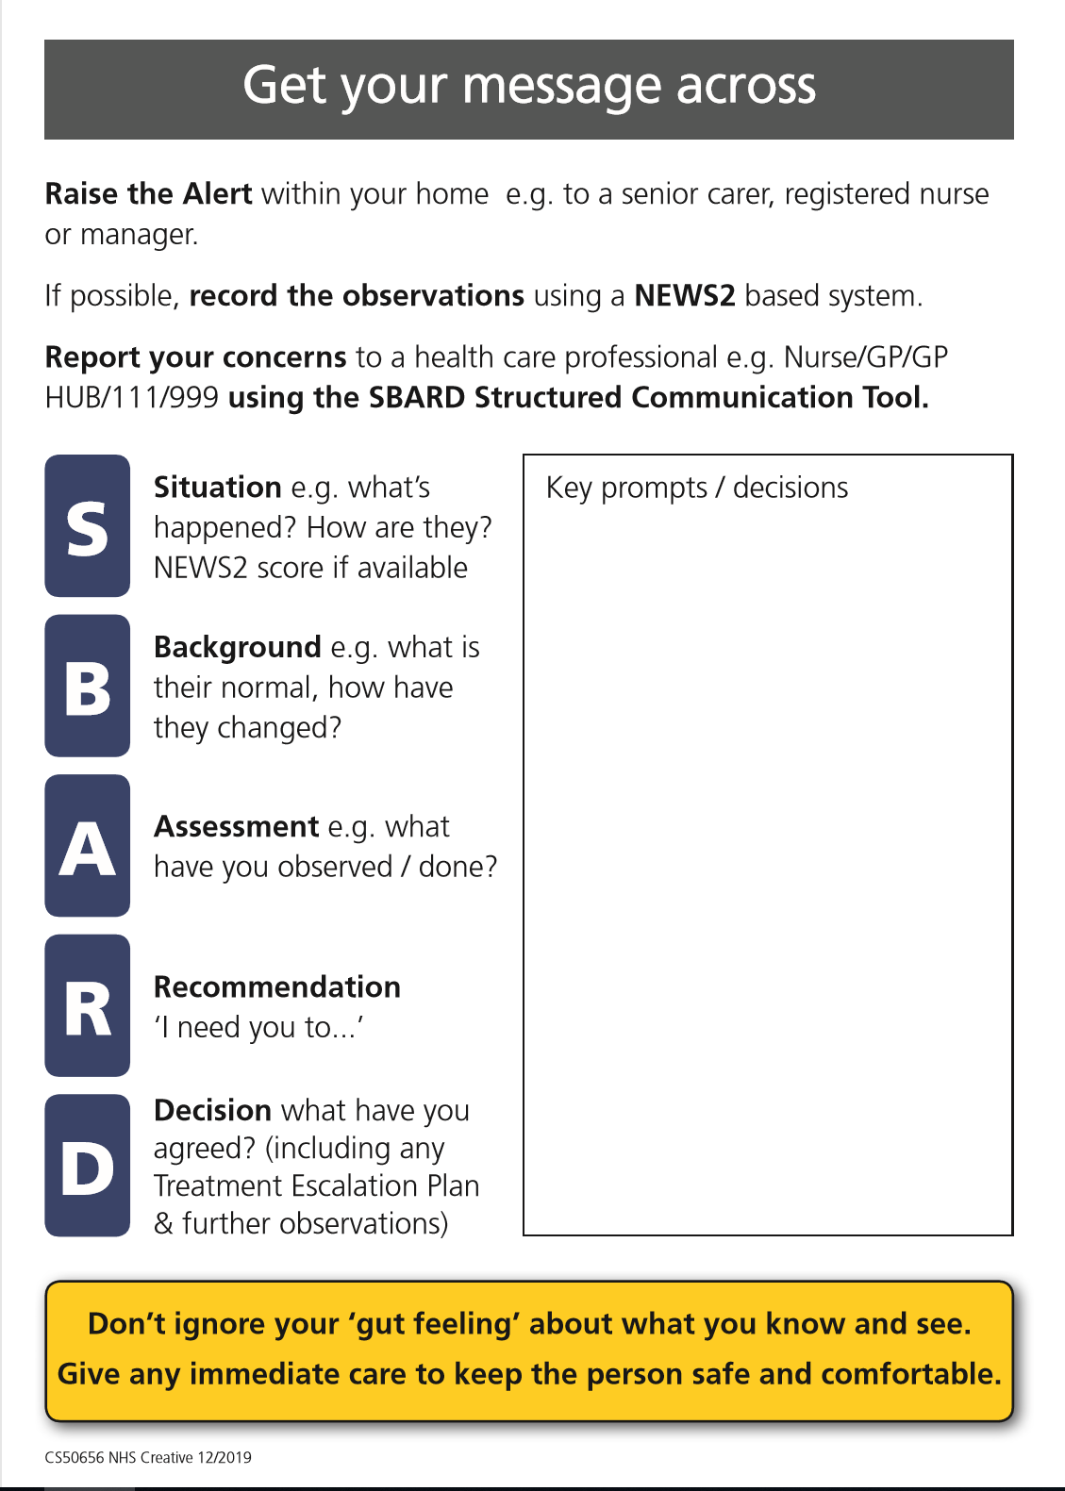
SBARD Communication Tool
Once carers have attended the RESTORE2 to training please discuss your concerns with other healthcare providers in the following format:
Situation
Background
Assessment
Recommendation
From The GP or ambulance get:
Decision that has been agreed

Slide 25
Simon is an 81 year old resident (NHS number 239 293 0128) who has been in your home (Sunny Hollow Residential Home, 01276 623 9833) for two years – you know him very well.
Simon is always very cheerful and engaging but he has dementia – he has trouble remembering where he is and has to be supported to take his medication.
However, he always recognizes his daughter when she visits and loves talking about old memories with her. Simon is physically well, and only takes some tablets to lower his blood pressure. He is prone to chest infections and has just in case antibiotics in the home.
When you see Simon today, he looks more withdrawn. His daughter tells you that he struggled to recognize her and thought that she was his mother. He sounds chesty so you sit him up.
Simon has a treatment escalation plan that states he is not for resuscitation but is for full medical treatment of any reversible illness. This includes being admitted to hospital for treatment.
Simon’s temperature is 37.8°C, he has new confusion, heart rate 89, BP 181/90, Sats. 96% on air, & respirations 24 breaths per minute giving him a NEWS2 score of 5. His normal score is 0 or 1
Complete the Situation, Background, Assessment and Recommendation SBARD sections.

Slide 26
Situation
XX calling from Sunny Hollow Residential Home. I am a Carer. Direct line 01276 623 9833.
Calling about Simon, 81 year old resident who appears unwell today.
Concerned that he is chesty with a higher than normal breathing rate and more confused than usual.
His NEWS2 score is 5 & normally is 0 or 1
Background
Simon has dementia. He always recognizes his daughter but struggled to recognize her today and thought that she was his mother.
Simon has a DNACPR (do not attempt cardio pulmonary resuscitation) in place but is for full treatment of any reversible illness, including hospital admission. He gets recurrent chest infections.
He is currently on a blood pressure medication only. He does have antibiotics in the home.
Assessment
He has deteriorated in the last XX hours his temperature is 37.8°C, new confusion, heart rate 89, BP 181/90, Sats. 96% on air & respirations 24. I think he has a chest infection. I have sat him up.
Recommendation
Please could you come and see him. I will repeat his observations in 30 minutes. Would you like me to start his antibiotics?

Slide 27
QUIZ
What does RESTORE2 stand for?
What is RESTORE2 ? (in one sentence)
Why is early detection of deterioration important?
Name 2 benefits of RESTORE2
What does NEWS stand for?
What observations have different escalation trigger points during this Covid 19 pandemic?

Slide 28
REVIEW of CORE LEARNING OUTCOMES
to know about Restore2 training in homes and the benefits to Primary Care
to know about RESTORE2 and why it is, important
to understand what soft signs are and why they matter.
To understand NEWS2* scores
*Used by Homes that can undertake a full set of physical observations
to expect Carers to use a SBARD format when calling

Slide 29
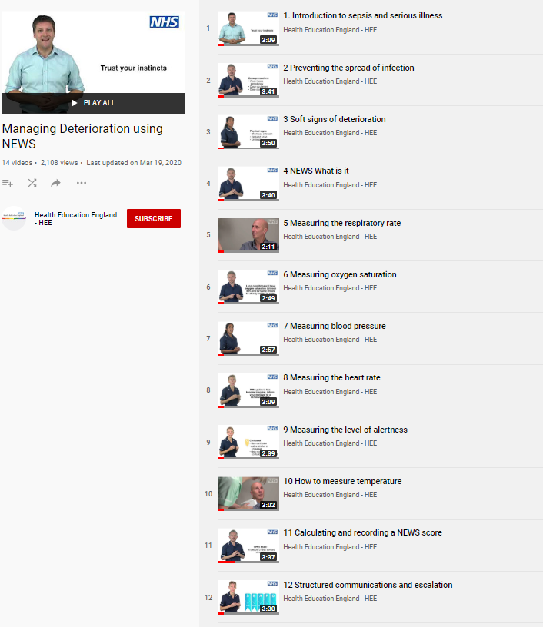
REFERENCES AND RESOURCES
Wessex AHSN and West of England AHSN have collaborated with West Hampshire CCG (RESTORE2) and Health Education England to produce a series of free videos and e-learning materials to support staff working in care homes to care for residents who are at risk of deterioration.
The full set of 14 Managing Deterioration Videos can be accessed via: https://wessexahsn.org.uk/projects/358/care-home-training-resources and individual videos applicable to the use of RESTORE2mini are flagged below with a green tick ( ) and indicated on the relevant slides.
✓
Linking the Managing Deterioration Videos and RESTORE2
Spotting serious illness and sepsis
Some people are more at risk than others of becoming unwell very quickly and developing a serious illness such as sepsis. This is known as ‘deterioration’ and it is important that anyone who cares for individuals who are at risk of deterioration knows how to spot the signs, especially during the current COVID-19 outbreak.
Watch this film
Introduction to sepsis and serious illness
Soft Signs and What’s Normal
What to look out for when it is not appropriate to take measurements of a person’s vital signs.
The RESTORE2 mini tool is helpful in these situations.
A white paper from Geoff Cooper at Wessex AHSN looks at using soft signs to identify deterioration.
Watch these films
Preventing the spread of infection
Soft signs of deterioration
Recognising deterioration with a learning disability
Take Observations
The National Early Warning Score is used by GPs, ambulance services and acute hospital trusts.
RESTORE2 makes NEWS2 more accessible to care and nursing homes.
Watch these films
NEWS: What is it?
Measuring the respiratory rate
Measuring oxygen saturation
Measuring blood pressure
Measuring the heart rate
Measuring level of alertness
How to measure temperature
Calculating and recording a NEWS score
Escalate and Communicate
Effective communication is vital for safety critical messages between different healthcare staff
Watch these Films
Structured communication and escalation
Treatment escalation plans and resuscitation
✓
✓
✓
✓

