Slide 1
Somerset Care Provider Survey
May 2023

Slide 2
Background
Somerset last conducted a Care Provider Survey during the pandemic in June 2021 when the system was working very hard to support providers through Covid-19, seeking to understand how supported providers had felt and what more assistance was needed.
At this time, 88% of survey respondents reported feeling well or very well supported by the Somerset health and care system. A number of 'asks' were made to continue to progress certain areas in partnership. These included: fair rates of pay; more work to support care sector recruitment/retention/training; recognising care providers as equal partners that are part of the solution to shared challenges; more investment in communities and micro-provision; and continued communication, collaboration, support and engagement with a 'one stop shop' website.
In response, a range of work was undertaken which included the development of a provider engagement website, continued weekly provider briefings (newsletters), the re-launching of monthly Learning Engagement Meetings, investment in Proud to Care Somerset and recruitment campaigns, and more.

Slide 3
Background
We were very keen to hear again from our care provider colleagues as part of work planned to review the local Health (NHS Somerset) and Social Care (Somerset Council) system's existing support offer and ensure it meets wants and needs wherever possible.
The feedback helps the system to monitor partnership working, govern local performance, and also provides invaluable feedback evidence for a range of activity.
The survey ran throughout May 2023, and was actively promoted via a range of communication channels including the Council’s weekly care provider briefings, through Learning Engagement Meetings, and via the Registered Care Providers Association.

Slide 4
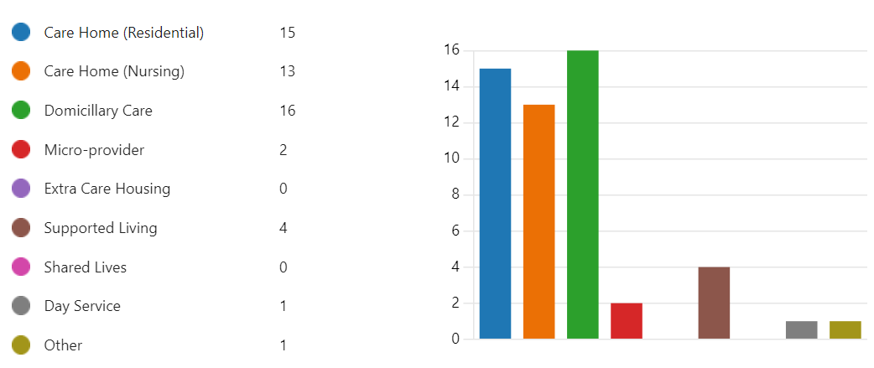
Response rate
This year, we received 52 survey responses from Somerset adult social care providers, across a range of services and settings:

Slide 5
Q6. What does your business/organisation need most currently?
Example comments:
Recruitment of permanent staff. Volunteers to support in the home.
I think a training directory of places that care homes can access training providers would be useful. Manual Handling , train the trainers , first aid and fire training etc. It is often hard to find training providers especially for us smaller independent homes.
More realistic funding. FCoC exercise showed care costs of over £900 per week before a year of inflation at over 10%. Whilst fee increases have been welcome they are still 2 years behind i.e. £1000pw from 2025 is where we need to be now!
Better rates for ASC funded people.
Recognition for staff including staff terms and conditions equal to NHS staff eg pensions and sick pay, access to NHS learning and libraries to study. Being treated as a equal not being told to or done to by NHS colleagues who have never worked in a care home service
Enhanced rates of pay including travel allowances for remoter clients
Referrals. Bed vacancies

Slide 6
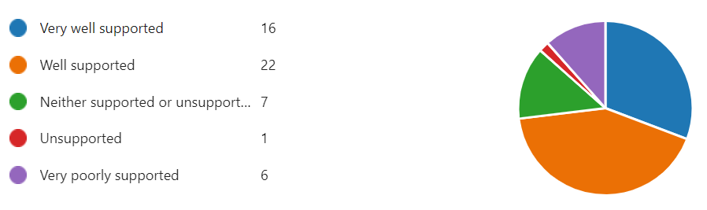
Q1. How supported do you feel by the Somerset health & care system?
Overall, 73% of survey respondents reported they feel well (42%) or very well (31%) supported by local health and social care colleagues and services in Somerset. This was especially the case for domiciliary/home care providers who made up 37% (14) of this cohort. This is down on 2021 results (88%)
The main feedback amongst less satisfied providers indicated frustrations with having available bedded capacity but not being utilised, unrealistic fee levels, as well as poor response times from GPs, 111 and 999, or a lack of understanding by health colleagues of the Mental Capacity Act.
Two thirds of the 6 providers reporting feeling ‘very poorly supported’ were Nursing Homes in Somerset.

Slide 7
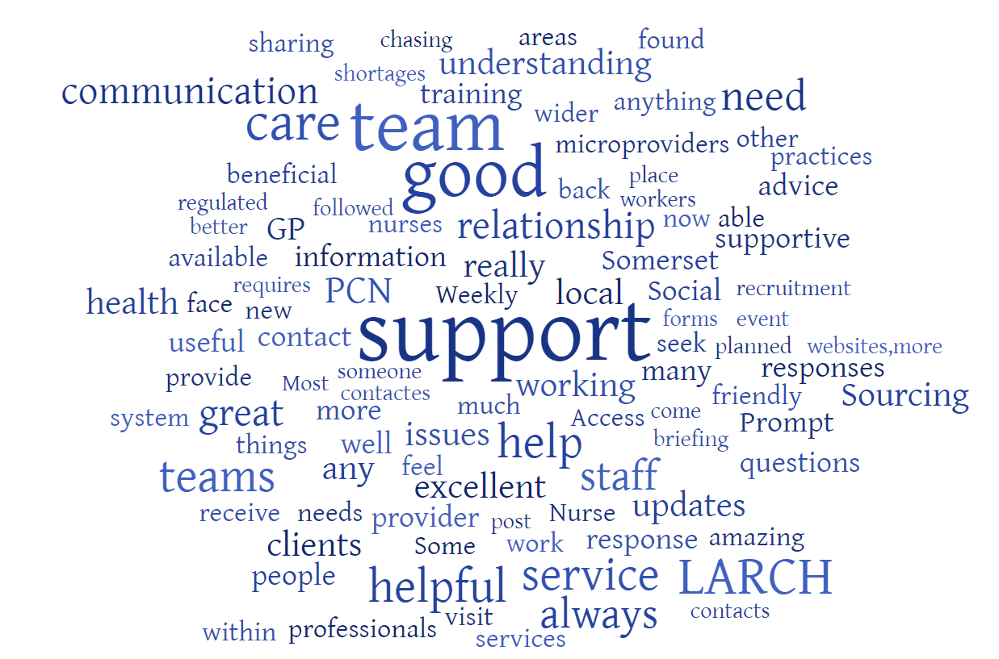
Q2. What works well in relation to the support provided by the wider local health and care system?
Most commonly referenced feedback about what works well in Somerset centred on:
Good communication and engagement opportunities across the sector, including webinars, briefings, co-production
Positive working relationships
Having help, support and advice available when needed
The work of the LARCH team and Primary Care Networks (PCNs)
The support and approach of the Sourcing Care team

Slide 8
Q2. What works well in relation to the support provided by the wider local health and care system?
Example comments:
Somerset Council is always updating us and are there if you need support
The care co-ordinators are brilliant and we really appreciate that they are there for when we need them and that they will help us solve any issues that arise. They keep in good contact and come to visit and sit down for a chat and always ask if there is anything we need and take action to help if we do need anything
The PCN teams are helpful with regards to feeding things back to GP practices. During Covid we had useful support from LARCH. LARCH are now less proactive but I am sure that if we reached out to them they would prove a useful resource
Establishing a good working relationship is important and to be able to trust the systems in place. Our relationship with Sourcing Care and the Quality Assurance team are excellent.
The local health and care system shows a fair understanding of the issues, costs and barriers to providing a compliant and regulated service. From talking to other providers in different localities we feel Somerset offers better support than many others

Slide 9
Q3. What could be better in terms of the support provided by the local health and care system in Somerset?
Most commonly referenced feedback about what could be better in Somerset centred on:
Improving the responsiveness and accessibility, especially from Local Authority social workers
Improving communication, especially from hospitals to support effective admission or discharge arrangements
Enhancing information about access to key contacts/services and extent of support available

Slide 10
Q3. What could be better in terms of the support provided by the local health and care system in Somerset?
Example comments:
It would be good to be given a guide as to all the support available and how to access it
Reviews by CHC and FNC reviews are on the phone-they should be in person
We urgently need better responses to enquiries - it is almost impossible to speak to anyone on the initial point of contact / call - no telephone response - have to either leave a message or email. When emails are sent, especially Somerset Council, no response and often have to chase with another and another. Access to timely support from Mental Health colleagues - very drawn out. This causes so much wasted time – chasing.
Individual workers are becoming very difficult to contact, we are having to chase considerable with regards to placements and financial agreements. this causes an operational issue with regards to finances.
LA Clients having a named social worker, like the old times.
Hospital discharges need to be improved regarding mobility concerns. It's important the hospitals know the correct procedure for discharging services users who are already in the care system and that the care needs are reviewed and approved prior to discharge.
Communication from hospital staff to providers where client's being admitted
Schemes to aid recruitment that actually work. For example offering free parking in council car parks, free access to leisure centres or even a carers discount on council tax. Finding a means to stop domiciliary care staff leaving to become micro providers and stopping micro providers cherry picking the easier packages/taking weekdays only.

Slide 11
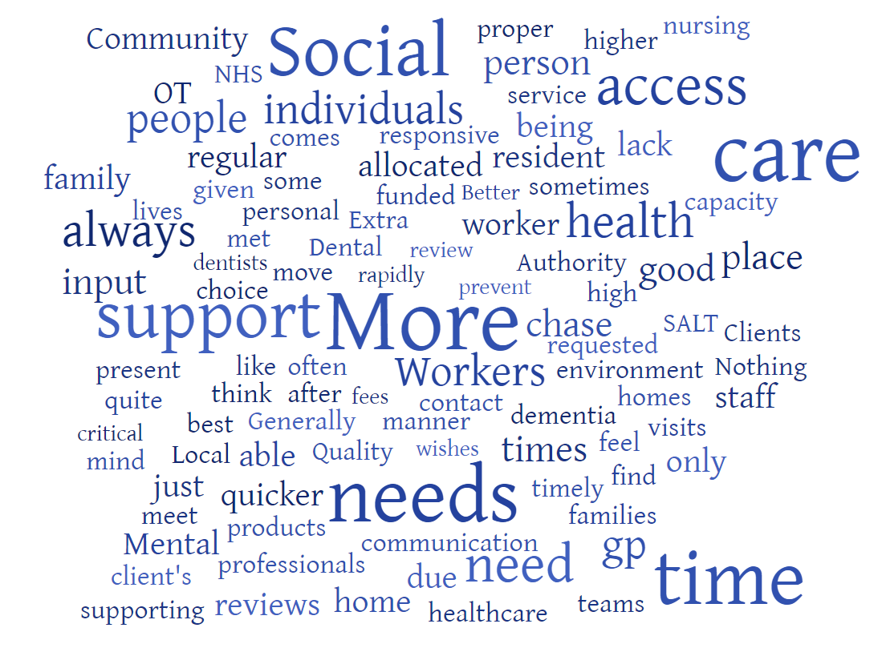
Q4. What do you feel the individuals you care for and support need most currently?
Most commonly referenced aspects were:
More social workers and timely reviews / re-assessments of needs
Dentistry
GP access
Mental health support and input
Easier access to Occupational Therapists
Support with frailty / falls

Slide 12
Q4. What do you feel the individuals you care for and support need most currently?
Example comments:
Better access to mental health services. An NHS dental service - and even access to any dentist in a timely manner
Reviews - we chase and chase and when they happen we never get the minutes and then we chase and chase again
Quicker reassessments of needs as our concerns and needs for enhanced care packages to meet rapidly changing needs are not always approved until reassessment which causes sometimes unwanted hospital admissions
Named social worker; also quicker times to be assessed as this can take quite a long time
Quicker access to CPNs; More online training for RGNs
Incontinence products and care.
OT equipment specifically for their needs - as in person centred for specific needs.
Allocated Social Workers!
Currently we are supporting a lot of people who are just generally getting frail. Closely followed by our dementia clients

Slide 13
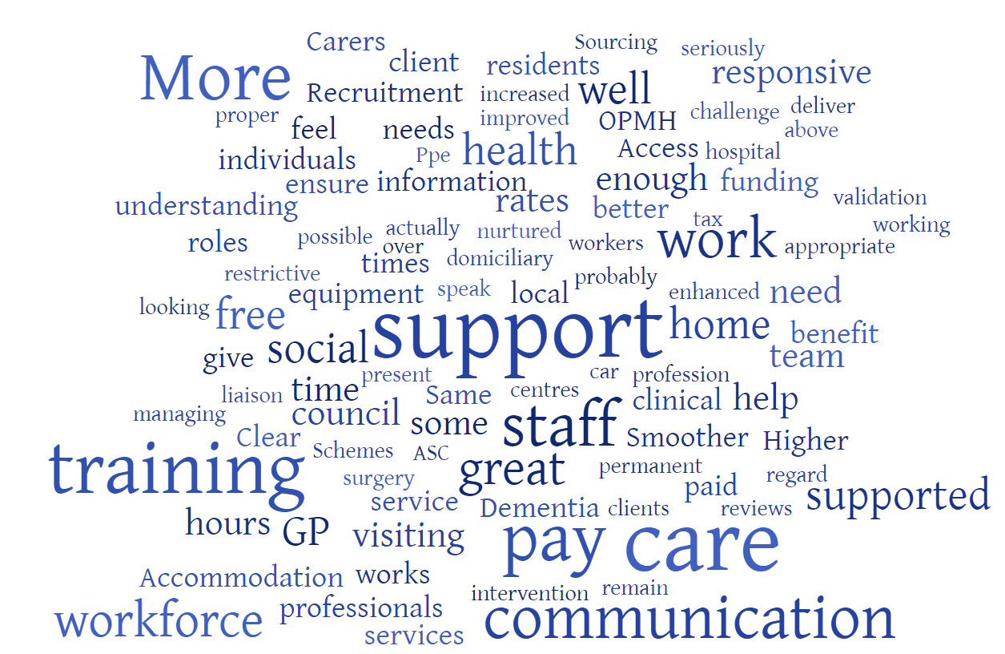
Q5. What do your workforce/colleagues need most currently?
Most commonly referenced aspects were:
Higher wages and rates of pay to support recruitment and retention
More training opportunities
Improved response time from system colleagues (GPs, social workers etc) to help keep people safe and well
Equity with NHS

Slide 14
Q5. What do your workforce/colleagues need most currently?
Example comments:
More free or affordable training such as clinical training for senior staff
GP services, staff have good understanding of this is also nurtured through professionals at the local surgery interested and knowing the home.
My nursing team (& residents) would benefit from a named visiting GP - that ownership for our residents would improve patient care. We would also benefit from MDT's with the GP
Responsive support from social workers and health professionals to ensure the needs of individuals are met in order to keep them safe.
Support with training-specialized training
Enhanced rates of pay beyond what we can give
For care work to be a more respected profession.
Supported with increased funding to enable us to pay a better rate of pay to staff - to ensure we have enough people looking to join our workforce.
Higher wages; more validation for important work they do

Slide 15
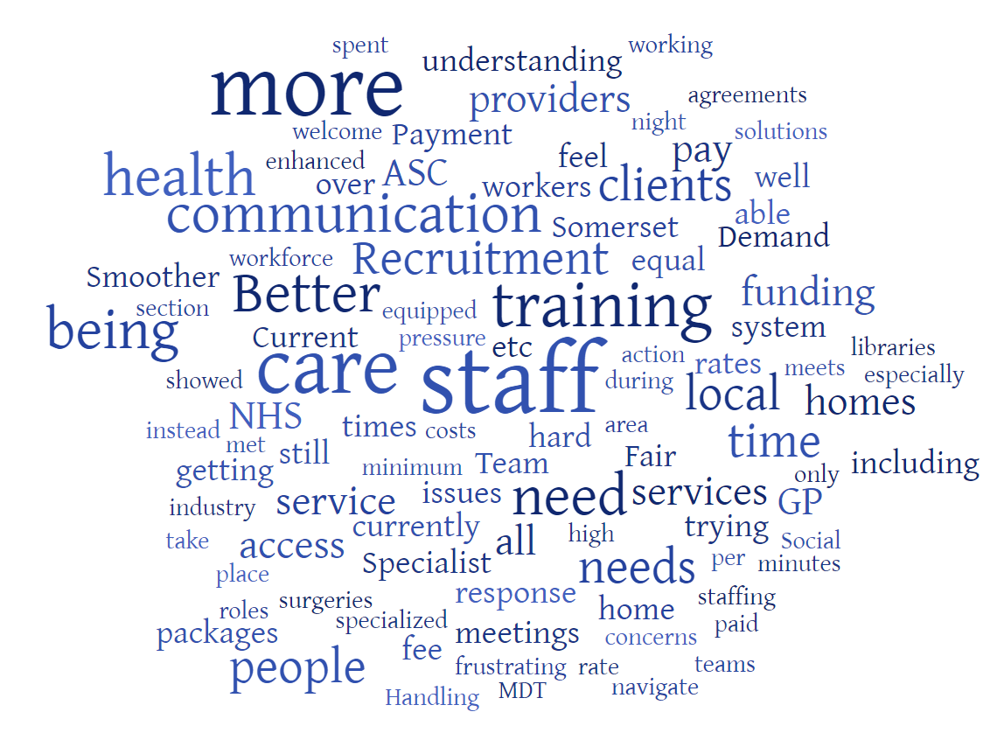
Q6. What does your business/organisation need most currently?
Most commonly referenced aspects were:
Staff / permanent staff
Training Directories / support
Fair rates of pay / funding
Improved response times / communication
More work (clients, packages of care, bed vacancies)

Slide 16
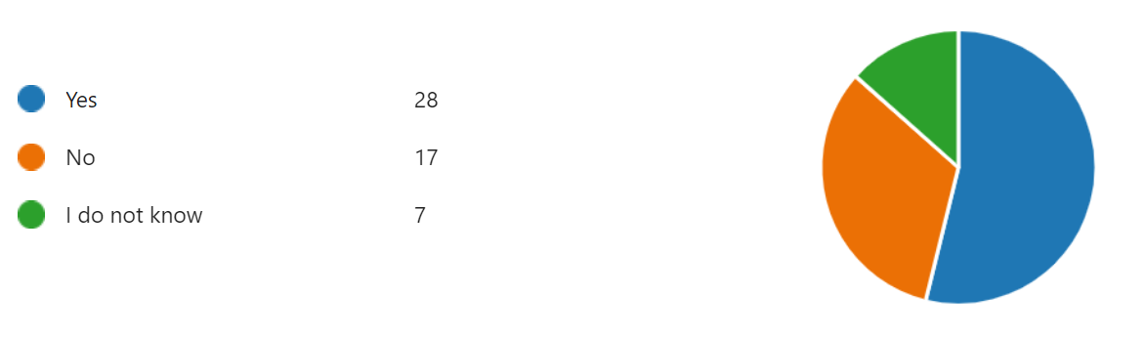
Q7. Do you feel local people have access to a diverse range of safe, effective, high-quality support options to meet their care and support needs?
This question reflects one aspect the Care Quality Commission is keen to explore as part of new Local Authority assessments of delivery of Care Act duties, launched from April 2023.
Based on this survey, 54% of care providers agreed that local people have access to a range of safe, effective and high-quality support options to meet their needs.

Slide 17
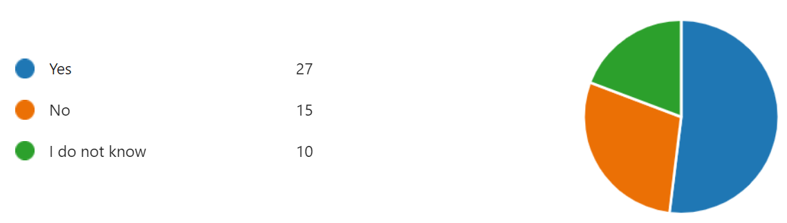
Q7. Do you feel partnership working in Somerset helps to ensure that care and support meets the diverse needs of individual people and communities, with people's support co-ordinated across different agencies and services?
This question reflects one aspect the Care Quality Commission is keen to explore as part of new Local Authority assessments of delivery of Care Act duties, launched from April 2023.
Based on this survey, 52% of care providers agreed that partnership working locally is effective and helps to meet the needs of our local communities.

Slide 18
Q9. Any other comments / feedback?
Positives
I think Somerset are doing very well working in partnership with providers.
I think we are very well supported and appreciate you asking these questions. Thank you all for your hard work and for caring so much.
Having worked with other Authorities I can honestly say Somerset are the best for joint working including providers in decision makings, inviting us to participate in new initiatives and actively helping with recruitment.
We are in a fortunate position with the health professionals associated with this home having good awareness of peoples needs and presenting behaviours when and should they need medical interventions
Thank you for all your continued support
Concerns
Recent access to Adult Social Care teams has been difficult. The calibre of Social Workers in localities teams spoken to recently have been poor
Response to complaints that are made to NHS England on behalf of individuals is very slow, and so far, no feedback from it.
While Social Services work so hard to maintain services it is undermined by NHS and the inequality of access to additional funding.
I feel very frustrated with the whole situation of the care sector at present - still so much focus is on the NHS and their staff. Care sector staff, my staff, seem to be the lowest of the low - when in fact without them the whole NHS system would come to a grinding halt.
Fees on offer from Somerset far lower than can be achieved from other providers such as BANES.
Less unregulated micro-providers who are not compliant and care is not monitored or regulated as this creates an unfair market for organisation who pay huge amounts to CQC to ensure quality compliance.
Somerset NHS and ASC are staffed by well meaning people. However it appears there is a repetitive inclination to repeat the myths and stereotypes of what a care or nursing home is. For hospital staff to tell patients and families go to ….. care home you will get help with funding eg fast track, CHC. People are angry when they hear the truth that they didn't qualify and must fund from their savings, and may have made different choices had they had understood properly.

Slide 19
Time for Questions
Contact email: niki.shaw@somerset.gov.uk

