Slide 1
Somerset Patient Safety Incident Response Framework (PSIRF)
Update
2nd May 2023

Slide 2
Our system strategic aim
To continuously Improve Patient Safety in Somerset by…
Ensuring our people have the skills and opportunities to improve patient safety across the system.
Improving our understanding of patient safety by drawing insights from multiple sources of patient incidents and patient experience information.
Having an improvement programme which enables collective and sustainable change in patient safety and knowing we have made a difference.
A patient safety culture
A patient safety system

Slide 3
Contents
Reminder of PSIRF and timetable
Introduction
Our PSIRF principles
Ensuring our people have the skills and opportunities to improve patient safety across the system
Improving our understanding of safety by drawing insight from multiple sources of patient safety and patient experience information
Our measures of success
How we will know we are making a difference

Slide 4
What is PSIRF?
Sets out our approach to respond to patient safety incidents for the purposes of learning and improving
A co-ordinated approach that prioritises compassionate engagement and involvement of those affected by patient safety incidents
Application of a range of system-based approaches to learning from patient safety incidents
Considered and proportionate response to patient safety incidents
Supportive oversight focused on strengthening response system functioning and improvement – having a just culture

Slide 5
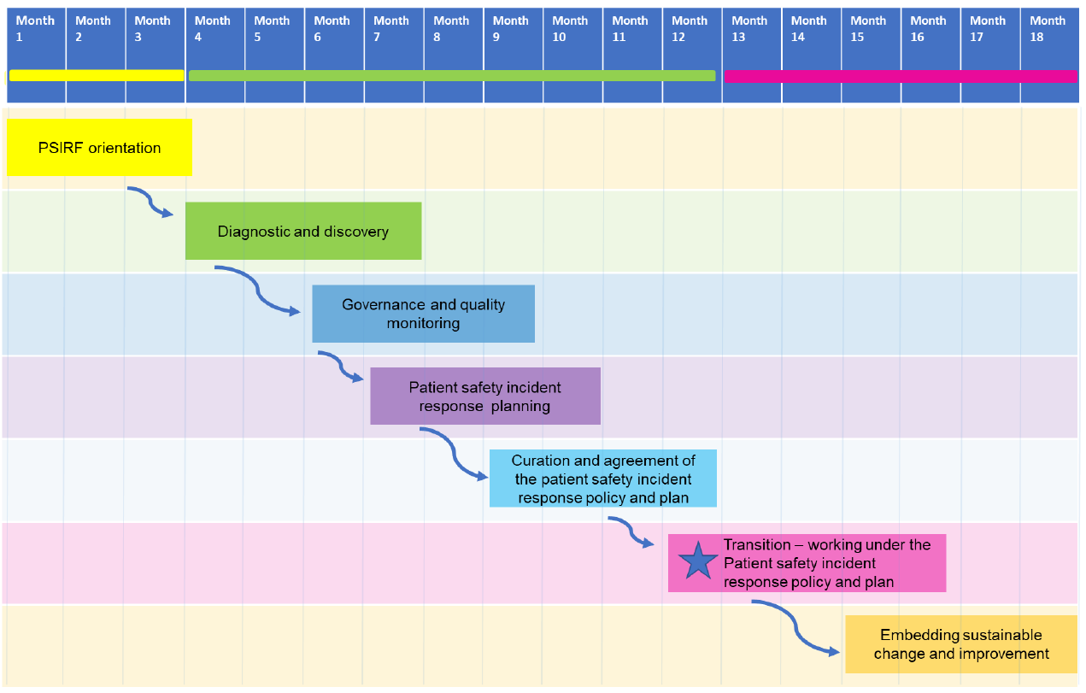
PSIRF Implementation Timetable
Sep 22
Dec 22
May
23
Sep 23
Feb 24
Implementing LfPSE
Notes:
Describe each step briefly:
Diagnostic: review strengths and weaknesses – will feed into integration processes
Governance: will look at structures for oversight and sharing learning
Planning: review data and consider priorities and methods (not just investigating because it “is serious”, but focussing on areas of greatest potential for learning)
PSIRP – agreeing plan and signing off with stakeholders
Transition
Embedding

Slide 6
1. Introduction
This is an overarching PSIRF plan for the Somerset health and care system following the national publication of PSIRF in September 2022. This plan sets out our approach to PSIRF and our planned ways of working.
System partners have been working together in the spirit of PSIRF since May 2022 and following publication of the national framework in August 2022 have been rolling out the PSIRF approach through a system wide project team.
It is intended that each system partner will have their own comprehensive PSIRF plan which details how PSIRF will be fully implemented within each organisation. It will be the responsibility of NHS Somerset Integrated Care Board (ICB) to review and approve each provider’s PSIRF plan during 2023/24 (as per the 2023/24 NHS Standard Contract).
Please note that a thorough PSIRF project plan also exists which sets out the detailed steps in fully implementing PSIRF across Somerset, along with our risks and issues.

Slide 7
2. Our PSIRF Approach (1)
At our PSIRF workshop in May 2022, as a health and care system, we agreed some common principles in our approach to PSIRF. These can be themed into:
Approach, communication, and language
To not try to implement PSIRF using a ‘big bang’ approach, instead implement it gradually.
To challenge culture in making our culture change.
To feel safe to challenge and not to slip into the old ways.
To understand that everyone has a role in recognising patient safety because safety culture is everybody’s business.
To welcome all ideas from all areas of our health and care settings.
To see, feel, and hear patient safety, be visible and use other ways to be able to raise a concern.
To have a process of top-down and bottom-up communication and joined up working with regards to patient safety. This will form part of our PSIRF communication plan.
To ensure communication throughout our geographical area.
To engage with all those in our system and get all involved.
To peer challenge and be brave in doing something different.
To update our language to focus on learning rather than investigation
To encourage uptake of Level 1 Patient Safety Syllabus training for NHS staff.

Slide 8
2. Our PSIRF Approach (2)
Others we want to work with
Patient Safety Partners
Patients, families, carers (paid and unpaid)
Primary care
Social care
Clinicians and care staff
NHS England
Regulatory Bodies
Coroner and Medical Examiner
Family Liaison Officers
Healthwatch
Communities, and engagement teams, particularly when addressing health inequalities
Academic Health Science Network

Slide 9
2. Our PSIRF Approach (3)
Building on what we have available in place already
Build on our existing processes, such as patient safety reviews, to strengthen our learning opportunities.
Triangulate our patient safety information with other intelligence e.g. Patient Advice and Liaison Services, complaints, staff and patient surveys.

Slide 10
3. Ensuring our people have the skills and opportunities
As a Somerset health and care system we have agreed to use the same PSIRF training provider to ensure we are being consistent in our approach and messaging on PSIRF.
It is intended that training will be provided together, across sectors, to promote the richness of conversations when working through patient safety examples.
Whilst we are engaging primary care colleagues in the awareness raising of PSIRF, it is not intended for them to fully implement PSIRF by September/October 2023. As a system we want to hear of the learning from the primary care national PSIRF pilots.

Slide 11
4. Our Somerset Patient Safety themes
As a system, we want to agree on a number of patient safety improvement projects per year which will be subject to PSIRF reviews.
Whilst having not yet completed the diagnostic and discovery phase of our PSIRF roll out, it is expected that the following patient safety topics will be subject to PSIRF thematic reviews from October 2023:
XXXXXX
XXXXXX
XXXXXX
XXXXXX
XXXXXX
XXXXXX
XXXXXX

Slide 12
5. Our measures of success
Increase in the proportion of time spent on improvement and a decrease in time spent on investigation of patient safety incidents.
1
Greater compassionate engagement and involvement of those affected by patient safety incidents
2
Being learning organisations on all aspects of patient safety by implementing a ‘just culture’
3
Reducing harm. People feeling confident and safe when in receipt of our care and support across Somerset
6
Providing examples of excellence, improvement and innovation across our health and care services with regard to patient safety
4
Patients and families seeing and feeling the impact of and the speed of our improvement with regard to patient safety
5

Slide 13
6. How we will know we are making a difference
As a Somerset system, we all need to experience and evidence the improvements that have taken place in response to a PSIRF review. This could take place in several ways and can include:
Creating a patient safety culture and people being able to speak up if they feel unsafe
Staff and patient surveys and other feedback mechanisms
Patient and public forums
Gathering and analysing patient, carer and staff feedback following implementation of a PSIRF improvement project
Healthwatch projects in response to a PSIRF improvement project
Walkthrough visits in response to PSIRF thematic reviews

Slide 14
Glossary
Patient Safety Syllabus – An NHS Patient Safety Syllabus training programme. The content of the training helps to deal with risks before they can cause harm and working to create a positive patient safety culture
Patient Safety Incident Investigation (PSII) - Provides a clear explanation of how an organisation's systems and processes contributed to a patient safety incident. Recognising that mistakes are human, PSIIs examine 'system factors' such as the tools, technologies, environments, tasks and work processes involved.
Patient Safety Incident Response Framework (PSIRF) - Sets out the NHS’s approach to developing and maintaining effective systems and processes for responding to patient safety incidents for the purpose of learning and improving patient safety.
Patient Safety Partner - Is someone who works with the NHS to help make care safer for patients. Roles can include:
membership of safety and quality committees whose responsibilities include the review and analysis of safety data
involvement in patient safety improvement projects
working with organisation boards to consider how to improve safety
involvement in staff patient safety training
participation in investigation oversight groups

