Slide 1
Crisis Prevention Institute suite of programmes and supports
Tim Sproston, Global Professional Manager
Charlotte Harrison, Senior Business Development Manager

Slide 2
Company Overview
Established in 1980
Over 17,000 customer organisations worldwide
38,000 work-based Certified Instructors worldwide
15 million trained participants wordwide

Slide 3
Customers
Healthcare (including Mental Health) 20%
Social Care (including Learning Disability) 47%
Education (Mainstream and SEN) 20%
Other (including Dentistry, Housing Associations etc) 13%

Slide 4
Values and Philosophy
Eliminate use of Restrictive Practices.
Minimise use (Restrictive Practices should be an exception event).
Maximise safety and minimise harm.

Slide 5
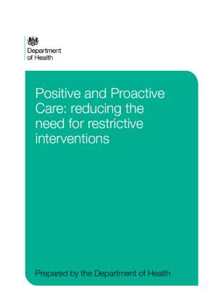
Drivers for Change

Slide 6
Drivers for Change
Established by CPI in 2014.
Now an independent charity.
UKAS Certification Scheme.

Slide 7
AFFILIATION
The process by which organisations,
with in-house instructors (CIs),
that deliver a certified provider’s programme,
can label their onward delivery
‘certified’.
Note for England - CQC state health and social care services in England are to only use training in restrictive practices that is certified as complying with the Restraint Reduction Network training standards will have to be affiliated to the RRN (Restraint Reduction Network, https://restraintreductionnetwork.org/). This is something we can help with, either through your affiliation with CPI or under your own affiliation.

Slide 8
Programmes: Sector and Topic Specific
Safety Intervention (Previously known as MAPA)
Health and Social Care
Education
Verbal Interventions
Clinical Holding
Classroom Culture
Dementia Capable Care

Slide 9
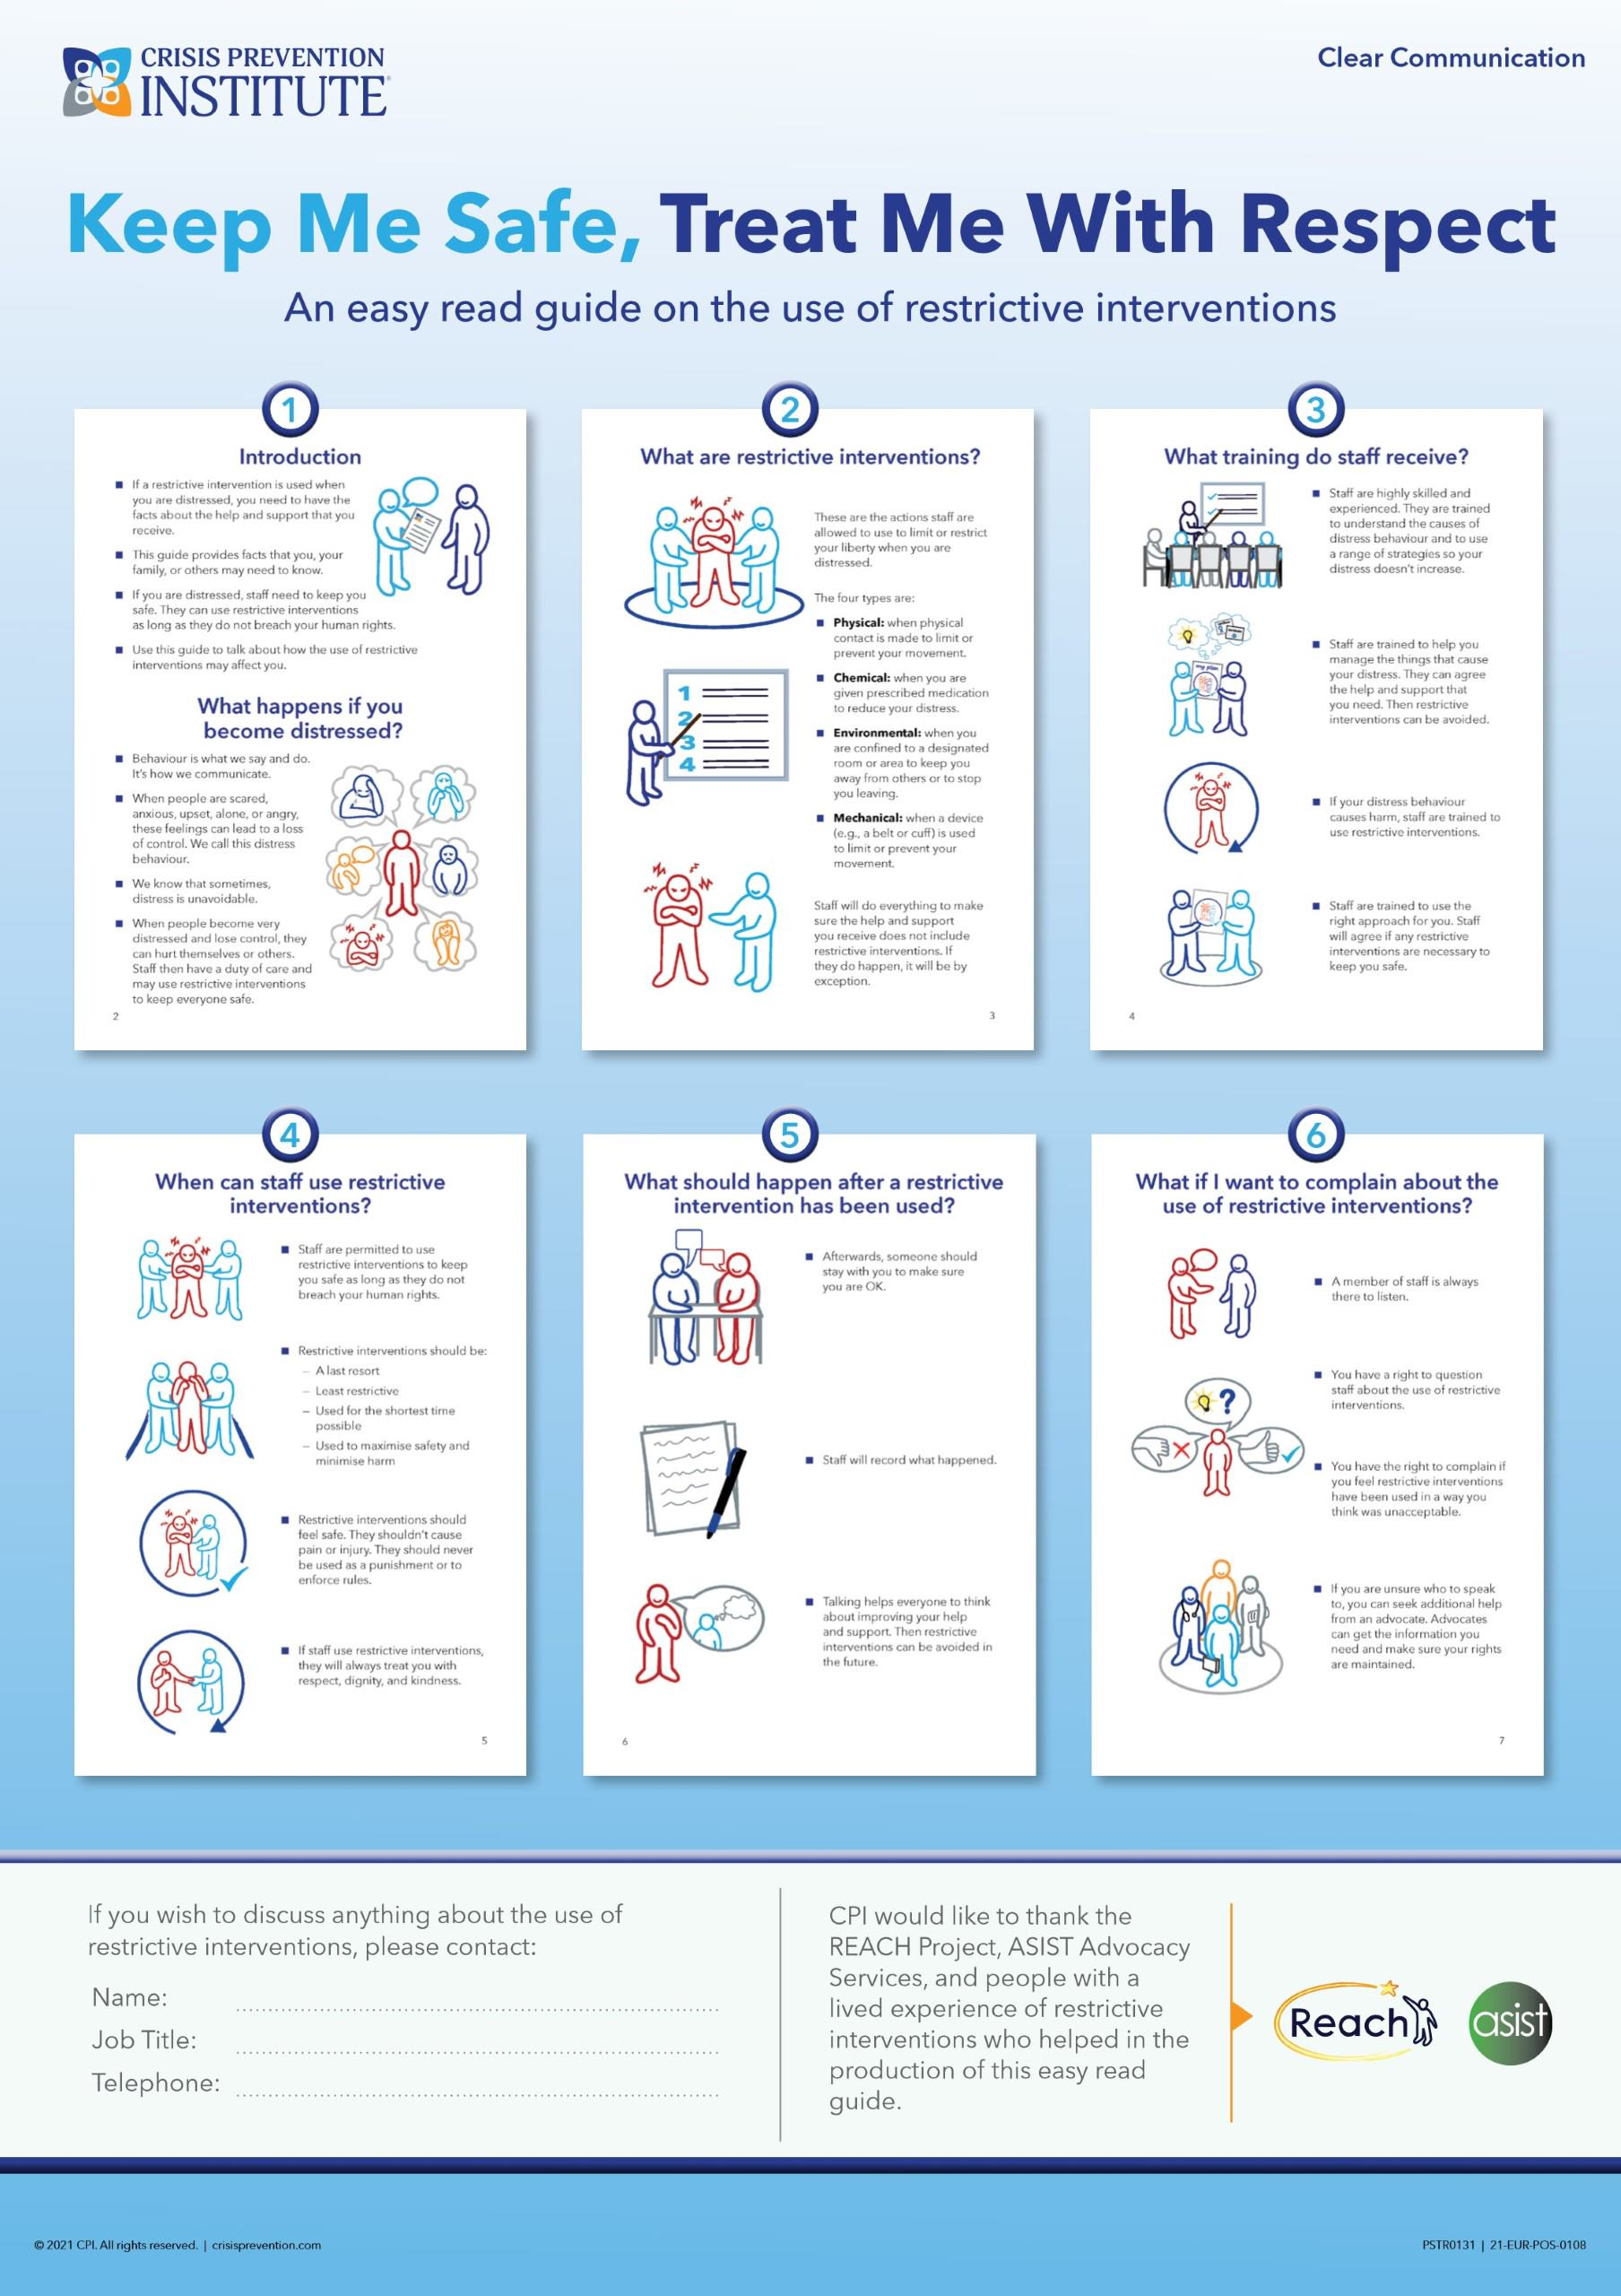
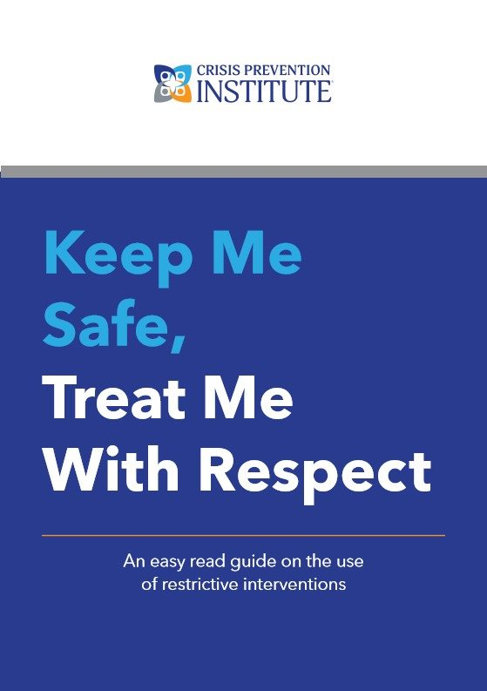
Programmes: Resources and Materials

Slide 10
Programme: Risk-Based Approach
HIGH RISK
Safety Intervention Advanced Course
MODERATE RISK
Verbal Intervention & Safety Intervention Foundation
LOW RISK
Prevention First
Driven by Training Needs Analysis.
Organisational authorization and approval.
Prevention compulsory.
Safety interventions (Non-restrictive and Restrictive) optional.

Slide 11
Programme: Flexibility of Delivery
DIRECT DELIVERY
CPI Professional Instructors.
In depth knowledge of programme
In depth knowledge of sector
Consistency of delivery.

Slide 12
Flexibility: Training Delivery Options
Blended
Face to Face

Slide 13
Programme: Online Documentation and Validation
Blue Card credential.
Unique verification number.
Annual Licence Renewal (in line with the RRN Standards).

Slide 14
More than training: Customer Feedback

Slide 15
Any questions?
CPI’s Understanding Behaviour Challenges and Reducing Conflict: How Experts By Experience Improve Outcomes event will deliver thought leadership to the education, healthcare, and social care sectors by bringing together experts by experience across sector workers and leaders. With a focus on behaviour challenges the event will identify current and future practices that will serve to develop collaborative working, improve outcomes of reduced conflict and violence and work towards making communities safer.

Slide 16
Thank You!
crisisprevention.com | 0044 (0)1615275436
charrison@crisisprevention.com

