Slide 1
Ageing Well January Update Learning and Engagement Group Meeting 4th April 2023

Slide 2
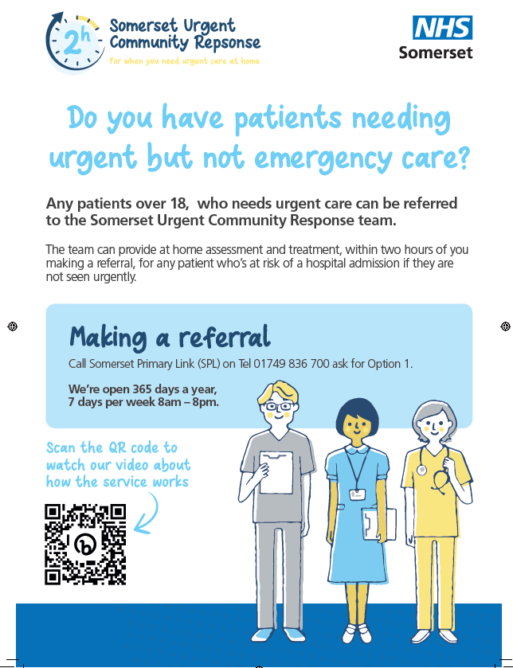
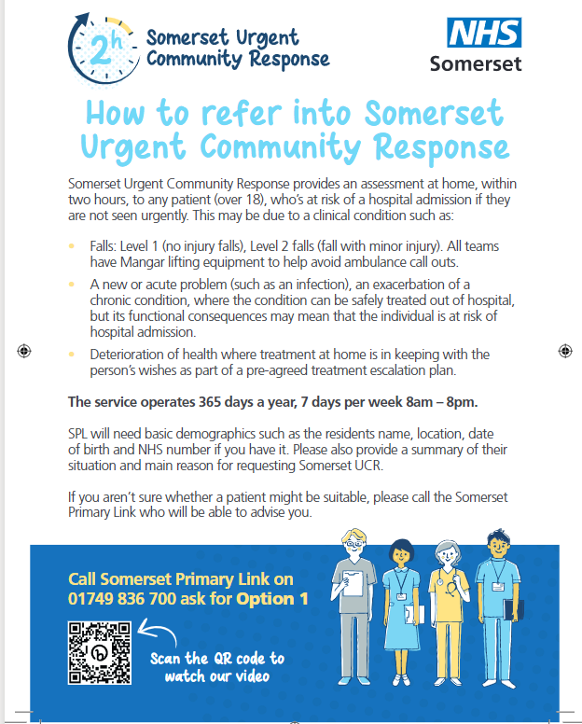
Urgent Community Response
Residential Homes will begin to receive posters on how to refer to UCR this week, please display and share with colleagues

Slide 3
Urgent Community Response Video

Slide 4
The South West Care Home Network
Are you in the network?
Find out what happened at the March meeting here
PowerPoint Presentation (swahsn.com)
Join the June Meeting here Form (hsforms.com)

Slide 5
Enhanced Health in Care Homes
Rebuilding Together
Coinciding with the 3rd anniversary of the first Covid lockdown, My Home Life England has released a new report called “Rebuilding Together” - A summary of insights into how care homes coped during the pandemic and what they need now to recover and rebuild. A Summary and link to full report is here https://myhomelife.org.uk/rebuilding-together-insights-how-care-homes-coped-during-covid-pandemic/
CQC Smiling Matters: oral health care in care homes report
This report shows what CQC found from a review on the state of oral health care in care homes across England. To access the report please click here: Smiling matters: oral health care in care homes - Care Quality Commission (cqc.org.uk)
Mouth and Swallowing Matters: Linking Oral Health, Dysphagia and Hydration Webinar 25 April, 10.00am – 12 noon
Following CQC Smiling Matters: oral health care in care homes report, NHSE invite you to attend a webinar on 25th April 10am – 12 noon. Bringing together a range of Health and Social Care Professionals whose work helps to improve mouth care, hydration, and swallow management for people at increased risk of (aspiration) pneumonia. You can join the meeting here: Please click here to join the meeting. If you would like to be included on the invitation and/or have access to the recording following the event, please email lisa.perrett2@nhs.net
Visits per referral
4

Slide 6
Intergenerational Linking in Care Homes
The Care Home FaNs: Intergenerational Linking project held a webinar on Wednesday 22nd February, sharing the outcomes and benefits from this England wide research project, it included 8000 young people and 2000 residents, with some of the projects happening in the South West being featured! We will shortly be sending out invitations to a South West learning and sharing event to share the benefits of this work and look at how this can be further enhanced in the future.
Joint Contractures Video
An awareness video for carers to highlight the risks associated with the development of joint contractures and practical preventative steps has been created by Dorset Healthcare University NHS Foundation trust. This video was co-created as a collaboration between Dorset HealthCare’s clinical staff, the quality improvement team and with support from staff at Encore Care Homes. Special thanks to Amanra Digital (www.amanradigital.com) for the excellent animations. https://www.youtube.com/watch?app=desktop&v=aITUZ63khr0
Co-Production in social care
As part of Social Work Week (20 March), the Social Care Institute for Excellence (SCIE) launched a survey for adult social care professionals and people who draw on services - to share their thoughts and experiences on co-production. They want to find out more about your understanding and experiences of co- production. What does co-production mean to different people? What can help or hinder co-production from happening?
Take this ten-minute survey to help the put people who draw on services in the driving seat. The survey closes TODAY 4 April. Findings will be published during Co- production Week in July.
Working Together to Improve Health and Wellbeing
5

