Slide 1

Walk Your Way
Are you looking to Walk Your Way and would like a FREE copy of our new DVD? Email healthenquiries@sasp.co.uk to find out more.
Choosing to walk virtually at home and bringing the outdoors in is a great alternative with many similar health benefits to walking outdoors.
https://www.sasp.co.uk/walk-your-way

Slide 2

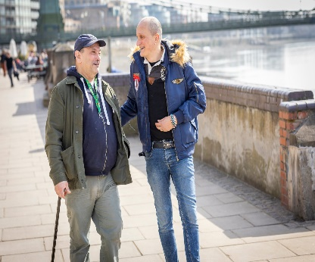
Move More Together
A Programme to Support Inactive Adults Over 50 to Get More Active.
Participants will be matched with a volunteer who will meet them regularly and support them on a one to one basis, providing friendly support and encouragement to get moving in ways that work for them at their pace. People can self refer or via a third party.
This is a really special opportunity whether you are looking for some help to take the first steps to a healthier happier future or have an hour or so to spare a week and would like to help someone start that journey.
For more details contact Jenny our Volunteering
Project Officer.
Call: 01823 653990/07599 654677
Email: jstreet@sasp.co.uk
Or visit our website :
https://www.sasp.co.uk/move-more-together.
Opportunities for participants and volunteers!

Slide 3


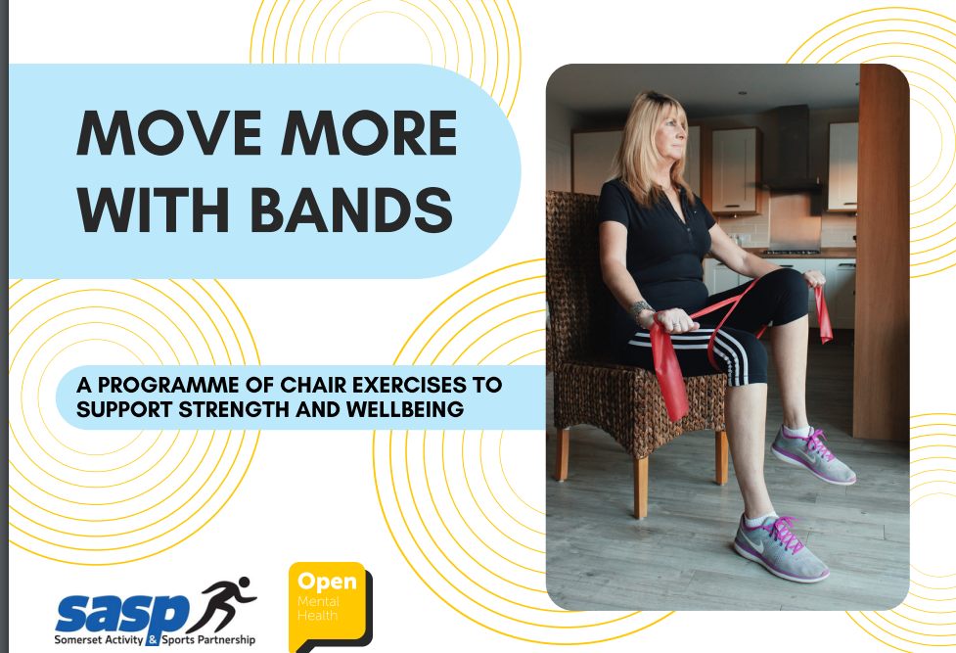




Active Ageing at SASP www.sasp.co.uk/health
WALK YOUR WAY- A short, adaptable walking offer with 10 mapped routes across Somerset featuring toilets, benches, parking / transport links and are under 1 mile long. A virtual option is available for those who wish to participate at home.
Love to Pedal - A chair based cycling programme supporting individuals at home or in groups to pedal, chat or watch filmed bike rides of Somerset. Great for upper or lower body movement and can be quite competitive too!
Stronger4Longer campaign and Move More with Bands resources – seated and standing exercise programmes that build strength, promote wellbeing and prevent falls. Online resource available.
Move More Together – Matching volunteers with older adults who need support with accessing movement opportunities, whether this be at home, outside or in community settings.
ProActive – The new physical activity on referral scheme for Somerset, where Health and Fitness professionals can refer individuals to accredited facilities across the county to participate in prescribed exercise sessions to support a range of health conditions.
SASP Challenges website – A great way of setting, participating and tracking any challenges to help yourself and others move more.
Ambassadors – We’d like your help to recruit new ambassadors to tell their stories and inspire others to move more with health conditions- if you know anyone who’d like to help, please let us know!
Active Ageing Newsletter – Quarterly updates from the active ageing team and partners. If you would like to input or sign up to receive a copy, please get in touch…
Notes:
3

