Slide 1
Our journey so far
Jude Glide Social Care Training Team Lead

Slide 2
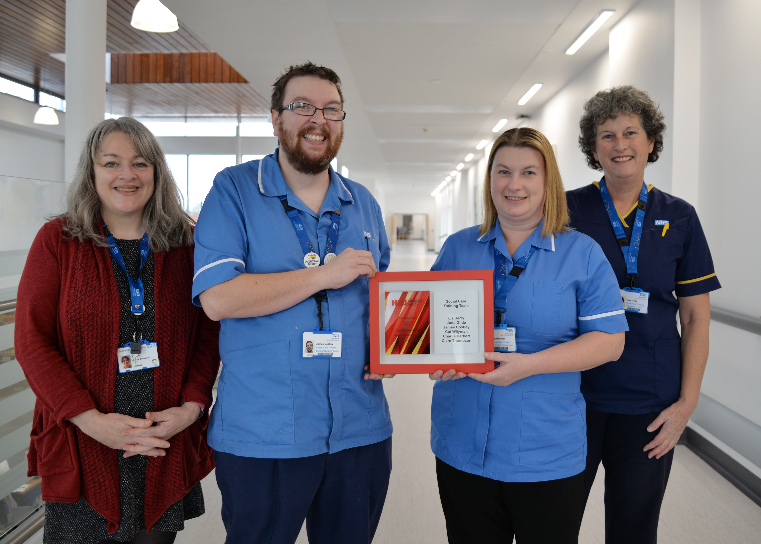
Social Care Training Team
Liz Berry Clinical Skills Lead
James Costley Social Care Trainer
Cat Wilyman Social Care Trainer
Jude Glide Social Care Training Team Lead

Slide 3
Our ambition:
Improve patient/resident safety and improve patient/resident experience
Improve colleague experience/well-being (District Nurses, Carers, Discharge Team)
Encourage ‘the RIGHT person, providing the RIGHT care, at the RIGHT time in the RIGHT place’
Support positive risks taking
Use sustainable methods and models that are replicable and scalable
Save NHS/Ambulance Service time and money by preventing patient/resident deterioration, avoiding unnecessary admissions & enabling timely hospital discharges
SPREAD this pioneering NHS and Adult Social Care collaborative piece of work

Slide 4
QUANTITATIVE OUTCOMES (in just 16 weeks)
56 courses delivered
Avoided deterioration in 47 patients
Facilitated 3 hospital discharges
Avoided 2 hospital admissions
Avoided 47 District Nurse visits
278 people trained

Slide 5
Patient A
Patient A diagnose with MND (motor neurone disease). Wants to stay at home & not be hospitalised or sent to a hospice. Patient deteriorating quickly & potentially in last 4 weeks of life.
Patient A’s Family Member
Wants to meet Patient A’s wishes. Required to learn skills as soon as possible to be able to support at home as had no prior experience with caring for someone.
Family reached out asking for help but was not sure how to get it. Makes initial contact with District Nurse Team for support with PEG feeding. Recognised as a training need and referred to Social Care Training Team.
Social Care Team
Deliver training on skills required following SomersetFT Standard Operating Procedures and Framework
Assess competence of skill via simulation prior to commencement of skill on patient, using Trust Competency Framework
Outcome
Family member able to give standardised, person centred care at home, allowing for a good quality of life and daily routine. Enabled family and patient to be in more control of their life, prevented District Nurse visits and reduce amount of time required in hospital. Avoided a hospice admission.

Slide 6
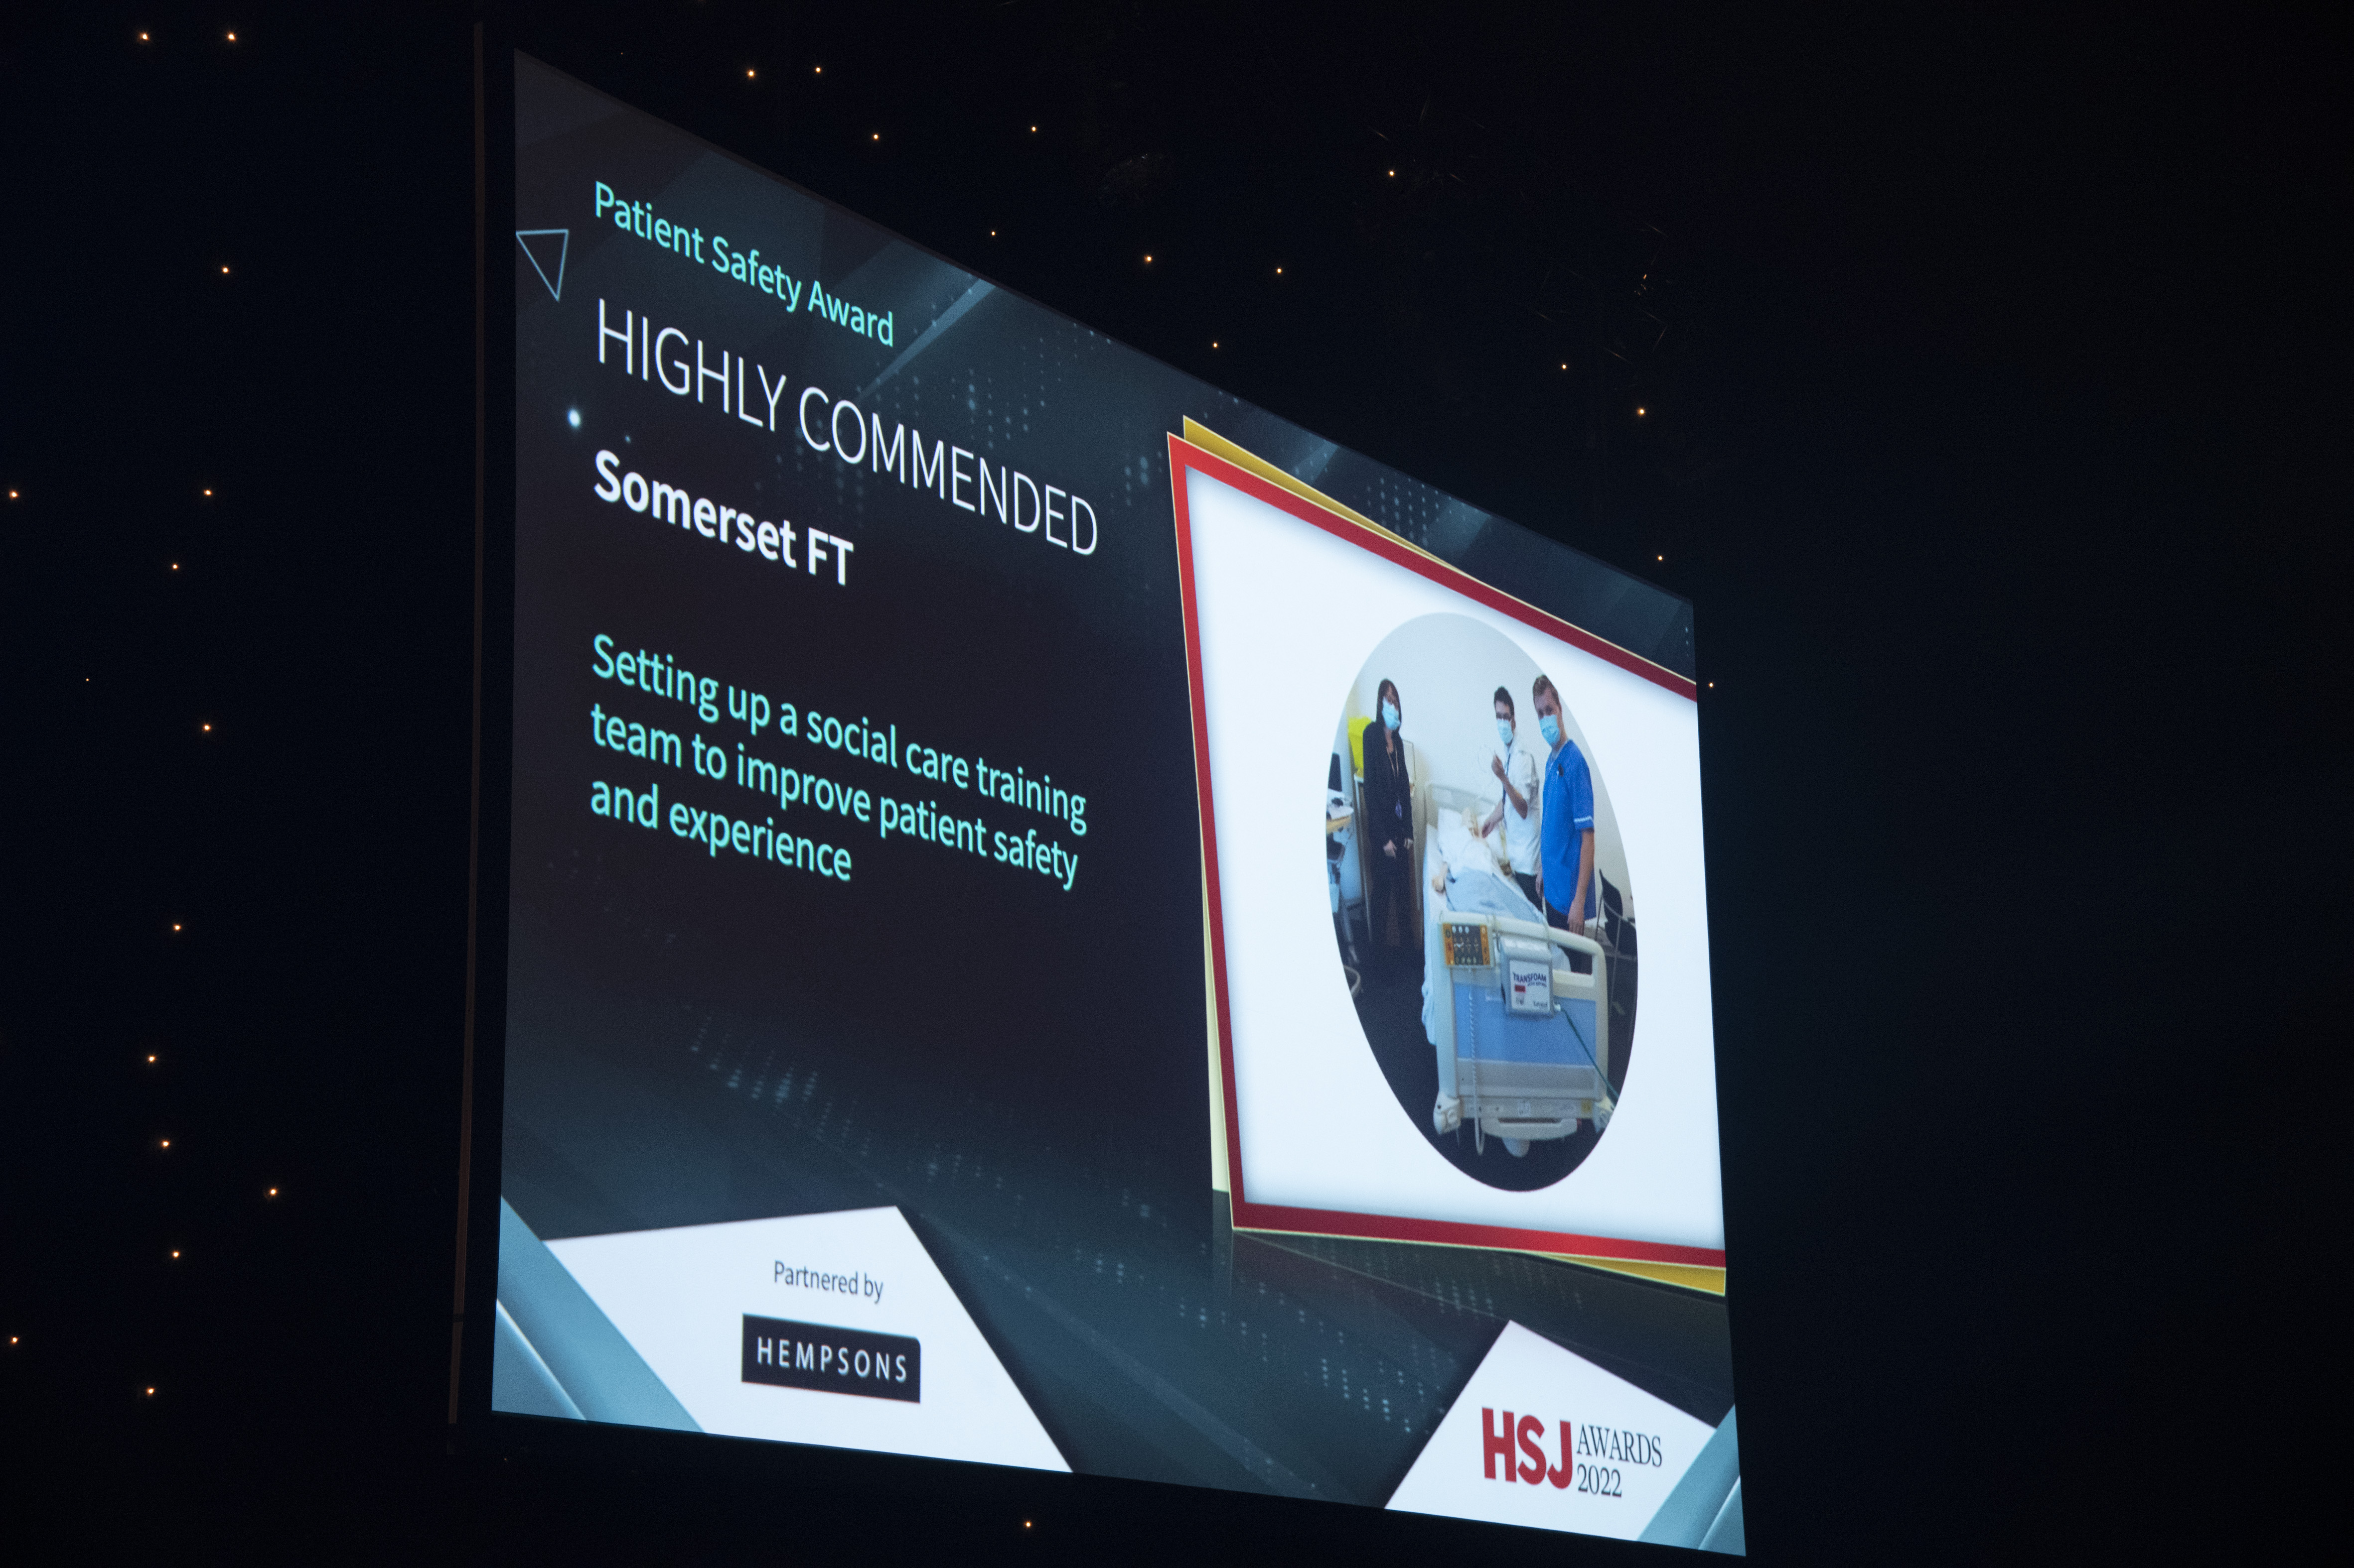
Our SUCCESSES
Presented at Bristol Patient Safety Awards May 2022
Featured in FAB NHS Stuff 4 times
Showcased at the QI South West Conference Sept 2022
Showcased at the HEE South West Multi-professional Educational Conference October 2022
Nominated for the SomersetFT 2022 People’s Award in the QI & Innovation category
Won a ‘HIGHLY COMMENDED’ award in the patient safety category at the HSJ Awards November 2022
Delivered Train the Trainer sessions to 13 care homes and care agencies. Training is now being cascaded

Slide 8
Training Manager Residential Home feedback……
Full story: https://fabnhsstuff.net/fab-stuff/how-a-train-the-trainer-ttt-model-has-enabled-safe-delivery-of-standardised-clinical-skills-and-competency-assessing-to-creamcare-staff-a-quality-improvement-qi-project
“The Train the Trainer has had such a positive impact on our staff, being able to upskill them has really made them feel valued.
It has helped insurmountably with staff retention, it has led to greater confidence amongst the staff team and in turn, resulted in staff aspiring for more clinical roles such as team leaders”

Slide 9
Benefits evidenced so far:
Improved patient safety & patient experience.
Reduced number of patient/resident safeguarding issues (PEG)
Improved colleague satisfaction & well-being (District Nurse/carers)
Improved staff retention/job satisfaction/valuing people
Increase in staff/patient/resident confidence/positive risk taking
Showcases QI methodology in action using Somerset’s 7 steps to quality improvement to spread our success
The RIGHT person providing the RIGHT care, at the RIGHT time in the RIGHT place
Reduced costs. NHS, ambulance service, patients & carers

Slide 10
QUESTIONS?
Catheter passports?

