Slide 1
Adult Social Care Fee Negotiation January 2023 Mel Lock - Director of Adult Social Care Lead Commissioner for Adults and Health

Slide 2
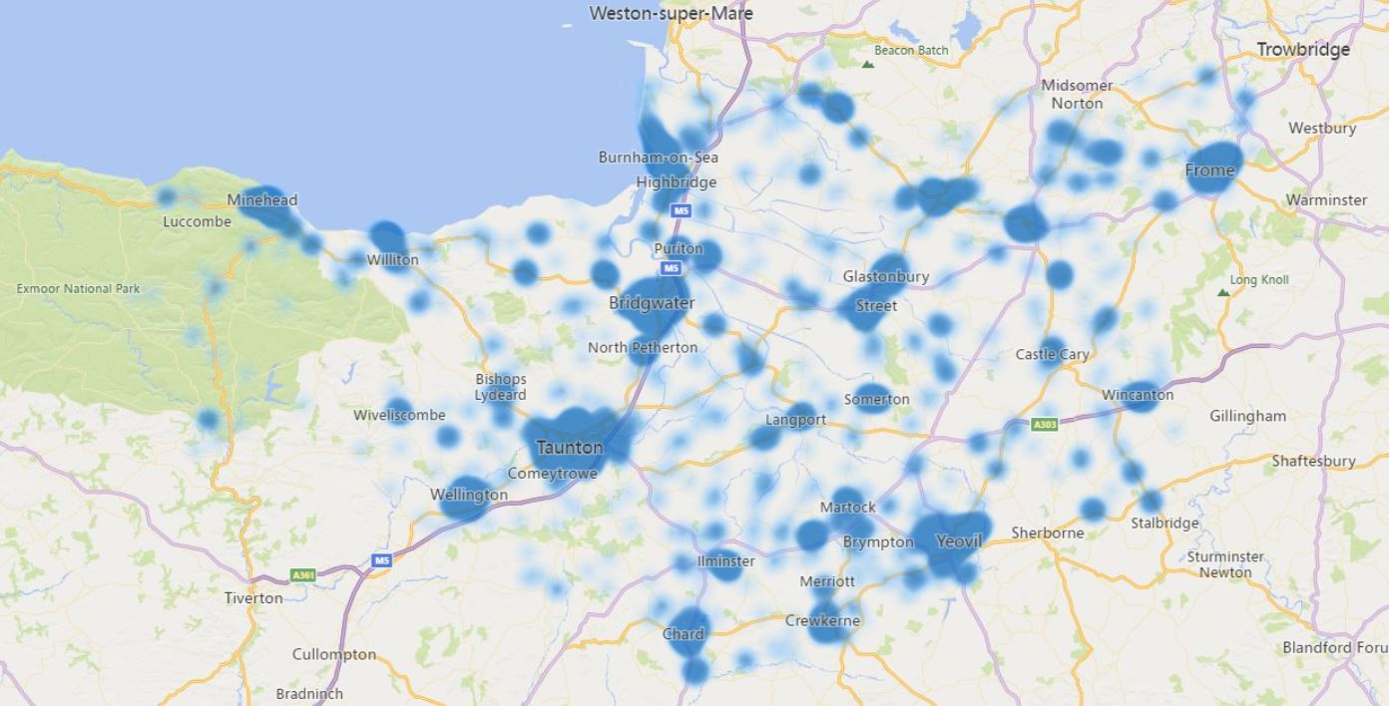
There are approximately 8000 adults in receipt of ASC statutory services across Somerset, and a further 500 residents are supported out of county.

Slide 3
The Adults Budget 2022/23 explained
GROSS SPEND
£262m
Statutory Care and Support for individuals and prevention activity
Discretionary spend
Fixed cost (i.e. staff)
£244m
£1.6m
£17.1m
INCOME
£102m
Better Care Fund
Pooled Budgets
Continuing Health Care
Health & Government
Contribution from individuals
Reimburse-ments
SCC Internal Recharges
NHS
£37.3m
£25.7m
£4.9m
£4.7m
£25.4m
£1.9m
£2.1m
NET BUDGET
£160m
ONE OFF FUNDING IN YEAR
Council allocation from government for ASC
Council tax and business rates
Notes:
Council Budget (income)
Government grants (using distribution formula)
Council Tax (general and ASC precept)
NHS joint funding
Better Care Fund
Pooled budgets for
Carers
Learning Disabilities
Equipment
Mental Health
Contributions from individuals who are receiving care and support (means test)

Slide 4
Statutory Services
c. 8000 people in Somerset
If the individual is assessed as requiring care and support under the Care Act or Mental Health Act,
And, as part of the care act, the individual falls under the financial threshold for receiving funded or part-funded support.
Then the council is responsible by law to meet their ongoing care needs and pay for all or part of this.
This care or support is provided either…
Older people
Care and support for individuals
£58.7m
in a residential setting…
Mental Health
inc. dementia
£10.5m
£131m*
in supported housing…
Learning Disabilities and Autism
inc. crisis support
£61.4m
Or at home.
*amounts are net spend on care and support only

Slide 5
Other Statutory Services
We also have a duty to prevent, reduce or delay the need for more formal care and support
Investing money in this means that we can better manage the demand for our statutory services and save the council money in the long term
These services are good for individuals as they help people to live independent lives for longer
These are contracts awarded to community organisations or providers for services that…
Maintain or improve a persons independence
Investing in prevention activities
Hospital discharge (intermediate care)
Equipment and wheelchair contract
Reset people back to normal after a crisis
£8.7m
Some Voluntary and Community Sector
Prevent people getting to crisis point
Support for carers

Slide 6
Discretionary Services
We have some small areas of discretionary spend
This includes funding community agents to help people connect and navigate local support
We also offer support to help people with learning disabilities enter employment
Investing in prevention activities
Community Agents
Helping people to lead their best life
Employment support
£1.6m
Connecting communities
Other voluntary and community sector activity

Slide 7
For FY22/23 these amounts were set at…
+£3m overspend met by one off funding. Budget not reset.
+ cost to implement statutory any changes
£0m
Net costs of individuals we are currently supporting
£132m
£18.7m
£4.6m
£2.3m
£1.6m
Fixed costs
(i.e. staff)
£0.8m
Forecast increased demand
+ demographics
Fee uplifts + Inflation factor
Contracts for prevention activity
Children transitioning to adulthood
Statutory Services
Discretionary spend

Slide 8
Financial Position – Month 7

Slide 9
So that was this year… What about next year?... and the year after?….

Slide 10
Pay
Inflation
Energy
Government Funding
Covid
Workforce
Interest Rates
Competitive market failure
Storm Warning

Slide 11
National Perspective
Councils face £900m shortfall due to inflation
District council leaders have warned that services that are essential for supporting residents through the cost-of-living crisis are threatened by inflationary pressures.
Rising costs mean district councils face a total budget shortfall of over £900m across 2022-23 and 2023-24, due to rising inflation and pay pressures, according to new research by the District Councils’ Network (DCN).
A survey by DCN, which received responses from around a third of district councils, also found that 70% are considering scaling back leisure services while 66% are considering cutting community support and resilience services.
Just over a third of the respondents (37%) said they were considering scaling back welfare support and 20% are thinking about scaling back homelessness support.
The survey also reveals widespread expectation that demand for support services will grow, including benefits support, homelessness and support for domestic violence victims.
Autumn Statement The Chancellor Jeremy Hunt is reportedly targeting a 50:50 split between spending cuts and tax rises in November’s Autumn Statement, meaning £25 billion tax increases. Prime Minister Rishi Sunak yesterday said the “difficult” package was needed to restore market confidence in the public finances and “limit as best as possible the increase in interest rates". Mail: Brits brace for the biggest tax burden since World War Two
Councils reducing services to meet £3.2bn budget shortfall The trade union Unison has collected data showing libraries and children’s centres are closing and home pick-ups for young disabled people being cancelled as councils try to meet a £3.2 billion budget shortfall next year. It found almost nine in 10 councils have a predicted budget gap in the 2023/24 financial year. The LGA has warned the Chancellor Jeremy Hunt in a letter that the £3 billion-plus shortfall facing councils will lead to cuts, particularly as inflation has worsened since the last Local Government Finance Settlement was announced. Guardian: UK councils slashing services to meet £3.2bn budget shortfall
New LGA Campaign: Save local services
#SaveLocalServices
UK expected to fall into longest ever recession The UK is expected to fall into its longest recession since records began, as interest rates were raised by the most in 33 years, according to the Bank of England. Rates were lifted to three per cent, from 2.25 per cent, the biggest jump since 1989. The Bank warned the UK would face a “very challenging” two-year recession, with unemployment potentially almost doubling by 2025
‘Worse than austerity’ – councils warn that any cuts to their budgets next year would mean they are only able to offer the bare minimum in local services
England’s largest councils today warn that any moves to cut their budgets next year would be ‘worse than austerity’ and result in ‘devastating’ reductions to local services – with local authorities offering just the bare minimum. With the new Chancellor Jeremy Hunt telling all government departments to look for further savings, the County Councils Network (CCN) warns in a letter to the Treasury that prospect of funding reductions on top of soaring inflation would be ‘unthinkable and devastating’ for services. New analysis from the CCN reveals that county authorities in England are grappling with £3.5bn in inflationary and demand costs this year and next – which is more than double the expected rise. CCN Report

Slide 12
Cost of Care
 | 2023/4 |  | 2024/5 |  | 2025/6
Service type | £ | % | £ | % | £ | %
Residential Care | £750 | 30% | £900 | 20% | £1,000 | 11%
Nursing Care* | £750 | 26% | £900 | 20% | £1,000 | 11%
OPMH Nursing Care* | £1,000 | 58% | £1,100 | 10% | £1,200 | 9%
Home Care | £25 | 13% | £27 | 8% | £30 | 11%
* Excluding NHS Funded Nursing Care element

Slide 13
Proposed fees for 2023/24*
Service type | Proposed fee for 2023/24 (where applicable) | Proposed % Increase*** | Increase last year
Extra Care Housing | - | 9.04% | 5.93%
Home Care | £25 per hour | 12.80% | 9.00%
Direct Payments: Self-employed Direct Payments: Agency | Self-employed: £16.91 per hour Agency: £21.81 per hour | 10.00% | 5.30%
Shared Lives: Weekly fees to carers Shared Lives: Assessment payment to provider/carer | £486.40 per week £15.17 (0-4hrs) / £30.18 (4-8hrs) | 8.90% | 5.00%
Daycare | - | 8.80% | 5.00%
Supported Living | - | 10.00% | 5.30%
Residential Care | £750 per week | 30.00% | 5.30%
Nursing Care** | £750 per week | 26.00% | 5.30%
OPMH Nursing Care** | £1000 per week | 57.51% | 5.30%
Specialist Residential Care (SRC) | £800 per week | 24.15% | 5.30%
LD & MH Residential and Nursing** Care Packages | - | 9.00% | 5.30%
* Excludes those contracts with a contractually defined fee increase calculation
** Excluding NHS Funded Nursing Care element ***Where a standard fee is shown in column 2 the % shown in column 3 is the increase from the standard fee last year to the proposed standard fee for 2023/24

