Slide 1
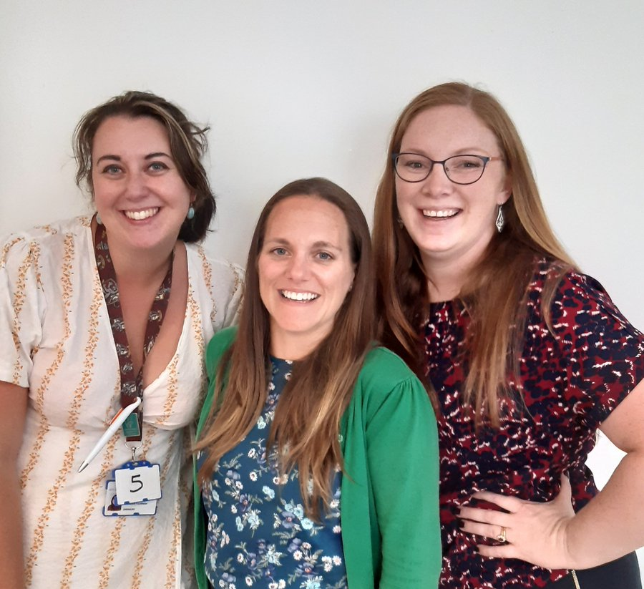
The End of Life Care Education Team
Laura James-
End of Life Care Education Lead & Occupational Therapist
Amy Giles-
Advance Care Planning lead & Social Worker
Karen Peters –
End of Life Care Practice Facilitator and Nurse

Slide 2
Courses:
Communication in End of Life Care – Microproviders / Allied Health Professionals / Commmunity hospitals. Upcoming: Acute hospitals and other care providers.
Train the Champion – the deteriorating resident. For care home staff - with LARCH team
ACP week – TBC libraries in Somerset June 2023
Somerset EOLC Conference 2023- Taunton Rugby Club 14th September

Slide 3
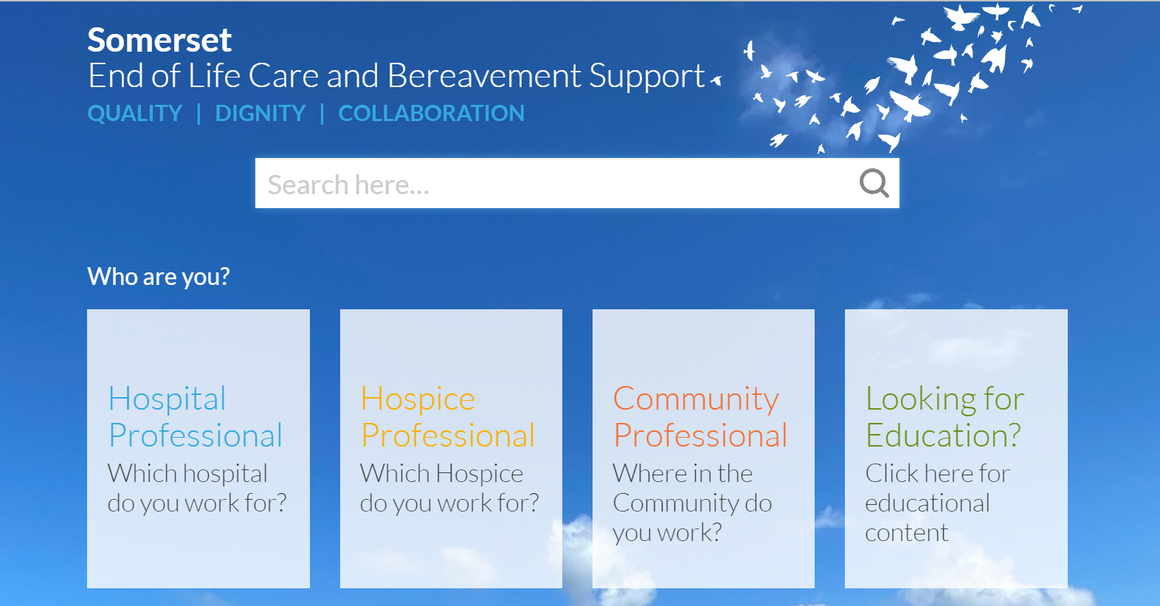
Website…
End Of Life (eolcare.uk)

