Slide 1
Delirium

Slide 2
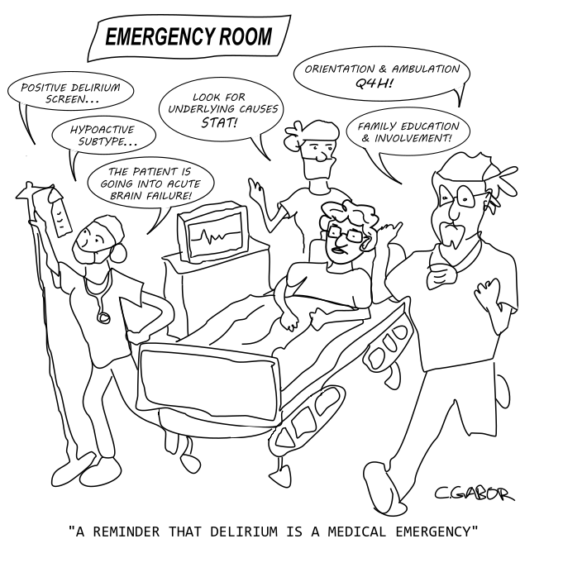
What is Delirium?
An acute onset confusion or change in behaviour.
Common, and in some cases preventable.
Episodes can last from days to weeks, even months in some cases.
Patients can present as Hyperactive, Hypoactive or often mixed – fluctuating between both states.
The person may not regain their full cognition after a delirium.

Slide 3
Who is at risk?
ANYONE!

Slide 4
Common Risk Factors
Co-existing medical conditions
Severe illness
Current hip fracture
Significant co-morbidity
Chronic renal or hepatic impairment
History of stroke
Infection
Drugs
Polypharmacy (>3 drugs)
Multiple psychoactive drugs?
Alcohol/recreational drug dependency
Over 65
Existing cog imp/Dementia
Urinary and faecal retention
Specifically examine to exclude, history is unreliable

Slide 5
Neurological illness
Stroke
Seizures
Subdural haematoma
Surgery
Orthopaedic
Vascular/cardiac
Gastro-intestinal
Pain
Acute pain
Acute on chronic pain
Fluid and electrolyte abnormality
Hypo/hypernatreamia
Hypercalcaemia
Renal failure
Dehydration
Infections
Chest
Urine Skin/ulcers
Abdominal

Slide 6
Types of Delirium:
Hyperactive | Hypoactive
Agitated or aggressive Incoherent speech Disorganised thoughts Delusions Hallucinations Disorientation | Withdrawn Less reactive Drowsy/sluggish Unusually sleepy Reduced motor activity Have difficulty staying focused

Slide 7
Why is identifying Delirium important?
Increased length of stay and complications
Poor outcomes- mortality, admission to care home
It often takes a long time to get better
It doesn’t always get better
It can be prevented
It can be treated
If it does happen, good care will shorten the duration
Good communication reassures and also provides realistic expectations
Good practice saves money

Slide 8
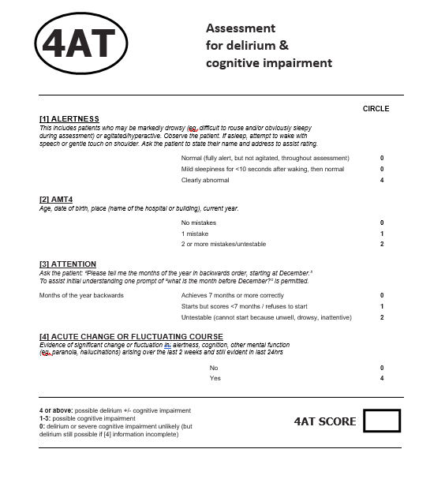
Identifying Delirium:
SQiD
Single Question in Delirium
‘Is this confusion new?’

Slide 9
PINCH ME
Pain
Infection
Nutrition
Constipation/catheter
Hydration
Medication/mobility
Environment

Slide 10
Delirium Care
High risk of falls
People need to be monitored
Positive behaviour techniques
Person Centered Care
Empathy not judgement
Medication review

Slide 11
Think about:
Body language
Consider whether the intervention is essential
Address from the front
Think about formality
Gentle orientation vs acknowledging pts reality
Minimise other distractions
Eye contact, smile, touch
Tone of voice
Short and simple sentences
Think about your own words, open questions. Validate what they are saying.
Choice is important
Don’t rush
Be empathetic
Consider occupation
Unless at risk of causing harm to themselves or others, leave alone.

Slide 12
After Delirium
Frightening experience
Post traumatic stress
Embarrassment
Need for reassurance
Need for information
Need for recognition of dementia after delirium

Slide 13
Bowels (no longer than 3 days)
Pain (Regular Para QDS as standard)
Promote hydration and nutrition
Get to know the person- job, family, hobbies, interest
Behaviour – is there an unmet need?
Different environment
Activities/occupation

