Slide 1
Care Provider Webinar
Public Health Update
1 June 2022
Public Health, Somerset County Council
sccphincidentroom@somerset.gov.uk

Slide 2
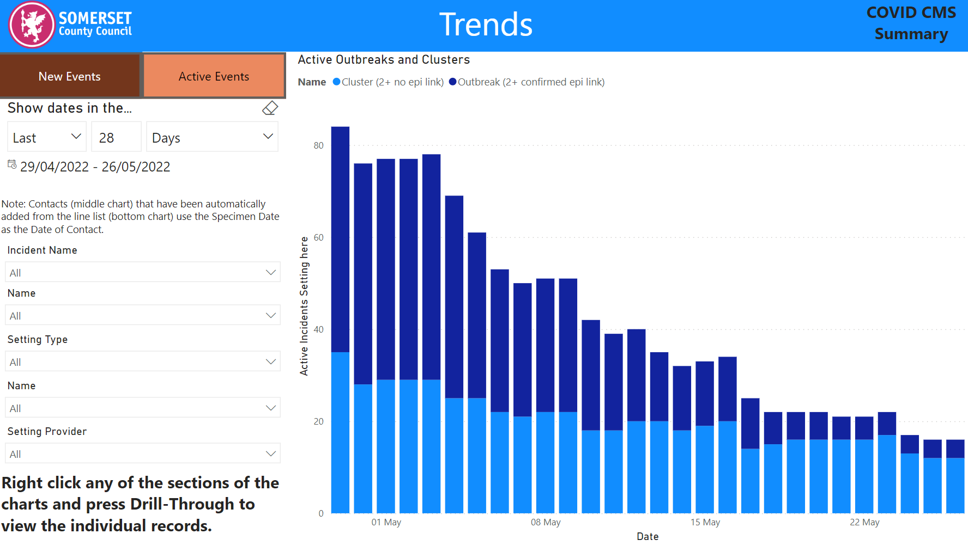
Current Covid-19 situation in care settings in Somerset

Slide 3
Adult Social Care guidance
All Adult Social Care guidance can now be found in one place:
Adult social care: guidance - GOV.UK (www.gov.uk)
Dept of Health and Social Care & UK Health Security Agency
Published 20 May 2022
Contents
Infection prevention and control - both general and Covid-19
COVID-19 testing in adult social care settings
Workforce - includes Health and wellbeing of the adult social care workforce
Planning care - includes social care reform white paper and ASC IPC and testing fund

Slide 4
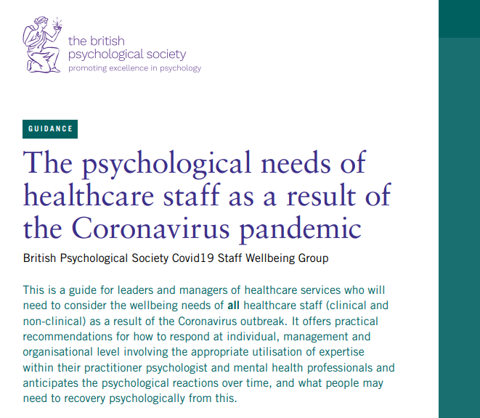
Health and wellbeing of the adult social care workforce
New guidance published 19 May 2022
Includes tips, advice and toolkits that employers and managers can use to help build the resilience of their team and address any concerns their staff may have.
It’s crucial that all those providing care and support – both employers and employees – take some time to think about their own colleagues, residents and family’s health, safety and wellbeing now more than ever before.
Includes wellbeing support and building resilience:
The British Psychological Society guide
Wellbeing for front line staff | Local Government Association
Wellness Action Plan download - Mind
Support for registered managers
Skills for Care registered manager group | Facebook
Local networks for managers (skillsforcare.org.uk)
Deputy manager networks (skillsforcare.org.uk)
Registered manager webinars (skillsforcare.org.uk)
Support for those who work alone
Health and wellbeing of the adult social care workforce - GOV.UK (www.gov.uk)

