Slide 1
Care Provider Webinar
Covid-19 Public Health Update
3 May 2022
Liz Green, Health Protection Practitioner
Public Health, Somerset County Council
sccphincidentroom@somerset.gov.uk

Slide 2
Key messages
An improving Covid picture
IPC measures – remain crucial
Spring booster vaccinations key
Guidance changes – simplified and lots of docs withdrawn
Continue to report outbreaks to SWHPT

Slide 3
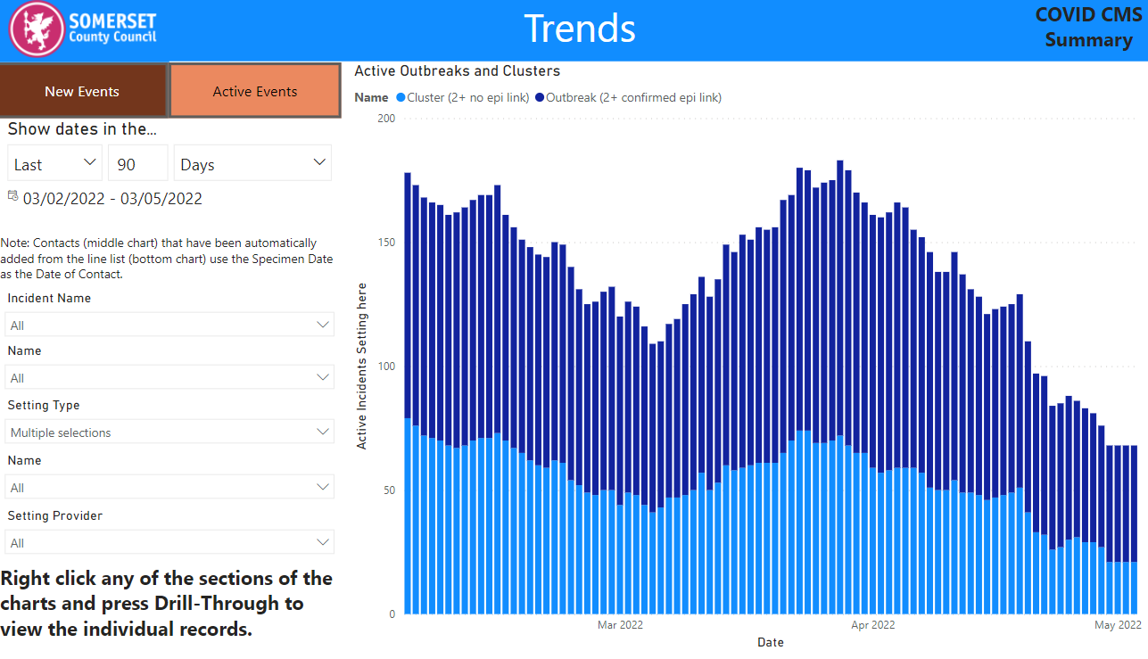
Covid-19 outbreaks and clusters in Somerset care settings

Slide 4
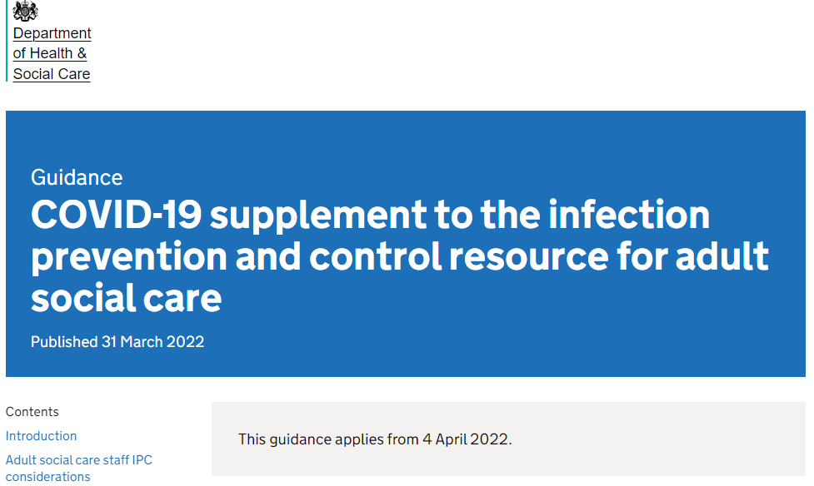
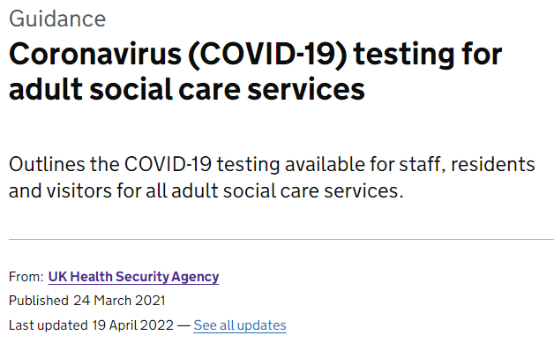
Guidance documents
Coronavirus (COVID-19) testing for adult social care settings
COVID-19 supplement to the infection prevention and control resource for adult social care - GOV.UK (www.gov.uk)

Slide 5
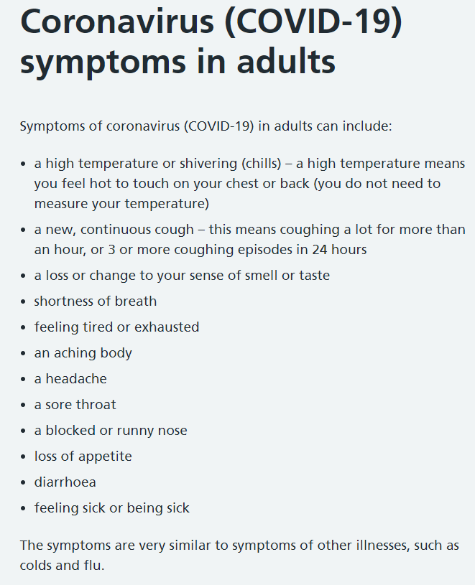
Testing
Symptomatic testing
Symptomatic testing for staff and residents - LFD immediately and another LFD 48 hours after first test
Symptomatic staff should stay at home and can come into work if both LFD's are negative and medically fit
Symptomatic residents should be isolated immediately - LFD immediately and another LFD 48 hours after first test
Asymptomatic testing
Asymptomatic staff testing - 2 LFD tests per week before work 3-4 days apart
Rapid response testing
Rapid response testing - if staff or resident tests positive - all staff daily LFDs (days they are working) for 5 days
Symptoms of coronavirus (COVID-19) - NHS (www.nhs.uk)
Coronavirus (COVID-19) testing for adult social care settings – updated 19 April 2022

Slide 6
Testing
Suspected or likely outbreaks
Suspected outbreak (2 or more linked positive Covid-19 results in same setting with 14 days period) - contact HPT - 0300 3038162 (option 9 for a Covid call) or swhpt@phe.gov.uk
After Risk Assessment (new online form), HPT might advise whole home outbreak testing
Whole Home Outbreak testing - staff and residents LFD and PCR on day 1 and days 4-7
After first week of outbreak testing - staff resume twice weekly LFD
Outbreak recovery testing - 10 days after no new cases or newly symptomatic individuals
If cluster is suspected, outbreak measures can be stood down after 2 rounds of whole home testing and regular staff testing reveal no positive results (around day 7).
If positive results from outbreak recovery testing, HPT may advise outbreak restrictions should continue until no further positives are found
Other respiratory infections
Symptomatic individuals who test negative for Covid may have another infectious illness like flu
Non-covid respiratory infections – keep away from others for 48 hours after symptoms have resolved
Coronavirus (COVID-19) testing for adult social care settings – updated 31 March 2022

Slide 7
Infection prevention and control in adult social care settings - Covid
Document includes info on vaccination, PPE, staff movement, ventilation, management of cases and outbreaks, testing, admissions, visiting
Discharge from hospital into a care home - cases of Covid-19 can be admitted to the care home, if the home is satisfied they can be cared for safely.
Residents would need to isolate for 10 days on arrival
Isolation can be reduced if negative LFD on days 5 and 6, 24 hours apart
Care home residents who are close contacts of Covid-19 cases are no longer advised to isolate or test
Covid positive residents need to isolate for 10 days (reduced if 2 consecutive negative LFDs 24 hours apart).
Covid positive residents do daily LFDs from day 5
During isolation residents case receive one visitor and can go into outdoor spaces within care home grounds if not in contact with other care home residents
Covid-19 residents should be monitored using pulse oximetry, GP informed, HPT informed, symptom monitoring, consider if eligible for Covid-19 treatments (antivirals or monoclonal antibodies)
RESTORE 2 and NEWS2 scoring systems to be used to monitor residents with symptoms
What does document include?
Discharges from hospitals
Close contacts - residents
Covid positive residents
Monitoring of residents
Updated 31 March 2022
Infection prevention and control in adult social care settings - GOV.UK (www.gov.uk)
Infection prevention and control in adult social care: COVID-19 supplement - GOV.UK (www.gov.uk)

Slide 8
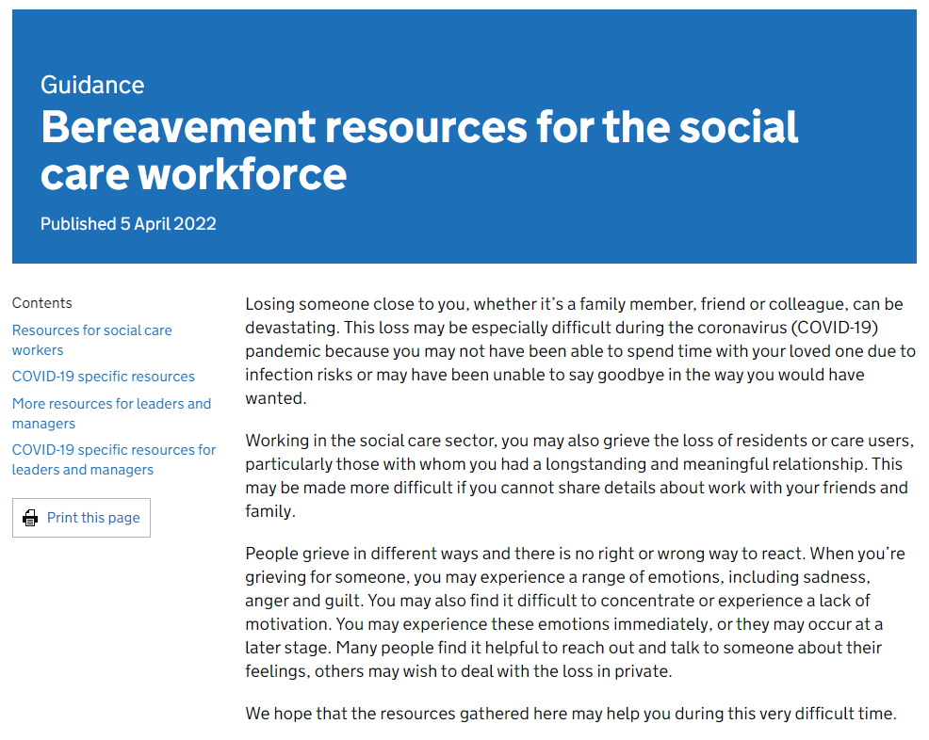
Mental health / bereavement
MHFA | Mind in Somerset
Bereavement resources for the social care workforce - GOV.UK (www.gov.uk)
Coronavirus (somersetprovidernetwork.org.uk)

Slide 9
Summary
Improvement in numbers of outbreaks/clusters of Covid in care settings
Removal of previous guidance docs
Replaced with 2 main new guidance documents:
COVID-19 supplement to the infection prevention and control resource for adult social care - GOV.UK (www.gov.uk)
COVID-19 testing in adult social care - GOV.UK (www.gov.uk)
Mental health / bereavement support available
Q & A Care setting Friday 3pm webinars with UKHSA – email for invite Samantha.wearne@phe.gov.uk

