Slide 1
DEMENTIA, DELIRIUM & DEPRESSION IN OLDER ADULTS
DR TIFF EARLE
CONSULTANT PSYCHIATRIST
OPMH Sedgemoor
SARAH OAKWOOD
TRANSORMATION TEAM OPMH specialist

Slide 2
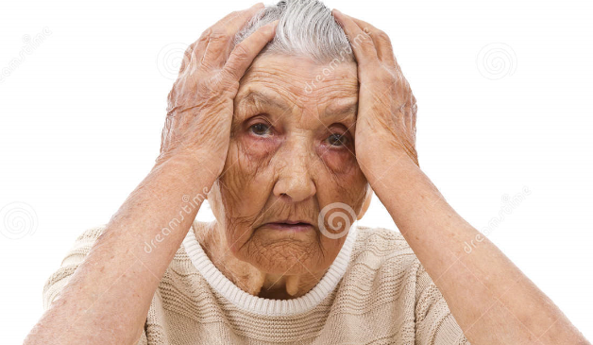
BEHAVIOURAL/NEUROPSYCHIATRIC SYMPTOMS
COMMON -
Repetitive questions, actions or movements
Trailing a carer around
Hiding, hoarding or loosing things
Shouting and screaming (disruptive vocalisation)
Persistent phone calls
Restlessness and pacing
Disinhibition
Suspicion/’paranoia’
Delusions/hallucinations
Aggression

Slide 3
Often caused by…. Unmet physical need
People with dementia are unlikely to be able to communicate discomfort from:
Acute medical problems – pain, infection, unwell.
Remember pain management is key, and can reduce BPSD in 50% of patients (and pain is not obvious)
Incontinence, constipation or wanting to go to the toilet.
Awkward or uncomfortable positioning.
Sleep disturbances – often result in fatigue and may increase agitation and confusion.
Feeling too hot or too cold.
Sensory impairment.
Limited freedom of movement, eg restraint.

Slide 4
Psychological distress
Calling out may be the only way that the person is able to communicate sadness, frustration or distress. Vocal disruption may indicate:
Anxiety – the person may be seeking comfort.
Feelings of anger, frustration, resentment, hopelessness etc.

Slide 5
Environmental factors
Overstimulating environment – an environment that is cluttered and noisy will lead to agitation, irritability, stress and confusion not only for the person but also for carers and families. Unpleasant aromas can add to a person’s distress and agitation.
Lack of stimulation or social contact – Studies have shown that residents in aged care facilities lack social contact. One study found that 95 per cent of the time elderly patients have no contact with nursing staff (Armstrong, E. 1989). Often, the only contact patients have with staff is when they are providing specific and basic nursing care.
Repetitive behaviour can result from loneliness and boredom – the value of frequent personal attention by staff cannot be underestimated.
Not being able to see and watch what is going on around the person can contribute to a person’s sense of isolation, loneliness and fear.

Slide 6
Practical management strategies
Increase social contact and meaningful activity:
Establish formal activity periods outside of the mandatory nursing care routines. Contact should be one on one and involve verbal communication. Know and use the residents past skills and interests. For example, if the resident enjoyed housework encourage them to help fold the laundry or allow them to have a basket of towels and dusters in their room. Encourage a walk in the garden if this was an area of interest.
Use sensory techniques such as massage; provide visual cues through touch.
Encourage light exercise.
Encourage the family to create a video of family having conversation and reminiscing about special events, or a memory book of photographs and special memories to help with conversation.

Slide 7
Practical management strategies
reduce stressful stimuli or increase stimulation
communicate continually with the resident during the task at hand
alter the stimulation level according to need eg if overstimulated, place in a quieter environment; if under-stimulated, place in an area such as the lounge room.
Provide adequate meals/snacks/fluids to prevent hunger and thirst.
Initiate an individual toileting regime and change promptly after incontinent episodes.
Allow/encourage rest periods to prevent fatigue.
Provide frequent positioning changes/massage for people who are immobile.
Check environment and maximise cognitive capacity through orientation cues such as notes, signs, diagrams, calendars and personal items of significance.

Slide 8
BEHAVIOURAL/NEUROPSYCHIATRIC SYMPTOMS
Delusions/hallucinations
Visual are most common in dementia, especially Lewy Body, but can happen in all dementias
May be misinterpretation, eg seeing faces in a pattern on fabric, not recognising own reflection
Arrange an eye exam as they may be due to visual impairment
Exclude physical illness such as UTI

Slide 9
Medication as a last resort
Exclude delirium/physical cause
In any literature you care to look at – psychosocial interventions should always be the mainstay of treatment

Slide 10
Personhood
To improve the care & experience of an individual with dementia, care should be geared to promoting personhood.
Dementia affects a person’s cognitive functioning (memory, orientation, problem solving, comprehension & planning), but personhood is more than just those abilities.
People with dementia are still Fred, Mary or Rachel, each with unique identities, needs & preferences.

Slide 11
PERSON with dementia vs person WITH DEMENTIA

Slide 12
Communication and dementia
Behaviour's that we may perceive as ‘challenging’ are often an expression of unmet need. The emphasis is on us, alongside the family, to establish what it is we are not understanding.

Slide 13
When we talk to someone with dementia let’s…
Be at their level but give them space.
Limit distractions.
Smile & use their name.
Speak in clear, short sentences.

Slide 14
Give them plenty of time to answer.
Avoid giving them too many choices.
Listen carefully with empathy & understanding.
Try to enter their world.

Slide 15
VERA MODEL
Validation
Emotion
Reassure
Activity
(Blackhall et al 2011)

Slide 16
What is validation?
‘Validation is a method of communicating and being with disoriented very old people. Validation is built on an empathetic attitude and a holistic view of individuals’
Validation Institute 2019

Slide 17
Linking Behaviour to need
Wanting to go home.
Asking for parents.
Asking for children.
Walking around a lot.
Moving theirs or other peoples things around.
Being aggressive or violent.

Slide 18
Validation techniques
Avoid challenging.
Avoid ‘why’s’.
Ask ‘who, what, where, when’ questions’.
Eg; ‘When was the last time you saw your mum?, what was she doing?, where was she?’
This helps to link the behavior to an unmet need.

Slide 19
BEHAVIOURAL/NEUROPSYCHIATRIC SYMPTOMS – if all else fails and we have to do medication
Cholinesterase inhibitors have been shown to be effective in behavioural/neuropsychiatric symptoms in dementia of nearly all types, but not in dementia affecting frontal lobes!
Limited evidence that trazadone and anti-epileptics can be useful in some people, but they do cause drowsiness and increase falls
Memantine is useful in agitation and aggression
Quetiapine does not work.
Aripiprazole limited evidence for hallucinations/delusions (especially in LBD) or where psychosocial interventions or dementia drugs have not worked – efficacy is debateable
Low dose Risperidone licensed for short term use (6 weeks), evidence of minimal benefit vs 70% increase in mortality
Avoid benzos
Never forget pain management!!!
Even with optimal management, BPSD can remain challenging for all parties

Slide 20
What does Professor Clive Ballard say?
He is described as a world leading expert on dementia on Wikipedia ☺ (he is)
‘Give them regular analgesia and Citalopram’

Slide 21
sundowning
Why does sundowning happen?
There are lots of reasons why sundowning occurs. As the day goes on, the person with dementia becomes more tired, and this can lead to their symptoms worsening. Hunger, thirst and physical pain can also play a part. As darkness falls, street lights come on and people settle in for the evening and some people with dementia become increasingly concerned that they are in the wrong place

Slide 22
Tips for managing sundowning as it happens
Use distraction techniques: go into a different room, make a drink, have a snack, turn some music on, or go out for a walk
Ask the person what is the matter. Listen carefully to the response and if possible, see if you can deal with the source of their distress
Talk in a slow, soothing way
Hold the person’s hand or sit close to them and stroke their arm.

Slide 23
Practical tips on preventing sundowning
Follow a routine during the day that contains activities the person enjoys
Going outside for a walk or visiting some shops is good exercise
Limit the person’s intake of caffeinated drinks. Consider stopping the person from drinking alcohol altogether. Caffeine-free tea, coffee and cola are available, as is alcohol-free beer and wine
Try and limit the person’s naps during the day to encourage them to sleep well at night instead
Close the curtains and turn the lights on before dusk begins, to ease the transition into nighttime
If possible, cover mirrors or glass doors. Reflections can be confusing for someone with dementia
Once you are in for the evening, speak in short sentences and give simple instructions to the person, to try and limit their confusion
Avoid large meals in the evening as this can disrupt sleep patterns
Introduce an evening routine with activities the person enjoys, such as: watching a favourite programme, listening to music, stroking a pet etc. However, try to keep television or radio stations set to something calming and relatively quiet—sudden loud noises or people shouting can be distressing for a person with dementia.

Slide 24
What is Delirium?
An acute confusional state (in old money)
Usually has a reversible cause
Characterized by:
Inattention
Sudden onset
Fluctuation in 24 hours
Disorganised thinking

Slide 25
Assessment

Slide 26
SQID
SQID – Single Question to Identify Delirium
‘Has there been a sudden change in confusion or behavior?’

Slide 27
Think…
I’M A SEA CATCH

Slide 28
I’ INFECTION; e.g. urine/chest infections/ flu/pressure ulcers
M METABOLIC; e.g. acidosis/ electrolyte Imbalance/vitamin deficiencies
A ACUTE VASCULAR; e.g. hypertensive crisis/ arrythmias

Slide 29
S SUBSTANCES; e.g. alcohol/street drugs /prescribed/OTC meds
E ENDOCRINE; e.g. thyroid/diabetes/ adrenal
A ANYTHING ELSE; 20% no cause found ?In pain ?Immobilised ?anaesthetic in last 5 days

Slide 30
C CONSTIPATION; e.g. Check last time bowels open
A ANOXIA/HYPOXIA; e.g. Cardio/respiratory insufficiency or arrest
T TRAUMA; e.g. falls/head injury/assault /haematomas
C CNS PATHOLOGY; e.g. stroke/TIA/tumours /Hydrocephalus/ seizures
H HYDRATION; e.g. Check for AKI & dehydration
(Dr Tiff Earle Consultant Psychiatrist 2019)

Slide 31
Outcomes of Delirium
(even with complete recovery, 30% dementia within 3 years = decreased brain reserve) – so do not assume CT brain is ‘normal’ (atrophy/ischaemia are relevant ++)
Notes:
Patients with pre-existing dementia are likely to not recover fully after a delirium. Having a delirium often will precede the diagnosis of a dementia. A delirium may be the thing that tips the patient over to needing LTC, however, the decision should not be made while the patient is acutely delirious. Need to give it time to clear before making a final decision.

Slide 32
Recognition of Delirium
Previous studies 32%-66% of cases are unrecognized by Medical Staff !!
Yale- New Haven study (Inouye S. Ann Intern Med 1993: 119-474)
65% unrecognized by Physicians
43% unrecognized by Nurses

Slide 33
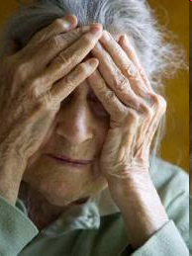
Delirium versus Dementia?
DELIRIUM
DEMENTIA
It is common for Delirium to be superimposed on Dementia!
Notes:
The patient’s family or friends will always say, “This is not the same persona that we usually know”.
-Inattention is when they can not keep speaking on on topic. Their topic discussion is all over the place.
Common Demtias with Hallucinations
Lewy Body Dementia, a common dementia found with patients who have Parkinson's disease

Slide 34
Types of Delirium
Hyperactive
Hypoactive
Mixed

Slide 35
Once You Identify Delirium, Now What?
Identify the acute medical problems that could be either triggering the delirium, or prolonging it!!!! AND TREAT IT ……..
Clarify pre-morbid functional status, sequence of events and previous admission cognitive baseline (remember, patients with dementia are at increased risk of delirium)
Identify all predisposing and precipitating factors, and consider the differential

Slide 36
Non Pharmacological Interventions
Always apply non-pharmacological interventions in your Care Plan. Examples
Initiate toileting routines
Mobilize ASAP
Quiet room, soothing music, well lit
Sleep hygiene
Nutrition and fluids
Pyjama paralysis
Notes:
Mobilization: Also means getting the patient dangling at the beds side and upon their chair.

Slide 37
Communication is person-centered, sympathetic and effective, uses short sentences, and includes reorientation and reassurance for people diagnosed with delirium.
Involve family and friends: provide information leaflet on delirium.

Slide 38
Pharmacological Interventions
Only use medication if:
Non-pharmacological interventions are not successful
The patient is a danger to themselves or others
You may suggest the following medications:
Low dose Haloperidol (not in Parkinson's or LBD) or
Low dose Olanzapine/Risperidone
** Avoid the use of benzodiazepines
Medications must be discontinued once the agitation from the delirium is resolved

Slide 39
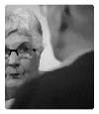
Depression in older people
The core symptoms of major depression (low mood, anhedonia and loss of energy) are similar across the lifespan.
Somatic concerns (hypochondriasis) may predominate, which can be challenging in older patients at risk of serious illness and/or with comorbid physical problems.
Psychotic symptoms in late-life depression are more common than at younger ages.
Apathy and amotivation are common in vascular depression and in Alzheimer’s disease. Depressed mood and apathy are distinct, but overlap.

Slide 40
Hot tip
Increasing anxiety along with marked somatic concern should prompt screening questions for depression. But do not assume automatically that the symptoms are ‘functional’ (i.e. Investigate accordingly).
New, unrelated somatic preoccupations tend to reinforce depression as the likely diagnosis. Remember that dementia can present similarly.

Slide 41
Depression and physical illness
There is a two-way interaction between depression and physical illness, each worsening the effects of the other. For example, a meta-analysis of survival in breast cancer demonstrated that patients with depression had a poorer prognosis (Falagas et al, 2007). Many chronic diseases reach a peak incidence in later life; all are associated with high rates of depression. Some diseases, such as idiopathic Parkinson’s disease, are particularly associated with depression (Khoo et al, 2013). Depression complicating dementia is associated with greater impairment in cognition and function than dementia alone.

Slide 42
Depression and dementia - another 2 way street
Its common
Studies have shown antidepressants don’t really work
For most mild/moderate depression (including in early stages of dementia) older people generally prefer talking therapies

Slide 43
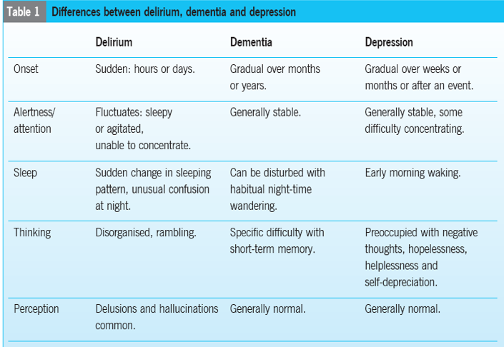

Slide 44
Any questions?

